Slide 1


Linux+ XK0-005 TTT Session 9:
Domains 4.1 (Storage), 4.2 (Network), and 4.3 (Processing)
August 23, 2022
@TeachCompTIA #LinuxPlusTTT
<number>
Notes:
<number>

Slide 2

Certificate of Attendance
Multimedia
Slides
Bios
ON24 Help
Q&A
Today’s Resources
Group Chat
Survey
<number>

Slide 3


The CompTIA Instructor Network (CIN) is a worldwide community for instructors who provide CompTIA certification training.
Benefits of being a community member include:
  Communicate and collaborate with CompTIA staff and other instructors.
  Access resources for students to understand the value of getting certified.
  Receive complimentary training and tools from CompTIA to enrich your classroom.
  Become proficient at teaching CompTIA standards.
  Share best practices and resources with each other.
https://cin.comptia.org
Notes:
<number>

Slide 4

Qualifications for Exam Voucher Distribution
Participate in all 12 sessions (live or on-demand) during the date range for the live series (January 18th – March 17th).
Be an active member of CIN through engagement in the community.
Be involved with a CompTIA training partner or an independent instructor teaching CompTIA certifications.
For questions or clarifications talk with your CompTIA Business Development Manager.

Slide 5



Project+ PK0-005 Sneak Peek
What: two-hour webinar investigating updated certification
When: Wednesday, September 7, 11:00 AM CST
Where: ON24
Who: Rick Butler, Intellitec College
Registr: https://bit.ly/CINSP-ProjectPlus2022 OR Scan QR Code

Slide 6


Instructor:
Lee McWhorter
Chief Technology Officer
Covered 6 LLC | DGP International
lee@covered6.com
Host:
Rick Butler
Subbing in for Stephen tonight!

Slide 7

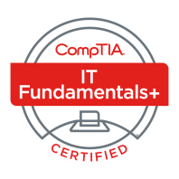
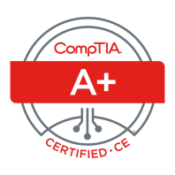



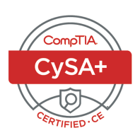

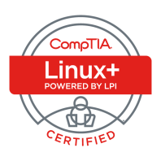
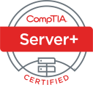
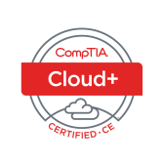
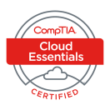
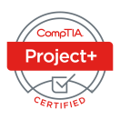
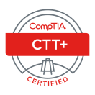





Lee McWhorter
CTO at Covered 6
CompTIA CIN Board member
lee@covered6.com
https://www.linkedin.com/in/lee-mcwhorter/
Twiiter: @tleemcjr
Previous TTT’s:
PenTest+ 001 2018
CASP+ 004 2021
PenTest+ 002 2022

Slide 8

Agenda
Session Objectives
Domain 4.1
Domain 4.2
Domain 4.3

Slide 9
A+ Core 1 220-1101 TTT Session Outline
Date | Topic
7/11/2022 | Introduction, Linux+ Information, Resources, Domain 1.1
7/12/2022 | Domains 1.2 (Files) and 1.3 (Storage)
7/18/2022 | Domains 1.4 (Services) and 1.5 (Networking)
7/19/2022 | Domains 1.6 (Build) and 1.7 (Configuration)
7/25/2022 | Domains 2.1 (Best Practices) and 2.2 (Identity Management)
7/26/2022 | Domains 2.3 (Firewalls), 2.4 (Remote), and 2.5 (Access Controls)
8/01/2022 | Domains 3.1 (Scripts) and 3.2 (Containers)
8/22/2022 | Domains 3.3 (Git), 3.4 (IaC), and 3.5 (Orchestration)
8/23/2022 | Domains 4.1 (Storage), 4.2 (Network), and 4.3 (Processing)
8/30/2022 | Domains 4.4 (Permissions), 4.5 (Common Problems) & Wrap Up
✓
✓
✓
✓
✓
✓
✓
✓
✓
<number>

Slide 10
Section break
Domain 4.1
<number>

Slide 11
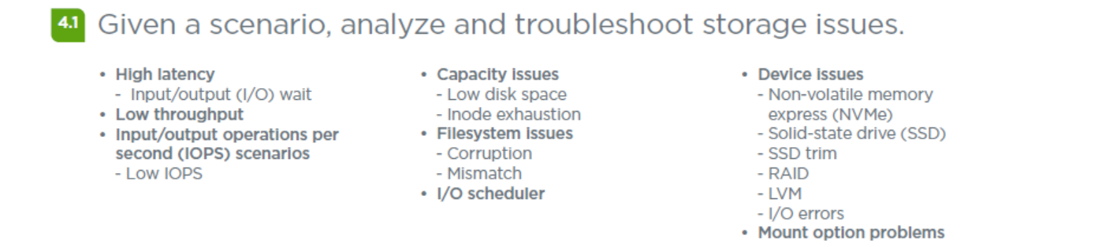
Domain 4.1 - Given a scenario, analyze and troubleshoot storage issues.
<number>

Slide 12
Domain 4.1 - Given a scenario, analyze and troubleshoot storage issues.
High latency
- Input/output (I/O) wait – Check with iostat -x and look at await column
Some other tools: iotop, ioping, sar
Low throughput
Throughput is the amount of data transferred to and from the storage device per second.
Input/output operations per second (IOPS) scenarios
IOPS shows how many read and/or write operations a storage device can perform per second.
- Low IOPS
<number>

Slide 13
Domain 4.1 - Given a scenario, analyze and troubleshoot storage issues.
Capacity issues
- Low disk space – use df and du commands
- Inode exhaustion – use df --inodes
The inode table keeps track of every file and directory on the file system.
Filesystem issues
- Corruption – use fsck
- Mismatch – for example could be a mismatch reported by df and du.
I/O scheduler - controls the way the kernel commits read and writes to disk.
cat /sys/block/sda/queue/scheduler
<number>

Slide 14
Domain 4.1 - Given a scenario, analyze and troubleshoot storage issues.
Device issues
- Non-volatile memory express (NVMe)
- Solid-state drive (SSD)
- SSD trim – OS tells drive which areas aren’t being used for erasing – fstrim.
- RAID – cat /proc/mdstat – mdadm --details /dev/device
- LVM – vgscan and lvscan
- I/O errors
Mount option problems – such as ‘failed to mount /etc/fstab’ or NFS issues.
<number>

Slide 15

Chat Question
What is the most common Linux storage issue you have seen?
Answer in the chat window and let’s share.
This photo is for placement only

Slide 16
Section break
Domain 4.2
<number>

Slide 17
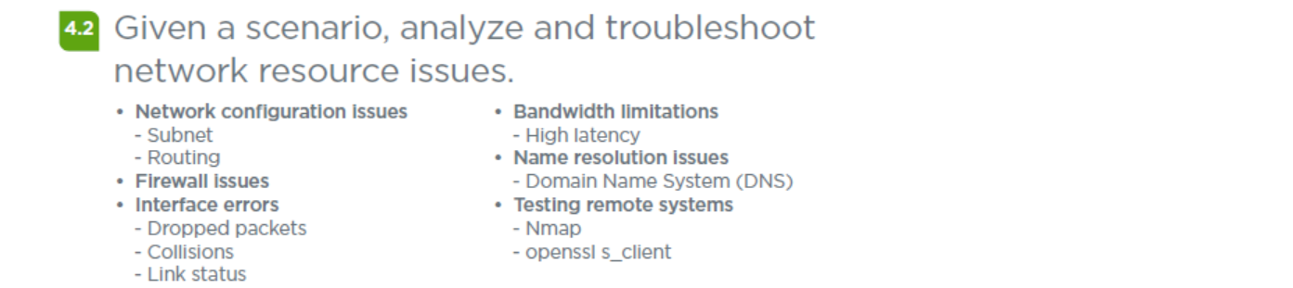
Domain 4.2 - Given a scenario, analyze and troubleshoot network resource issues.
<number>

Slide 18
Domain 4.2 - Given a scenario, analyze and troubleshoot network resource issues.
Network configuration issues – use ip and standard tools, check config
- Subnet
- Routing
Firewall issues – depends on firewall, check rules
Interface errors – check with ip, cat /proc/net/dev and/or ethtool
- Dropped packets
- Collisions
- Link status
Best tools: ip/ifconfig, ping, netstat, host, arp, traceroute, dig, Wireshark
<number>

Slide 19
Domain 4.2 - Given a scenario, analyze and troubleshoot network resource issues.
Bandwidth limitations
- High latency
Name resolution issues
- Domain Name System (DNS) – It’s always DNS...
Testing remote systems
- Nmap
- openssl s_client
Best tools: ip/ifconfig, ping, netstat, host, arp, traceroute, dig, Wireshark
<number>

Slide 20
Chat Question
What is the most common Linux networking issue you have seen?
Answer in the chat window and let’s share.
This photo is for placement only

Slide 21
Section break
Domain 4.3
<number>

Slide 22
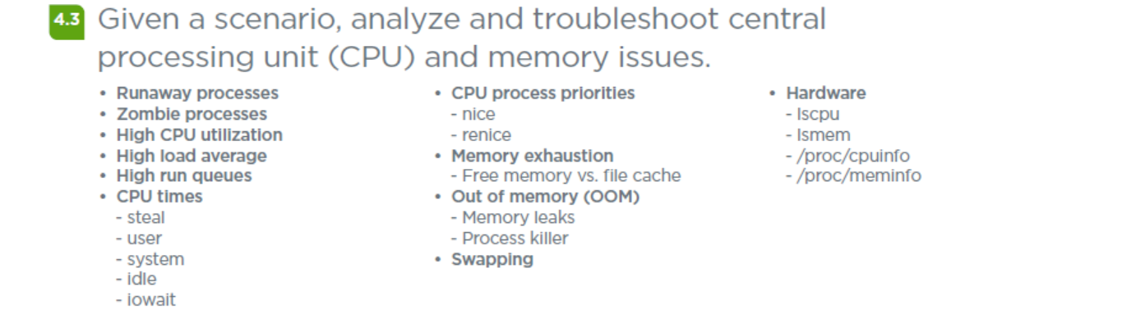
Domain 4.3 - Given a scenario, analyze and troubleshoot central processing unit (CPU) and memory issues.
<number>

Slide 23
Domain 4.3 - Given a scenario, analyze and troubleshoot central processing unit (CPU) and memory issues.
• Runaway processes - a process that enters an infinite loop and spawns new processes.
• Zombie processes - processes that have completed their execution, but their entries are not removed from the process table.
• High CPU utilization
• High load average - system load on a Linux server for a defined period of time, usually shown for 1, 5, and 15 minutes.
0-1 is fine, 1.5 or higher is warning sign, 3 or higher means long queue times.
• High run queues
Tools: w, uptime, top
<number>

Slide 24
Domain 4.3 - Given a scenario, analyze and troubleshoot central processing unit (CPU) and memory issues.
• CPU times
- steal - percentage of time a virtual CPU waits for a real CPU
- user - time the processor spends in running application code
- system - time the processor spends in running the OS
- idle
- iowait
From top: us = user, sy = system, ni = niced apps, id = idle, wa = i/o wait, hi = hardware interrupts, si = software interrupts, st = virtual only, time virtual cpu waits for cpu to service another virtual cpu.
<number>

Slide 25
Domain 4.3 - Given a scenario, analyze and troubleshoot central processing unit (CPU) and memory issues.
• CPU process priorities
- nice – used to manually change a processes priority (-20 faster to 19 slowest), nice command with no option sets a 10.
- renice – used to change a running processes priorty
• Memory exhaustion
- Free memory vs. file cache
• Out of memory (OOM)
- Memory leaks
- Process killer
• Swapping
Tools: free, sar, top
<number>

Slide 26
Domain 4.3 - Given a scenario, analyze and troubleshoot central processing unit (CPU) and memory issues.
• Hardware
- lscpu - CPU information of the system
- lsmem – Memory information and online status
- /proc/cpuinfo
- /proc/meminfo
cat /proc/cpuinfo
cat /proc/meminfo
<number>

Slide 27
Chat Question
What is the most common Linux CPU and/or memory issues you have seen?
Answer in the chat window and let’s share.
This photo is for placement only

Slide 28
Section break
CertMaster Learn and Labs
<number>

Slide 29
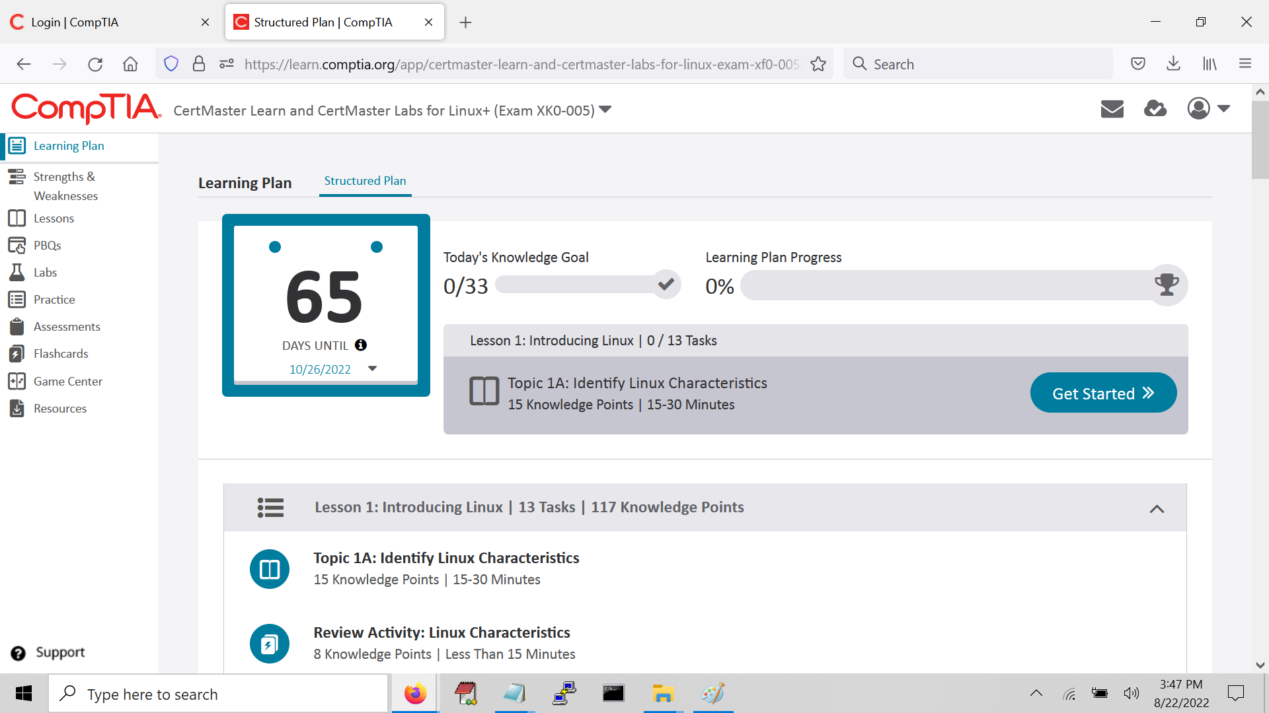
Section content title
<number>

Slide 30
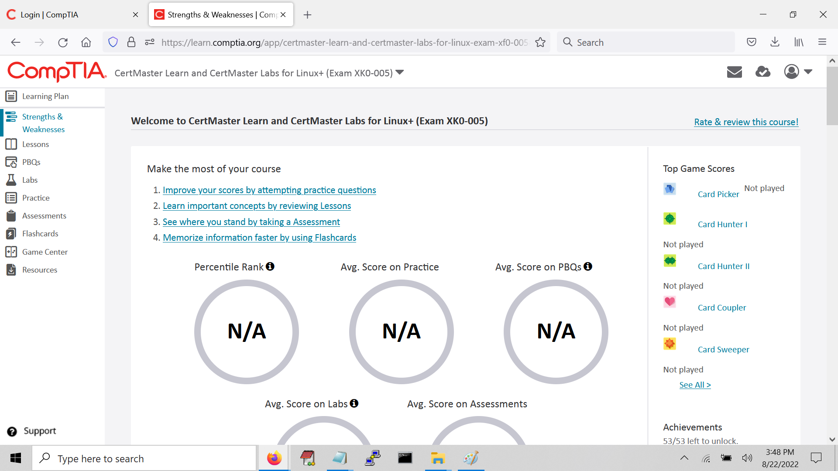
Section content title
<number>

Slide 31
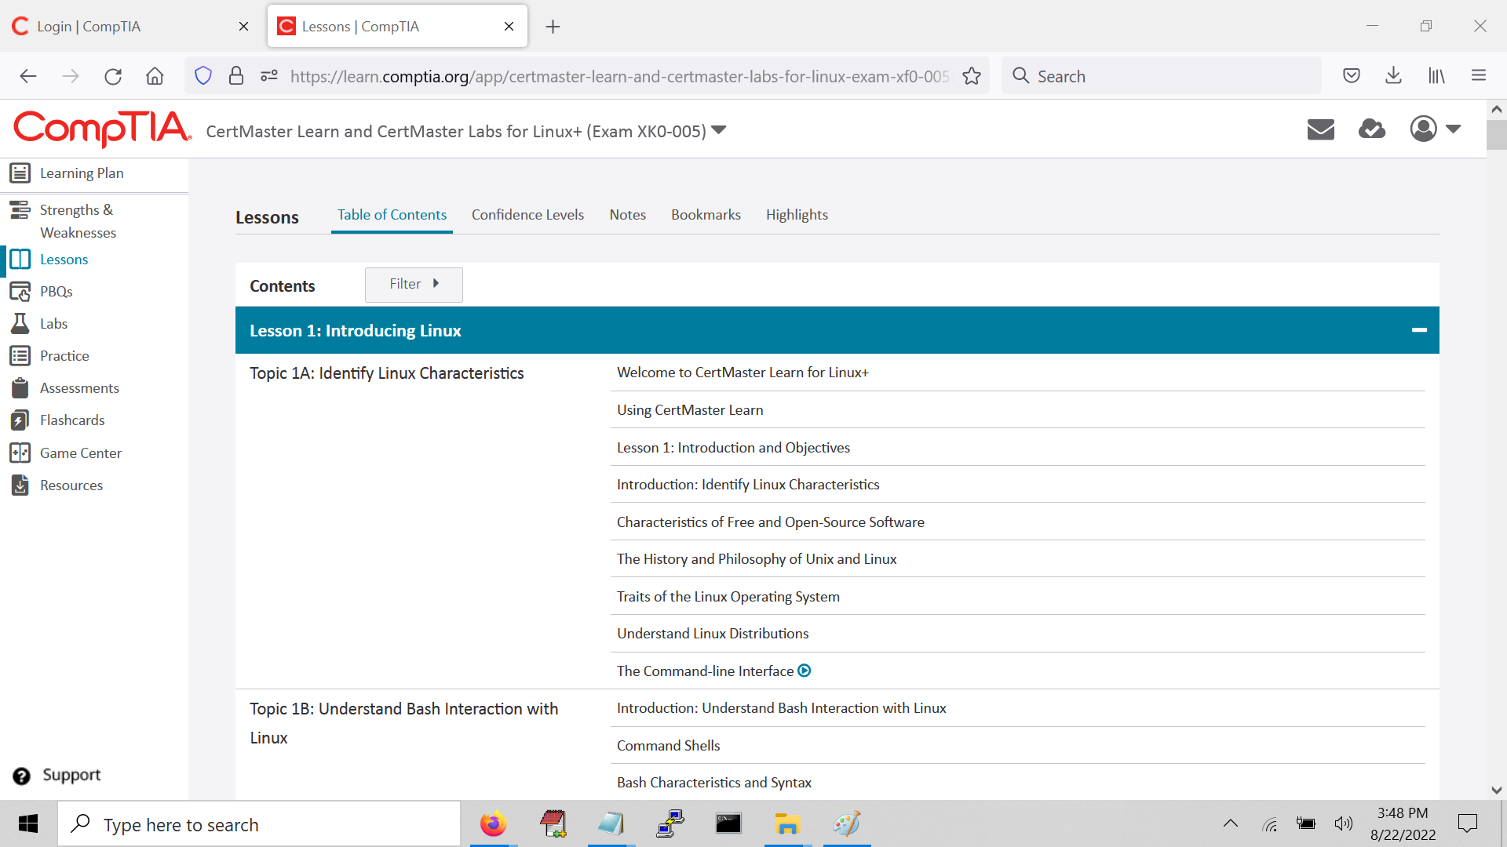
Section content title
<number>

Slide 32
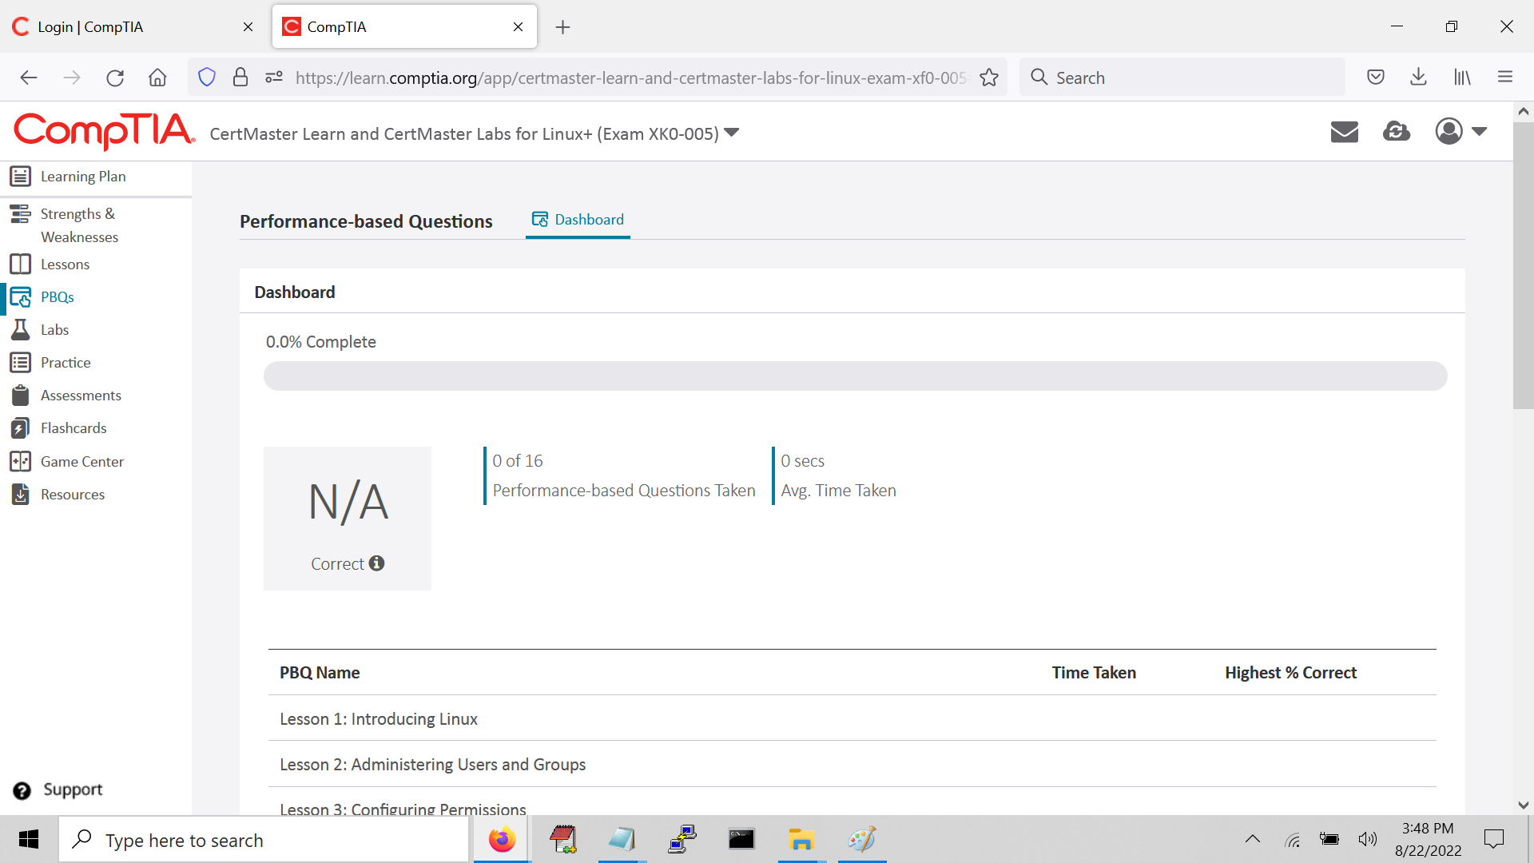
Section content title
<number>

Slide 33
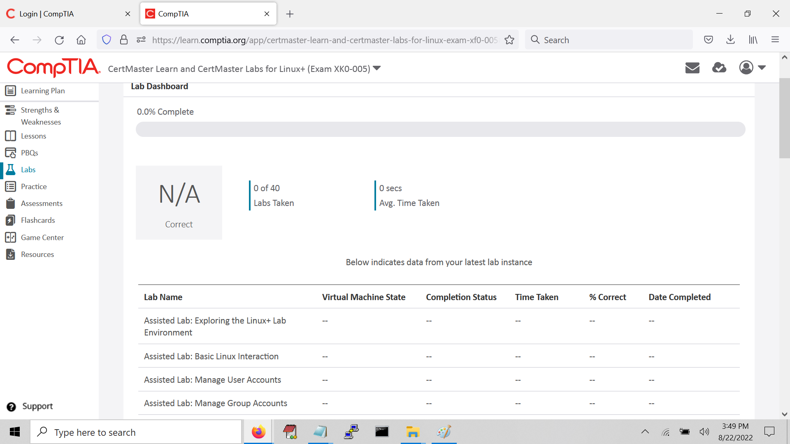
Section content title
<number>

Slide 34
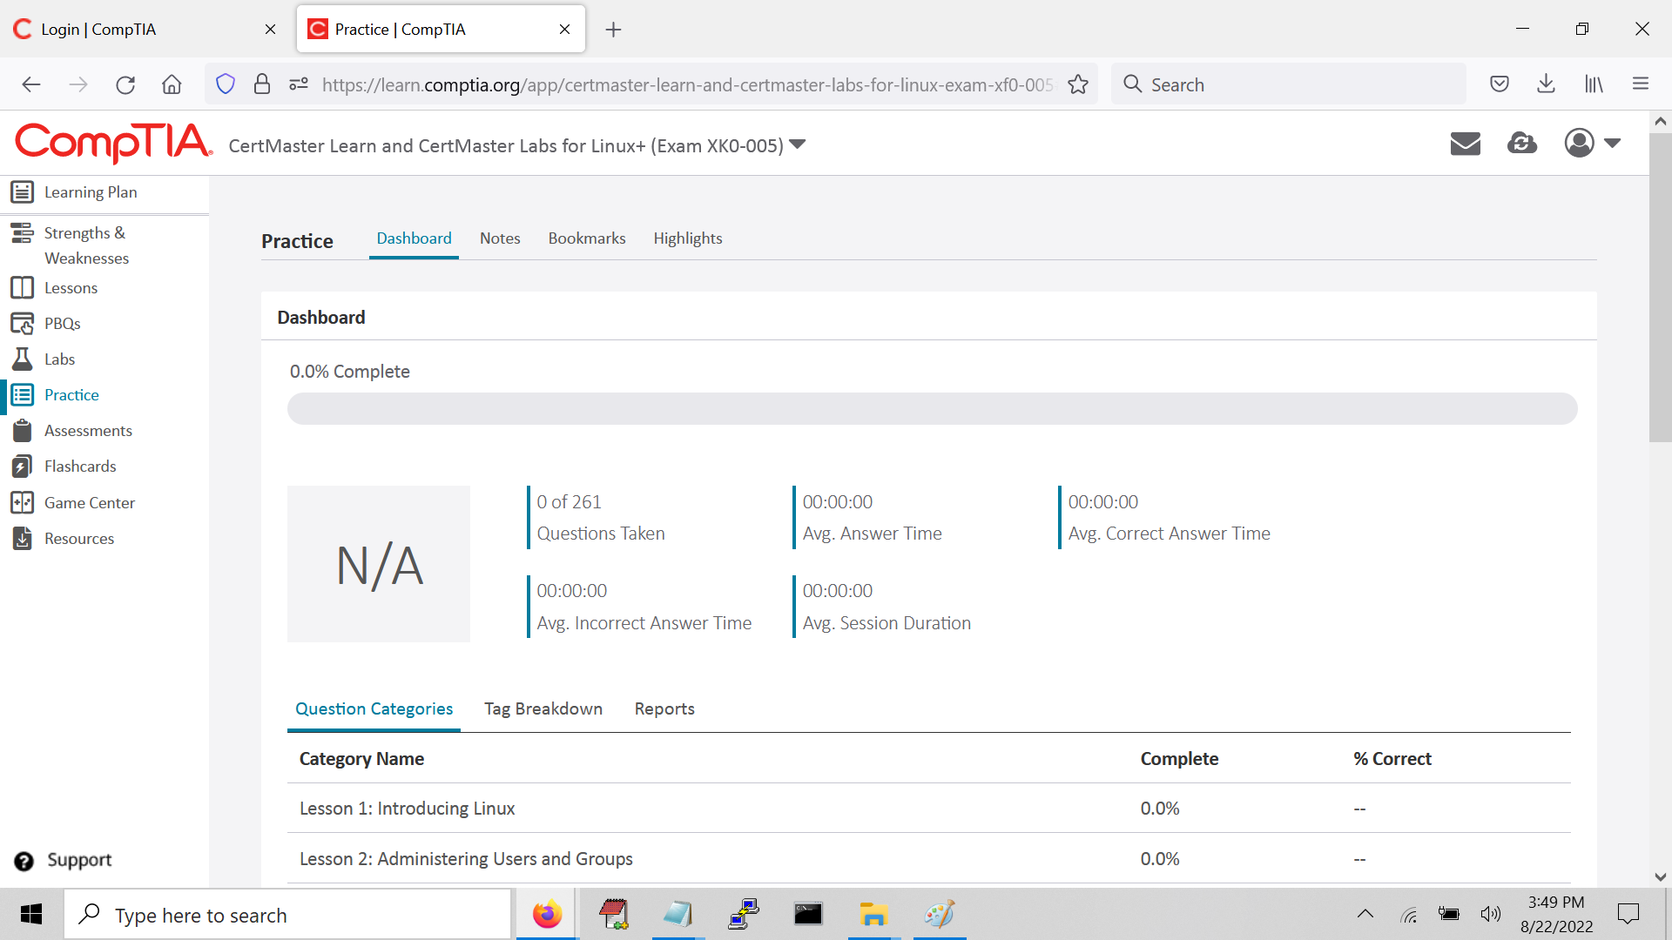
Section content title
<number>

Slide 35
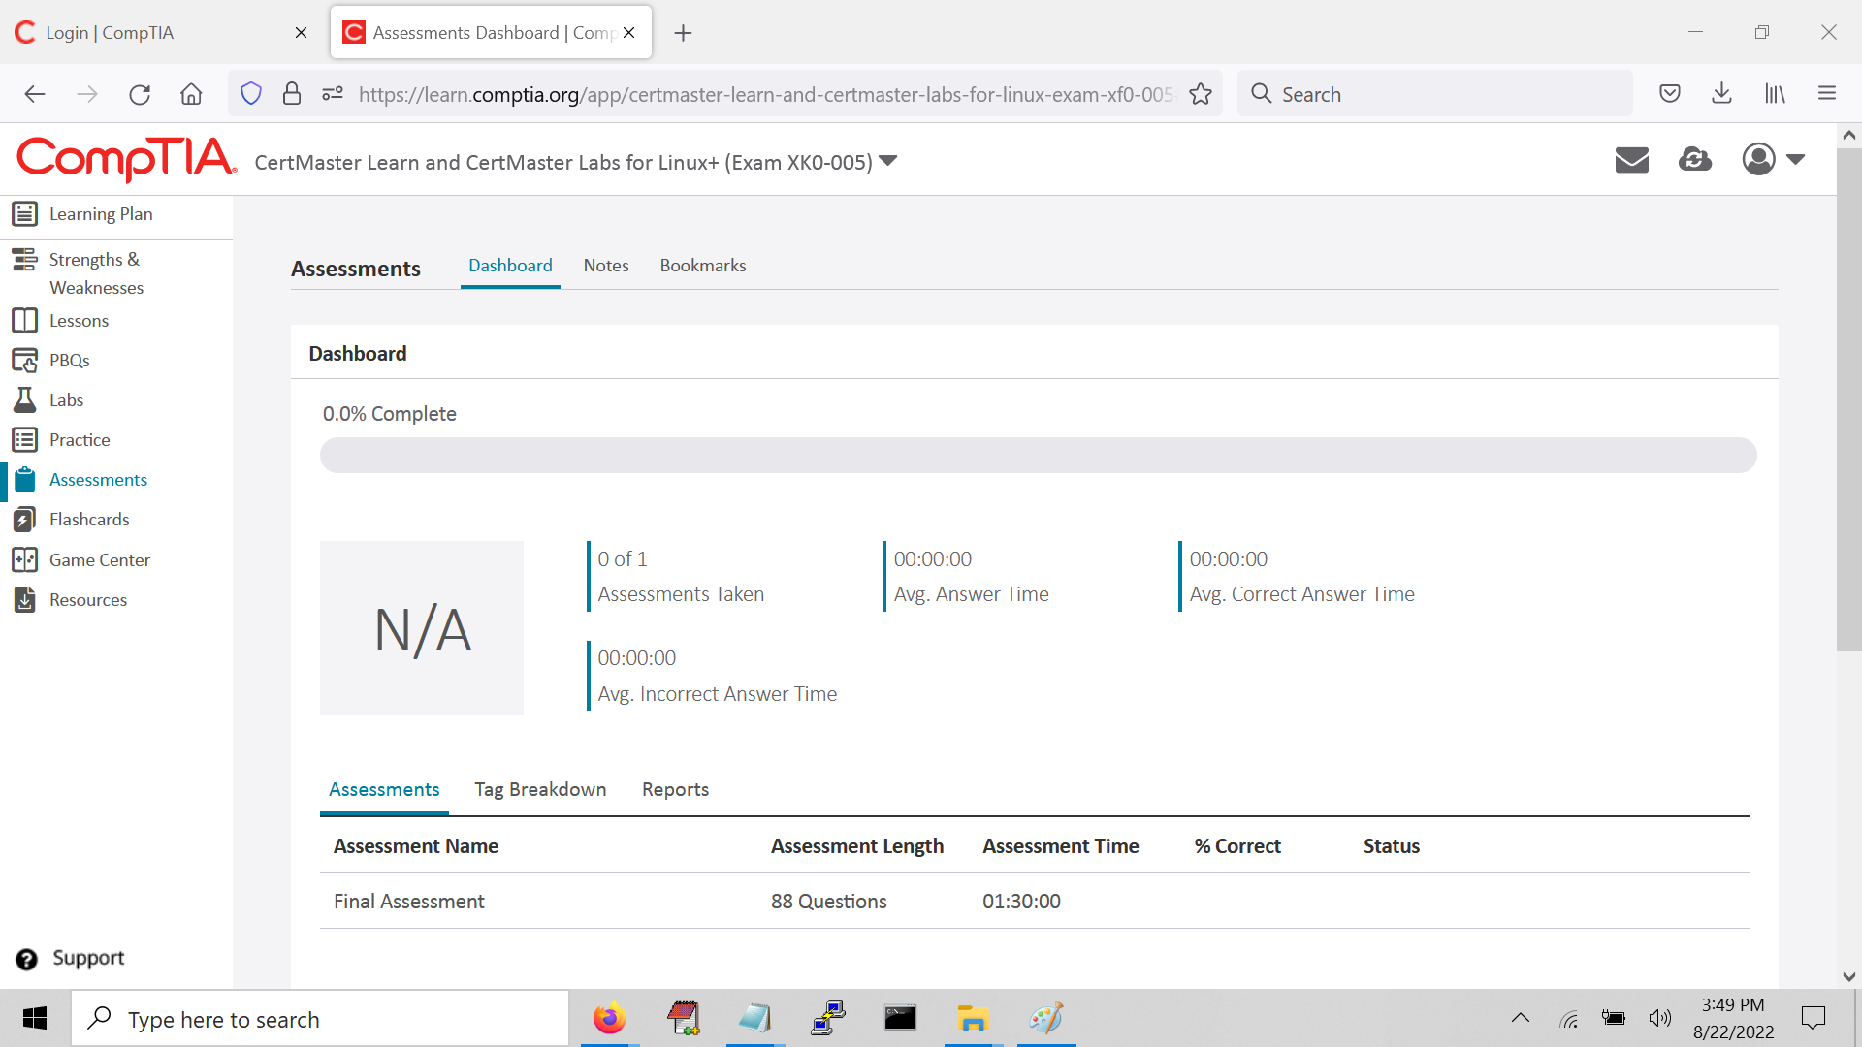
Section content title
<number>

Slide 36
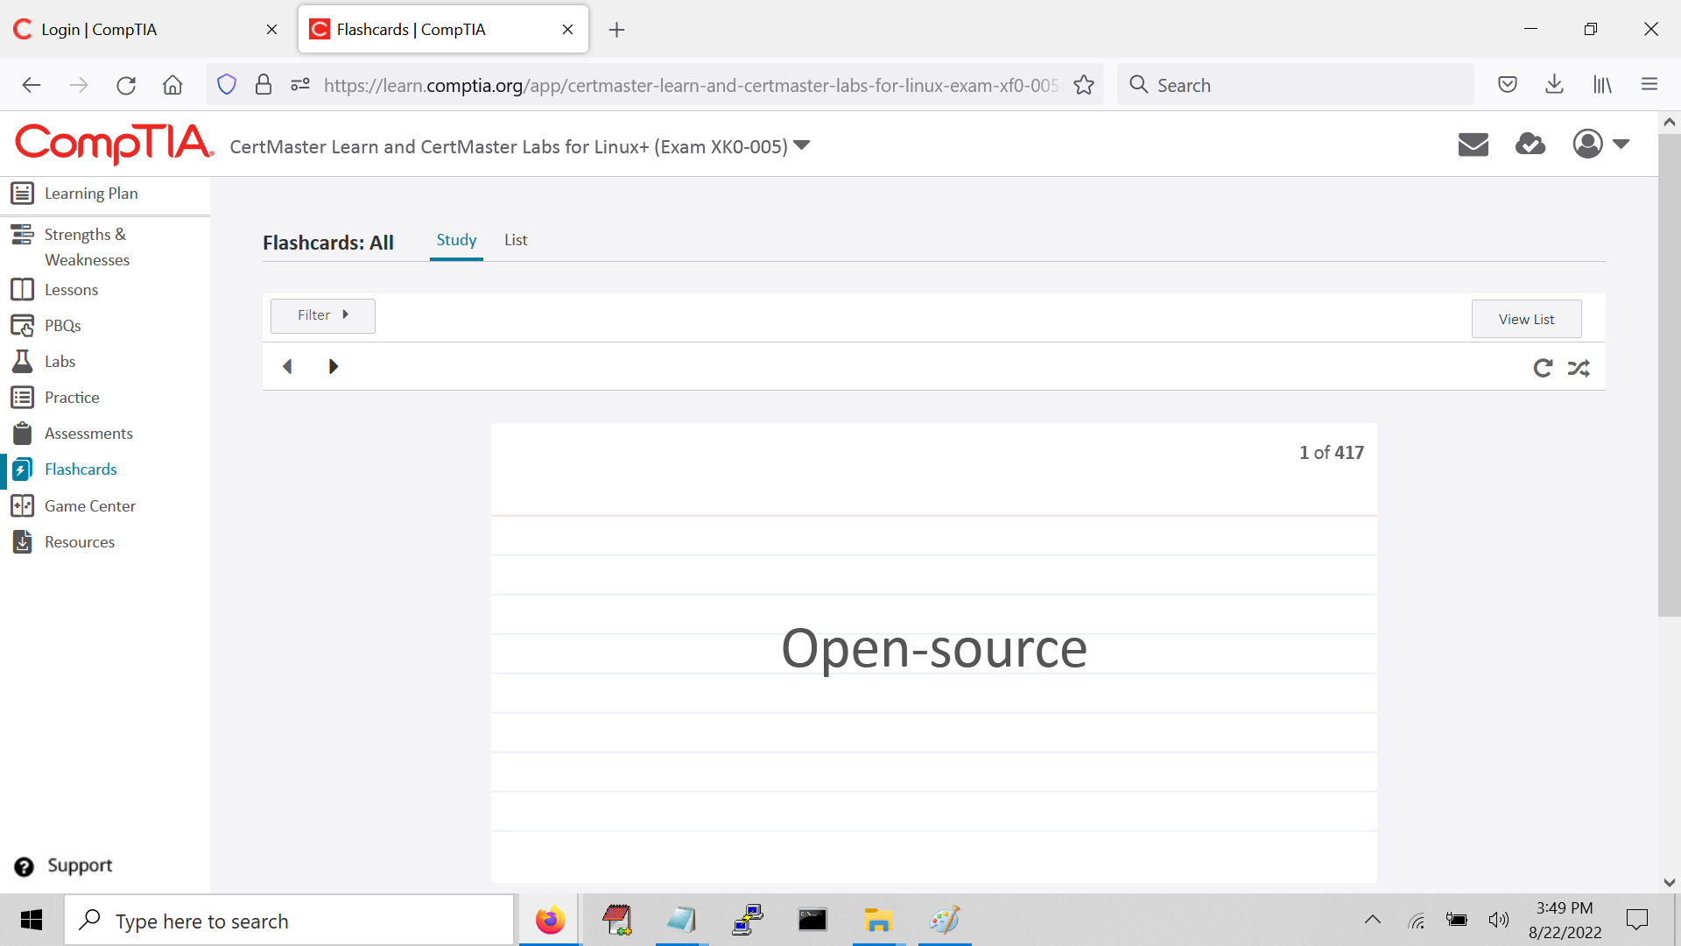
Section content title
<number>

Slide 37
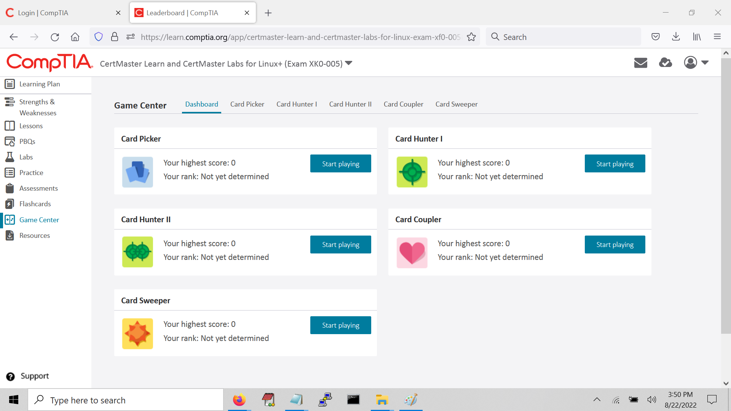
Section content title
<number>

Slide 38
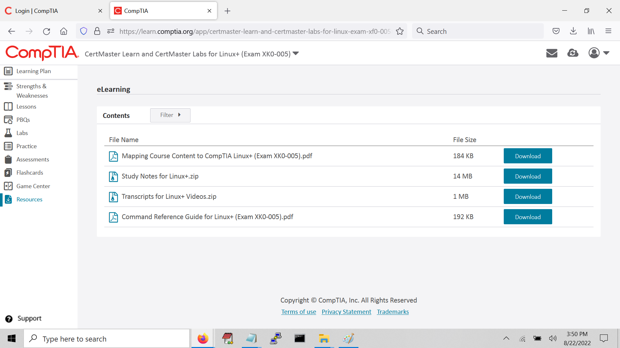
Section content title
<number>

Slide 39
Section break
Certmaster Practice
<number>

Slide 40
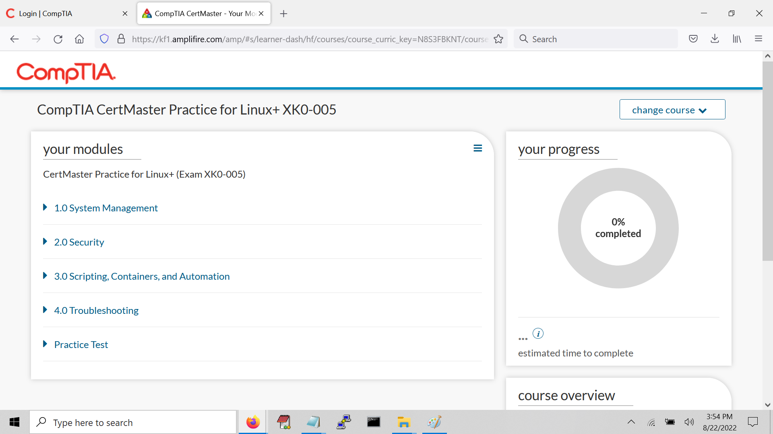
Section content title
<number>

Slide 41
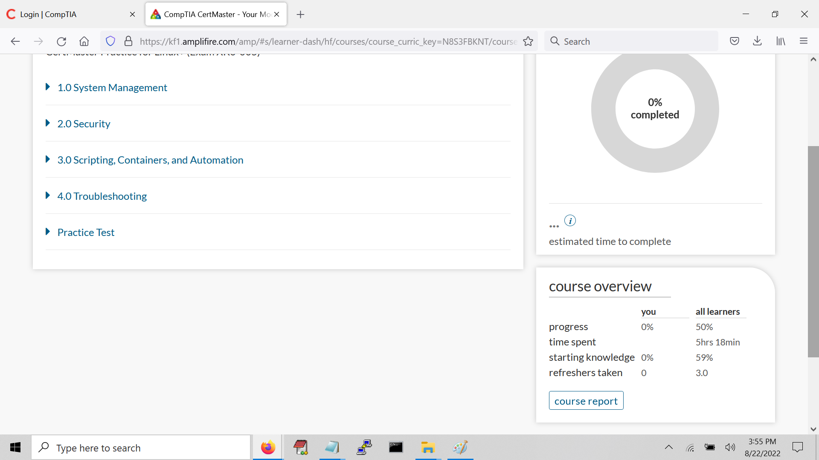
Section content title
<number>

Slide 42
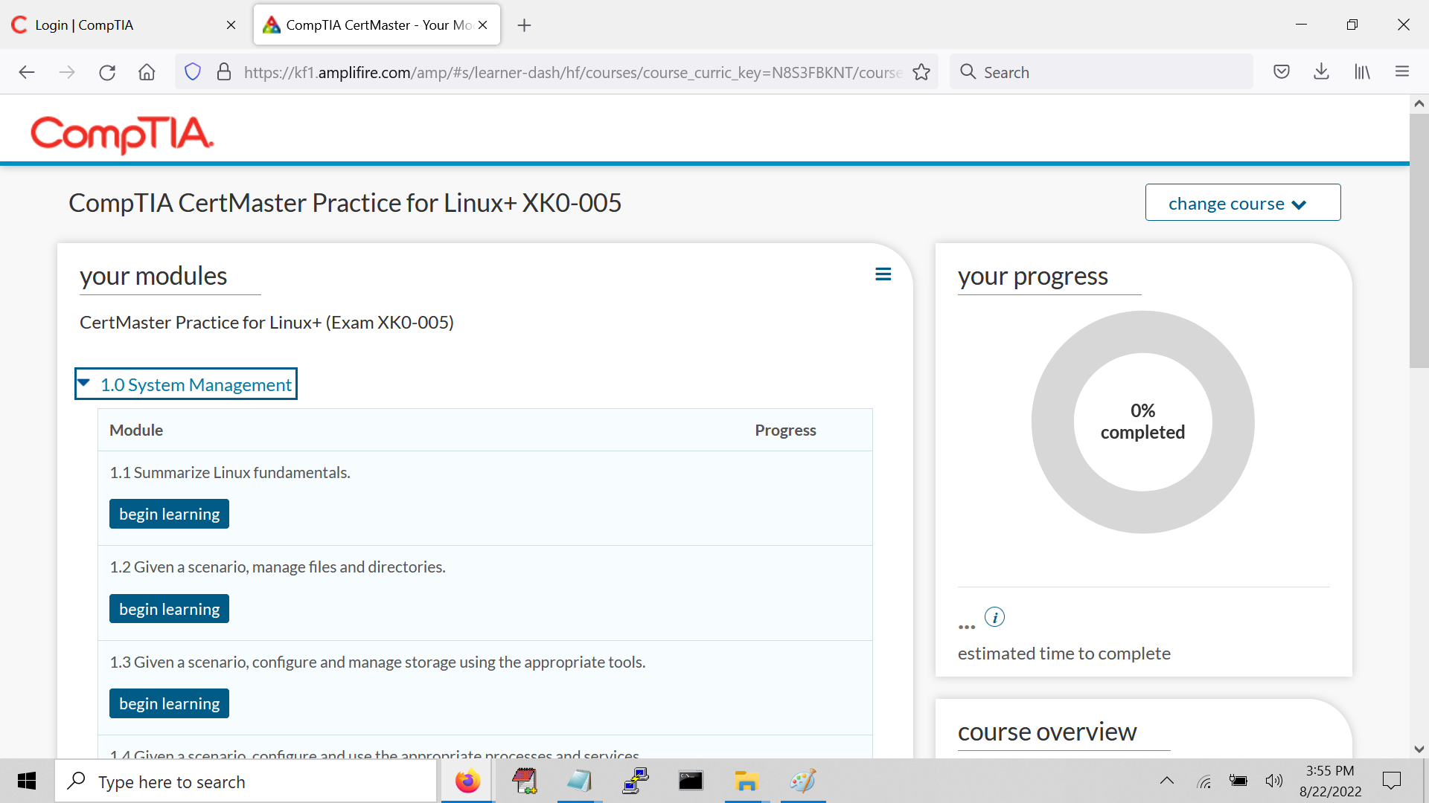
Section content title
<number>

Slide 43
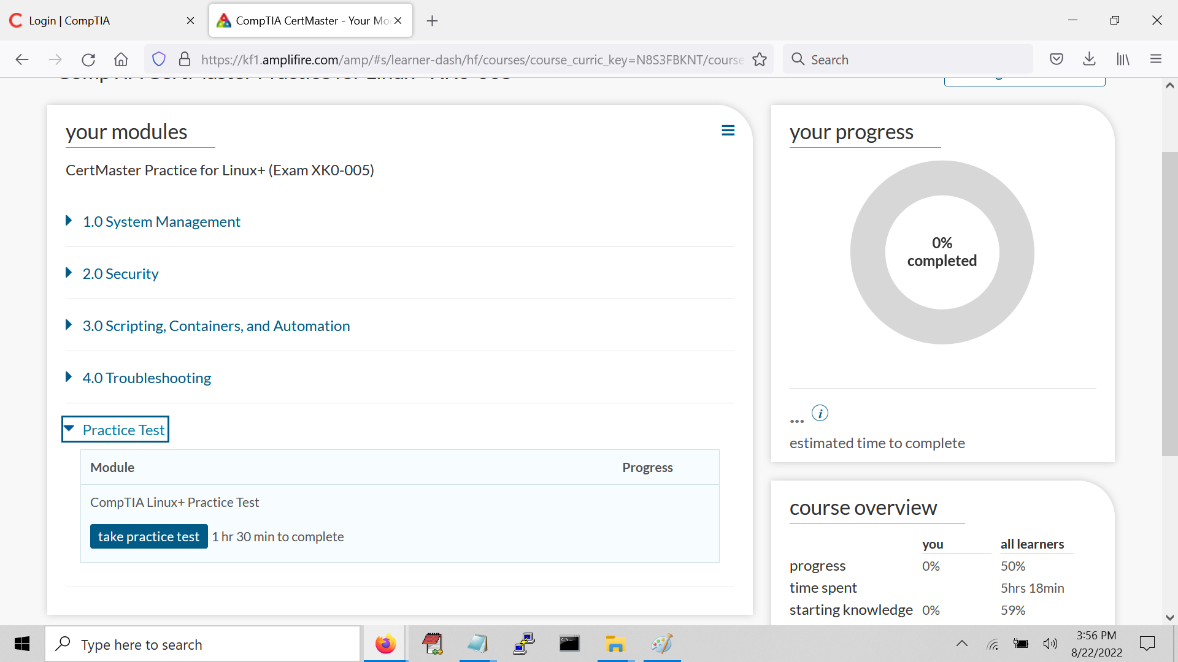
Section content title
<number>

Slide 44
For Next Week
Potentially use your trial access to check out Learn and Labs.
NOTE: No class next Monday, last class is next Tuesday!
Next class is Tuesday 8/30/22 and we will cover:
Domain 4.4
Domain 4.5
Wrap Up
<number>

Slide 45

Discussion time: Please type your questions in chat
Questions over content.
Share you experience.
What would you like to see
different moving forward?
Let’s keep the conversation going in the CompTIA Instructor Forum: https://cin.comptia.org
<number>

