Slide 1

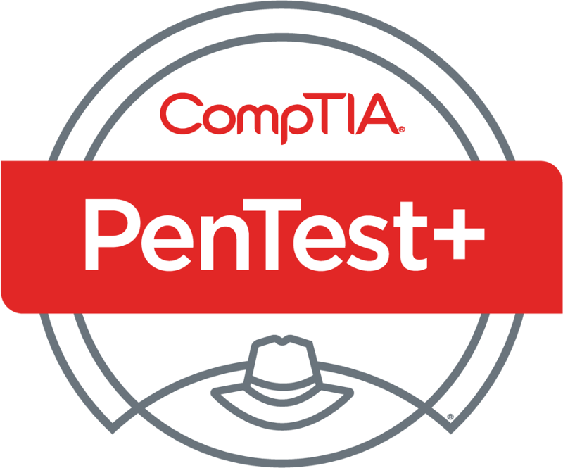
PenTest+ TTT Session 1: Introduction
05/29/2018
@TeachCompTIA #PenTestPlusTTT

Slide 2



Housekeeping
Unmute your speakers.
Use Chrome if you have issues
  Enable Flash: Chrome://settings/content flash settings enabled
Recording will be distributed within two hours. Slides and homework can be downloaded from the resource widget. You are able to do this via the recording as well.
Submit questions via the Q&A. The questions will be answered as submitted throughout the sessions.

Slide 3







Take Control of Your Console
Widgets are resizable and movable
Use the controls to minimize or maximize a widget
Drag the bottom right hand corner to resize it
Click the icon to download resources & bookmark helpful links
Chat with the audience and instructor by clicking the Group Chat icon and enter you questions or comments
Have a question? Click the Q&A icon and enter your questions
You can print your Certification of Attendance using the certification widget , after attending at least 110 minutes of the session
Do you have an idea or resource? We are trying the Idea widget out. Share resources you are using by typing in the Idea widget
The media player will show video, and when the instructor shares the screen, will show shared content.

Slide 4



Welcome to the Train-the-Trainer Series
Instructor:
T. Lee McWhorter, Jr.
IT Expert Generalist and Educator
lee@mcwhortertechnologies.com
Host:
Stephen Schneiter
Instructor Network Program Manager
CompTIA
sschneiter@comptia.org
Host:
Tazneen Kasem
Director. Product Management
Network+, CTT+, Project+ & CIN
CompTIA
tkasem@comptia.org
4

Slide 5

Agenda
Session Objectives
CompTIA program information
Tech review (Labs, GNS3 Project, & VMs)
Planning and Scoping I

Slide 6
PenTest+ PT0-001 TTT Session Outline
Date | Topic
05/29/2018 | Introduction: CompTIA program information, Tech review (Labs, GNS3 Project, & VMs), and Planning and Scoping I.
05/31/2018 | Planning and Scoping II: Penetration testing engagement scoping and compliance-based assessments.
06/05/2018 | Information Gathering: Scanning, enumerating and the many other means of information gathering.
06/07/2018 | Vulnerability Identification: Vulnerability scanning and analysis to prepare for exploitation.
06/12/2018 | Attacks and Exploits I: Social engineering attack types and physical security.
06/14/2018 | Attacks and Exploits II: Network-based, wireless & RF-based, and application vulnerabilities.
✓

Slide 7
PenTest+ PT0-001 TTT Session Outline
Date | Topic
06/26/2018 | Attacks and Exploits III: Local host vulnerabilities and post-exploitation techniques.
06/28/2018 | Penetration Tools I: Using and analyzing output from Nmap, Netcat and other penetration testing tools and utilities.
07/17/2018 | Penetration Tools II: Programming and scripting overview (BASH, PowerShell, Python & Ruby).
07/19/2018 | Reporting and Communications I: Report writing and handling best practices, and the importance of communications.
07/24/2018 | Reporting and Communications II: Recommending mitigation strategies and other post-report activities.
07/26/2018 | Wrap up: Final review, demos, and best practices as well as CompTIA wrap up information and survey.

Slide 8


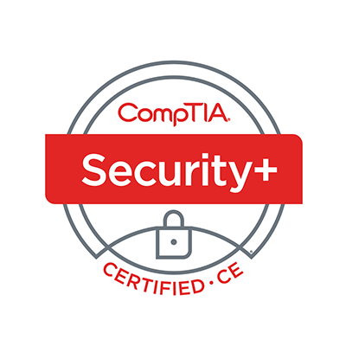
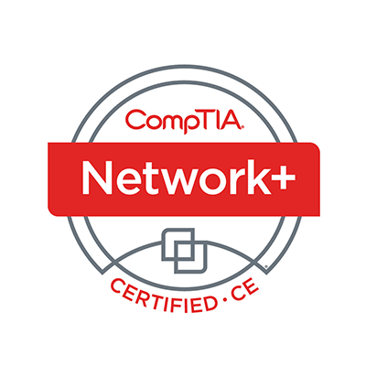
Welcome
Lee McWhorter
Instructor
Lead Author
Woz U Cyber Security Program
lee@mcwhortertechnologies.com

Slide 9

Chat Question
Does anyone recognize the building in the background of my headshot?
Answer in the chat window and let’s share.
This photo is for placement only

Slide 10
POLL
Which virtualization software do you use?
VMWare
VirtualBox
Windows Hypervisor
Other

Slide 11
Tech review (Labs, GNS3 Project, & VMs)
Instructor provided content:
Over the course of the TTT, I plan to provide you with the following:
  A GNS3 Portable Project with a custom built topology for use in this course
  A number of VirtualBox virtual machines (VMs) in .ova format
As such our main tools will be VirtualBox and GNS3
Note: All provided resources are open-source and freely usable. If you want to give me credit, that’s great, but not required. ☺

Slide 12
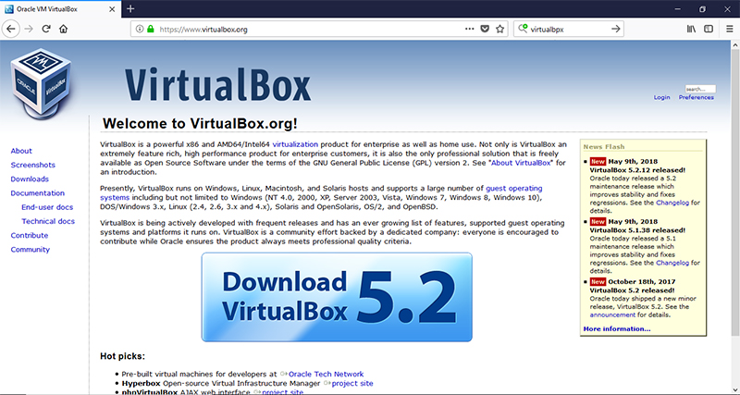

Slide 13
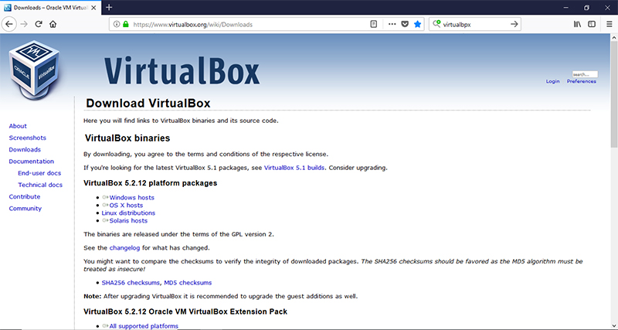

Slide 14
Tech review (Labs, GNS3 Project, & VMs)
You will need to download the VirtualBox installer for your operating system.
While on the download page also download the Extension Pack.
Install VirtualBox first. Once this is installed you can double-click on the Extension Pack file and add it to your VirtualBox install.

Slide 15
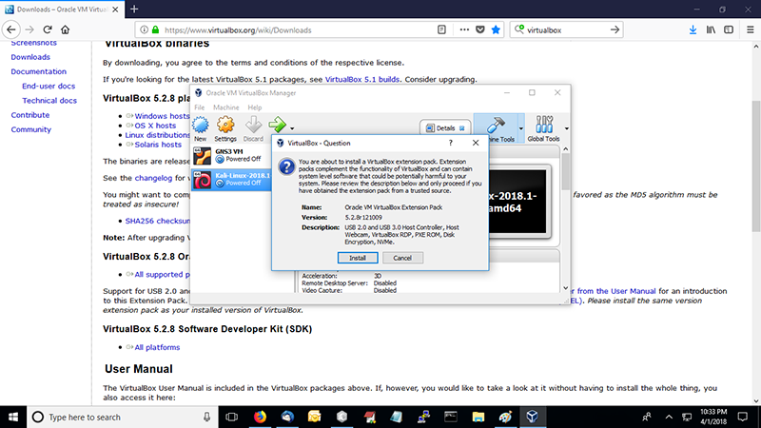

Slide 16
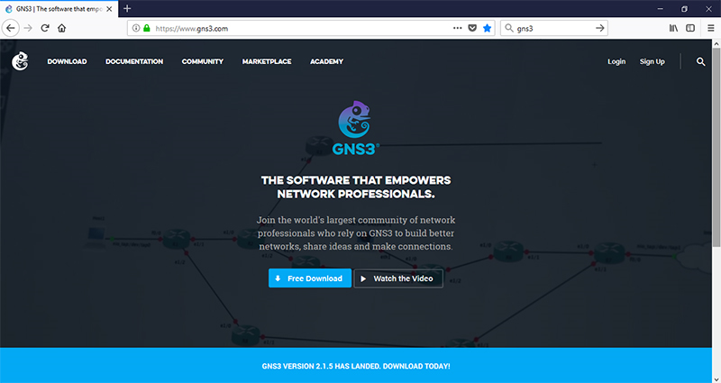

Slide 17
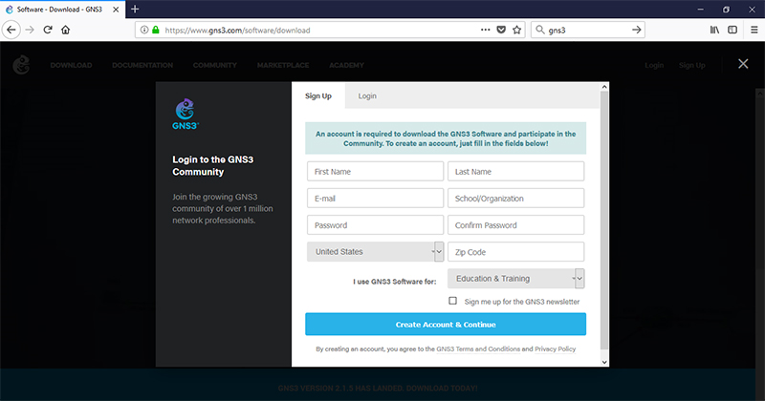

Slide 18
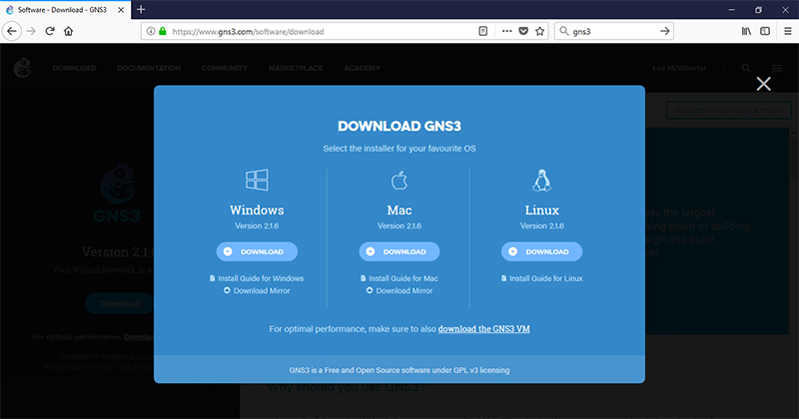

Slide 19
Tech review (Labs, GNS3 Project, & VMs)
You will need to download both the version of the GNS3 software for your operating system AND the GNS3 VM to go with your virtualization software.
First step is to Import the GNS3 VM into VirtualBox.
Then install the GNS3 software and set it up to use the GNS3 VM.

Slide 20
DEMO
GNS3 Setup, Preferences, and Basics

Slide 21
Tech review (Labs, GNS3 Project, & VMs)
Note: All of this can be done with VMWare or other options.
However, while I’ll try to help, all the resources provided by me will be VirtualBox based.
VirtualBox was chosen for the simple reason that it works consistently across all major operating system AND is free on all system.
I will help those trying to use another setup as well as I can. I use both VMWare and VirtualBox myself.

Slide 22
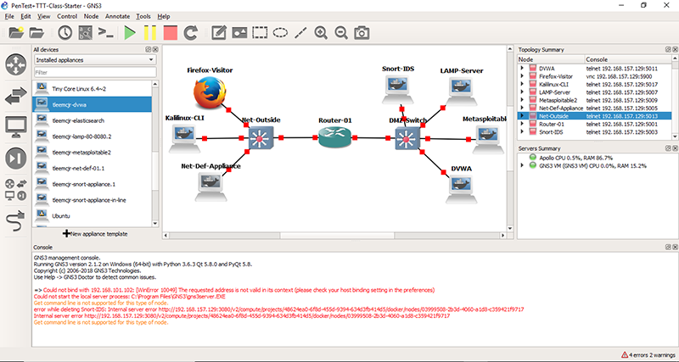

Slide 23
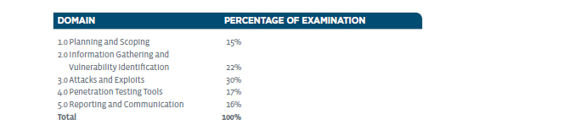
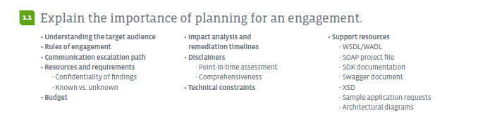
Planning and Scoping I – Domain 1.1

Slide 24

Planning and Scoping I – Domain 1.1
Why Plan and Scope a Pen Test?

Slide 25
POLL
Have you ever conducted a pen test?
Yes, lots of them
Yes, but not often
Yes, but only in lab environment
No

Slide 26
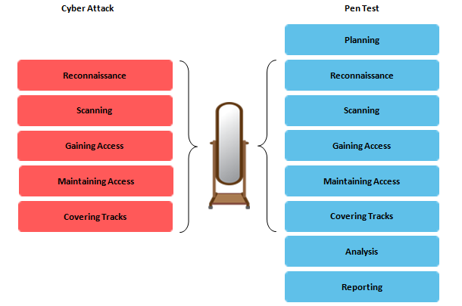
Planning and Scoping I – Domain 1.1

Slide 27
Planning and Scoping I – Domain 1.1
Understanding the target audience
  When conducting a penetration test it is very important to understand who you are conducting it for and why. You must understand their business and what their organization objectives. A small corner shop that is concerned about being PCI/DSS compliant will not have the same security goals as a multinational.
Communication escalation path
  Who do we communicate with if something goes wrong?
  What information to communicate, and when.
  Clear identification of the reasons behind communication actions.

Slide 28
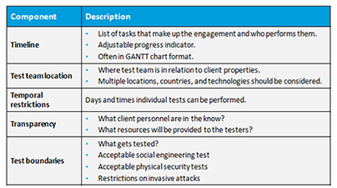
Planning and Scoping I – Domain 1.1
Rules of engagement
  Defines how that testing is to occur.

Slide 29
Planning and Scoping I – Domain 1.1
Resources and requirements
  What resources will the tester and the client provide?
  What requirements are to be meet in the testing?
    Confidentiality of findings
    Known vs. unknown
Budget
  One of the most important factor of a penetration test. It can affect how long the tester has, what can be done, what resources can be used, and among other factors.

Slide 30
Planning and Scoping I – Domain 1.1
Impact analysis and remediation timelines
  What kind and type of report will be provided at the end of the test?
  Estimation of time to complete recommended remediation steps.
Disclaimers
  Point-in-time assessment – results only valid for period of time.
  Comprehensiveness – Whole organization or just specific objectives?

Slide 31
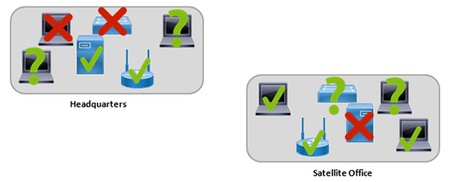
Planning and Scoping I – Domain 1.1
Technical constraints
  What constraints could limited testing? Tested, Not tested, Can’t be Tested?

Slide 32
Planning and Scoping I – Domain 1.1
Support resources (Note: These generally only apply to white box tests)
  WSDL/WADL
    WSDL (Web Services Description Language) is an XML-based interface definition language that is used for describing the functionality offered by a web service.
    The Web Application Description Language (WADL) is a machine-readable XML description of HTTP-based web services.
  SOAP project file
    SOAP (originally Simple Object Access Protocol) is a messaging protocol specification for exchanging structured information in the implementation of web services.
    SOAP projects can be created from a WSDL file or single service call. You can use these projects to test every aspect of your SOAP services.

Slide 33
Planning and Scoping I – Domain 1.1
Support resources (Note: These generally only apply to white box tests)
  SDK documentation
    SDK stands for Software Developer’s Kit. It is often useful to know which SDK’s are in use as well as which software libraries.
  Swagger document
    Swagger is an open source software framework backed by a large ecosystem of tools that helps developers design, build, document, and consume RESTful Web services. Representational State Transfer (REST) is an web application architectural style that is based on HTTP.

Slide 34
Planning and Scoping I – Domain 1.1
Support resources (Note: These generally only apply to white box tests)
  XSD
    XSD (XML Schema Definition) is a World Wide Web Consortium (W3C) recommendation that specifies how to formally describe the elements in an Extensible Markup Language (XML) document.
  Sample application requests
    Usually applies to web applications, but can technically apply to all applications used or created by an organization that will undergo testing.
  Architectural diagrams
    Network diagrams, software flow charts, etc. Can map out things such as network topology, where switch closets are, and location of other key information systems.

Slide 35
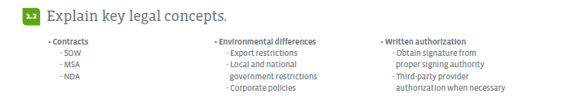
Planning and Scoping I – Domain 1.2

Slide 36
Planning and Scoping I – Domain 1.2
Contracts
  SOW
    Statement of work is a formal document that clearly states the scope of what will be done during the penetration test.
  MSA
    A master service agreement is a contract reached between parties, in which the parties agree to most of the terms that will govern future actions.
  NDA
    A non-disclosure agreement (NDA), is a legal contract between at least two parties that outlines confidential material, knowledge, or information that the parties wish to share with one another for certain purposes, but wish to restrict access to or by third parties.

Slide 37
Planning and Scoping I – Domain 1.2
Environmental differences
  Export restrictions
    There is a complicated network of federal agencies and inter-related regulations that govern exports collectively referred to as "Export Controls." In brief, Export Controls regulate the shipment or transfer, by whatever means, of controlled items, software, technology, or services out of U.S.
  Local and national government restrictions
    The laws in different countries are different. So what may be considered a crime in one country may not be a crime in another. Or regulations may be imposed in another country that are not imposed in yours.
  Corporate policies

Slide 38
Chat Question
What types or examples of corporate policy could affect a pent test?
Answer in the chat window and let’s share.
This photo is for placement only

Slide 39
Planning and Scoping I – Domain 1.2
Written authorization
  Obtain signature from proper signing authority
    A penetration test could potentially expose information that should not be released to the public or information that could damage a companies reputation. This is why before a test is done written authorization must be granted.
    Plus this is the key difference between white hats and black hats, white hat hackers have permission.
  Third-party provider authorization when necessary
    Can apply to third-party hosted applications, services and servers.
    As we learned in the Cloud+ TTT, extra care must be used when testing Cloud assets and many providers such as Amazon have specific procedures which must be followed to notify them of impending pen tests.

Slide 40
Chat Question
Who should sign a pen testing agreement for an organization?
Answer in the chat window and let’s share.
This photo is for placement only

Slide 41
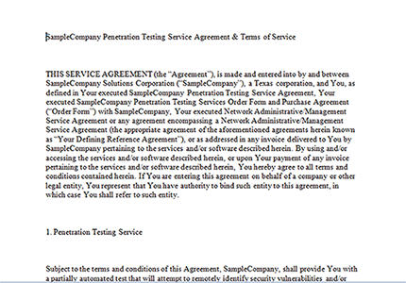
Planning and Scoping I – Domain 1.2

Slide 42
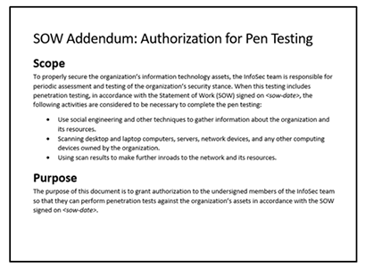
Planning and Scoping I – Domain 1.2

Slide 43
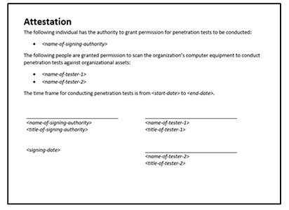
Planning and Scoping I – Domain 1.2

Slide 44
Homework for next class!
Set up GNS3 to work on your preferred system. Ideally you will use VirtualBox as the virtualization software, but you are not required to do so.
Get GNS3 set up and running on your system with the base components.
Next class we will cover how to install my custom appliances and we will provide you with the Portable Project file.
Over the coming weeks additional VMs will also be provided.

Slide 45
Next Class!
We will cover Planning and Scoping Domains 1.3 and 1.4
We will cover how to set up custom GNS3 appliances
We will make available and go over the provided GNS3 Portable Project

Slide 46

Discussion time: Please type your questions in chat
Questions over content.
Share you experience.
What would you like to see
different moving forward?
Let’s keep the going on LinkedIn in the CompTIA Instructor Forum: http://bit.ly/2wMU4nL

