Slide 1

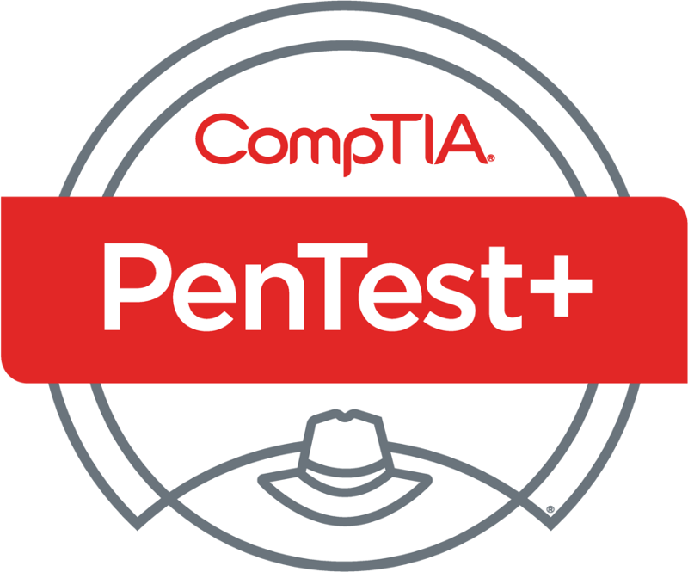
PenTest+ TTT Session 3: Information Gathering
06/05/2018
@TeachCompTIA #PenTestPlusTTT

Slide 2



Housekeeping
Unmute your speakers.
Use Chrome if you have issues
  Enable Flash: Chrome://settings/content flash settings enabled
Recording will be distributed within two hours. Slides and homework can be downloaded from the resource widget. You are able to do this via the recording as well.
Submit questions via the Q&A. The questions will be answered as submitted throughout the sessions.

Slide 3







Take Control of Your Console
Widgets are resizable and movable
Use the controls to minimize or maximize a widget
Drag the bottom right hand corner to resize it
Click the icon to download resources & bookmark helpful links
Chat with the audience and instructor by clicking the Group Chat icon and enter you questions or comments
Have a question? Click the Q&A icon and enter your questions
You can print your Certification of Attendance using the certification widget , after attending at least 110 minutes of the session
Do you have an idea or resource? We are trying the Idea widget out. Share resources you are using by typing in the Idea widget
The media player will show video, and when the instructor shares the screen, will show shared content.

Slide 4



Welcome to the Train-the-Trainer Series
Instructor:
T. Lee McWhorter, Jr.
IT Expert Generalist and Educator
lee@mcwhortertechnologies.com
Host:
Stephen Schneiter
Instructor Network Program Manager
CompTIA
sschneiter@comptia.org
Host:
Tazneen Kasem
Director. Product Management
Network+, CTT+, Project+ & CIN
CompTIA
tkasem@comptia.org
4

Slide 5

Agenda
Session Objectives
Review
Scanning
Enumerating
Other means of information gathering

Slide 6
PenTest+ PT0-001 TTT Session Outline
Date | Topic
05/29/2018 | Introduction: CompTIA program information, Tech review (Labs, GNS3 Project, & VMs), and Planning and Scoping I.
05/31/2018 | Planning and Scoping II: Penetration testing engagement scoping and compliance-based assessments.
06/05/2018 | Information Gathering: Scanning, enumerating and the many other means of information gathering.
06/07/2018 | Vulnerability Identification: Vulnerability scanning and analysis to prepare for exploitation.
06/12/2018 | Attacks and Exploits I: Social engineering attack types and physical security.
06/14/2018 | Attacks and Exploits II: Network-based, wireless & RF-based, and application vulnerabilities.
✓
✓
✓

Slide 7
PenTest+ PT0-001 TTT Session Outline
Date | Topic
06/26/2018 | Attacks and Exploits III: Local host vulnerabilities and post-exploitation techniques.
06/28/2018 | Penetration Tools I: Using and analyzing output from Nmap, Netcat and other penetration testing tools and utilities.
07/17/2018 | Penetration Tools II: Programming and scripting overview (BASH, PowerShell, Python & Ruby).
07/19/2018 | Reporting and Communications I: Report writing and handling best practices, and the importance of communications.
07/24/2018 | Reporting and Communications II: Recommending mitigation strategies and other post-report activities.
07/26/2018 | Wrap up: Final review, demos, and best practices as well as CompTIA wrap up information and survey.

Slide 8


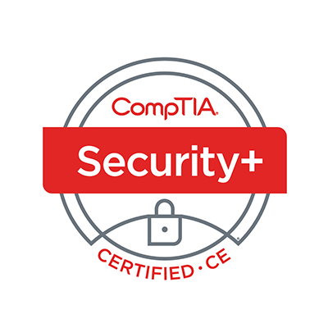
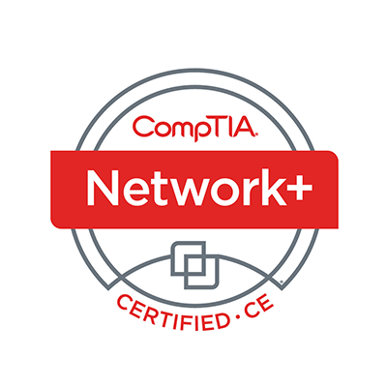


Welcome
Lee McWhorter
Instructor
Lead Author
Woz U Cyber Security Program
lee@mcwhortertechnologies.com

Slide 9
POLL
So what type of animal lover are you? ☺
Dog lover!
Cats for the win!
I want to hug them all!
Not really a fan of animals.
I can barely tolerate humans…

Slide 10
POLL
Were you able to get the provide GNS3 portable project topology downloaded and imported into your GNS3 set up?
Yes!
No, I’m still having VirtualBox problems.
No, I got Vbox running, but still having GNS3 issues.
No, didn’t have time
What, you’re giving away free stuff?

Slide 11
POLL
Which of the following are types of pen test assessments we have discussed?
Goal-based
Compliance-based
Red Team
Objective-based
All of the above

Slide 12
POLL – ANSWER SLIDE
Which of the following are types of pen test assessments we have discussed?
Goal-based
Compliance-based
Red Team
Objective-based
All of the above

Slide 13
POLL
We learned that understanding the target audience, budgeting, and gaining proper authority are critical to planning, scoping, and conducting a pen test. Which of the following is the next most important concept for such tests?
Tolerance to impact
Scope creep
Target Selection
Scheduling
Risk Acceptance

Slide 14
POLL – ANSWER SLIDE
We learned that understanding the target audience, budgeting, and gaining proper authority are critical to planning, scoping, and conducting a pen test. Which of the following is the next most important concept for such tests?
Tolerance to impact
Scope creep
Target Selection
Scheduling
Risk Acceptance

Slide 15
POLL
Which of the following is a legal contract which provides a framework for all future activities undertaken by the parties?
SOW
MSA
NDA
All of the above play a part
None of the above

Slide 16
POLL
Which of the following is a legal contract which provides a framework for all future activities undertaken by the parties?
SOW
MSA
NDA
All of the above play a part
None of the above

Slide 17
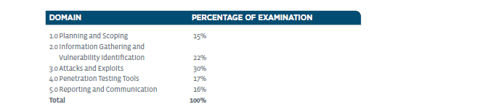
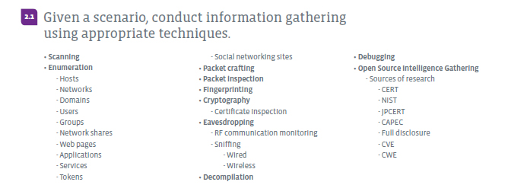
Information Gathering– Domain 2.1

Slide 18
Information Gathering– Domain 2.1
Scanning
  Scan = look at all parts of (something) carefully in order to detect some feature.
In computing and particularly pen tests, we can scan:
  Applications
  Devices
  Computers
  Networks
  Systems

Slide 19
Information Gathering– Domain 2.1
Enumeration
  Enumeration = the action of establishing the number of something.
From the exam objectives we see we need to understand enumeration for:
  Hosts, Networks, Domains, Users, Groups, Network shares, Web pages, Applications, Services, Tokens, and even Social networking sites.
  So how do we accomplish all of this?
  Usually with special scanning tools such as nmap, but there are also public sources for some of this information, like the Whois database for domain information.

Slide 20

Chat Question
Besides nmap, what other basic scanning and enumeration tools have your used or heard of.
Answer in the chat window and let’s share.
This photo is for placement only

Slide 21
DEMO
Scanning and Enumeration in the topology

Slide 22
Demo – Basic Command Reference
Using nmap to ‘ping sweep’ a network range in the topology:
  The “Outside” nmap -sP 10.1.1.0/24
  The “DMZ” nmap -sP 10.10.10.0/24
  Note: nmap exists on a number of nodes in the topology including the Kali Linux CLI, LAMP-Server, and Net-Def appliances.
Using arp-scan in the topology (Note: only on Net-Def appliance)
  arp-scan 10.1.1.0/24

Slide 23
Information Gathering– Domain 2.1
Packet crafting is creating custom packets according to various requirements to carry out attacks, exploit vulnerabilities, or gather information. Tools such as Netcat (nc), Ncat (ncat), and Hping can be used for this.
Packet inspection is analyzing packets after they are captured.
Fingerprinting in computing is generally concerned with identifying the operating systems and/or services running on a system.
Cryptography
  Certificate inspection

Slide 24
Information Gathering– Domain 2.1
Eavesdropping
  RF (Radio frequency) communication monitoring
  Sniffing
    Packet sniffing or packet capture work by intercepting and logging network traffic that can 'seen' via the wired or wireless network interface that the packet capture or sniffing software has access to on its host computer.
    Wired
      WireShark and tcpdump are popular tools for this function.
    Wireless
      Aircrack-ng is a popular wireless attack and analysis tool that is part of Kali.

Slide 25
DEMO
Packet capture and inspection in the topology

Slide 26
Demo – Basic Reference
GNS3 supports packet capture natively.
To use:
  Right-click on any wired connection link in the topology and chose Start capture.
  Right-click the same link again to view, stop or save the capture to a file.
  Viewing will open the packet capture in WireShark for live analysis.
  Saved packet capture files can be found in:
    C:\Users\Username\GNS3\projects\projectname\captures on Windows or something
    like /home/username/GNS3/projects/projectname/captures on Mac or *nix.
    The individual captures will have names based on the devices the link connected.

Slide 27
Information Gathering– Domain 2.1
Decompilation is a type of reverse engineering uses a decompiler that do the opposite of what a compiler does. A compiler takes source code and generates machine executive output. A decompiler attempts to reverse this and take the executable and turn in back into source code.
Debugging
  Debug = identify and remove errors from (hardware, software and systems).
Tools: Kali provides a number of reverse engineering tools and WinDbg is a popular tool for such tasks on the Windows platform.

Slide 28
Information Gathering– Domain 2.1
Open Source Intelligence Gathering - Sources of research
    CERT – US-CERT (Computer Emergency Response Team) - https://www.us-cert.gov/
      Their Alerts page: https://www.us-cert.gov/ncas/alerts
    NIST (National Institute of Standards and Technology) - https://csrc.nist.gov/
      National Vulnerabilities Database: https://nvd.nist.gov/
    JPCERT – Japan’s CERT - https://www.jpcert.or.jp/english/vh/project.html
    CAPEC - Common Attack Pattern Enumeration & Classification - https://capec.mitre.org/
    Full disclosure – Mailing list that is part of Seclists.org (the nmap folks) - http://seclists.org/fulldisclosure/
    CVE (Common Vulnerabilities and Exposures) - https://cve.mitre.org/
    CWE (Common Weakness Enumeration) - https://cwe.mitre.org/

Slide 29
Chat Question
Are there any other good sources of such information you are aware of? Please share with the group.
Answer in the chat window and let’s share.
This photo is for placement only

Slide 30
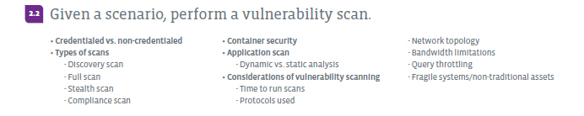
Information Gathering– Domain 2.2

Slide 31
Information Gathering– Domain 2.2
Credentialed vs. non-credentialed
Types of scans
  Discovery scan – Like the nmap ‘ping sweeps’ we covered earlier. Typically used to create a map of a network that shows all the devices connected.
  Full scan – Full port, service, & vulnerability scans, generally use more options.
  Stealth scan - Stealth scanning works by sending a SYN packet and looking at the response. If SYN/ACK is sent back, the port is open and the remote end is trying to open a TCP connection. The scanner then sends an RST to end.
  Compliance scan – Seeks to identify vulnerabilities in a network or system, enabling problems to be fix and compliance maintained.

Slide 32
DEMO
Vulnerability scanning in the topology

Slide 33
Demo – Basic Command Reference
Using nmap to perform different types of scans in the topology:
  Stealth scan nmap -sS 10.10.10.11
  Full port scan nmap -p 1-65535 10.10.10.11
  Fingerprinting nmap -p 21 -A 10.10.10.11
Using nikto on the Net-Def appliance within the topology:
  cd /usr/local/nikto-2.1.5
  perl nikto.pl -h 10.10.10.12

Slide 34
Demo – Basic Reference
OpenVAS
  To run OpenVAS you must use the Firefox appliance to login via the web interface of OpenVAS on the Net-Def appliance at:
  https://10.1.1.200:4000
  Confirm the security exception
  Then login in username: admin and password: admin
  Click Scans and the new scan wizard will walk you through, use 10.10.10.11
  If scan stops, you can restart it from the dashboard.
  Depending upon your system and setup this can be a very intensive operation and take awhile to complete. Once done you can review the results.

Slide 35
Information Gathering– Domain 2.2
Container security
  What are Containers? I like to think of them as micro virtual machines. Each container is built off a base OS image and then has custom software for its purpose on top. The Docker appliances I built for GNS3 are a good example.
  In addition to Docker, there is Puppet, Vagrant and other such systems.
Application scan
  Dynamic vs. static analysis
    Static analysis is performed in a non-runtime environment and will typical inspect program code for possible run-time behaviors and attempt to find coding flaws, back doors, and potentially malicious code.
    Dynamic analysis is performed while a program is in actual operation.

Slide 36
Information Gathering– Domain 2.2
Considerations of vulnerability scanning
  Time to run scans - scheduling
  Protocols used – target selection
  Network topology – layout of network affects access for tests/scans
  Bandwidth limitations – can’t over tax client resources – tolerance to impact
  Query throttling – to address above, we may throttling/slow down scan. Example is use of nmap -T option.
  Fragile systems/non-traditional assets – impact again – how do we handle these?

Slide 37
Chat Question
Any other considerations you can think of that might impact vulnerability scanning?
Answer in the chat window and let’s share.
This photo is for placement only

Slide 38
Homework for next class!
Run some vulnerabilities scans!
  Can you recreate some of the nmap and other scans demonstrated?
Run an OpenVAS scan against the MetaSploitable2 in the topology.
While you were only given a partial demo of OpenVAS, the provided reference instructions will help and it is web-based and fairly straight forward, if sometimes slow... ;)

Slide 39
Next Class!
Information Gathering and Vulnerability Identification Domains 2.3, 2.4, and 2.5.
We will go over the virtual machines and their host-only network in more detail.
We will begin using the stand-alone provided VMs next week.

Slide 40

Discussion time: Please type your questions in chat
Questions over content.
Share you experience.
What would you like to see
different moving forward?
Let’s keep the going on LinkedIn in the CompTIA Instructor Forum: http://bit.ly/2wMU4nL

