Slide 1


PenTest+ TTT Session 4: Vulnerability Identification
06/07/2018
@TeachCompTIA #PenTestPlusTTT

Slide 2



Housekeeping
Unmute your speakers.
Use Chrome if you have issues
  Enable Flash: Chrome://settings/content flash settings enabled
Recording will be distributed within two hours. Slides and homework can be downloaded from the resource widget. You are able to do this via the recording as well.
Submit questions via the Q&A. The questions will be answered as submitted throughout the sessions.

Slide 3







Take Control of Your Console
Widgets are resizable and movable
Use the controls to minimize or maximize a widget
Drag the bottom right hand corner to resize it
Click the icon to download resources & bookmark helpful links
Chat with the audience and instructor by clicking the Group Chat icon and enter you questions or comments
Have a question? Click the Q&A icon and enter your questions
You can print your Certification of Attendance using the certification widget , after attending at least 110 minutes of the session
Do you have an idea or resource? We are trying the Idea widget out. Share resources you are using by typing in the Idea widget
The media player will show video, and when the instructor shares the screen, will show shared content.

Slide 4
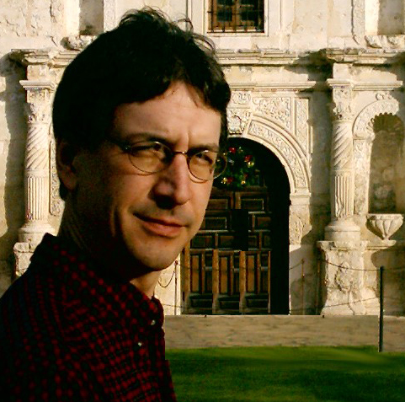


Welcome to the Train-the-Trainer Series
Instructor:
T. Lee McWhorter, Jr.
IT Expert Generalist and Educator
lee@mcwhortertechnologies.com
Host:
Stephen Schneiter
Instructor Network Program Manager
CompTIA
sschneiter@comptia.org
Host:
Tazneen Kasem
Director. Product Management
Network+, CTT+, Project+ & CIN
CompTIA
tkasem@comptia.org
4

Slide 5

Agenda
Session Objectives
Review
Vulnerability scanning
Analysis to prepare for exploitation

Slide 6
PenTest+ PT0-001 TTT Session Outline
Date | Topic
05/29/2018 | Introduction: CompTIA program information, Tech review (Labs, GNS3 Project, & VMs), and Planning and Scoping I.
05/31/2018 | Planning and Scoping II: Penetration testing engagement scoping and compliance-based assessments.
06/05/2018 | Information Gathering: Scanning, enumerating and the many other means of information gathering.
06/07/2018 | Vulnerability Identification: Vulnerability scanning and analysis to prepare for exploitation.
06/12/2018 | Attacks and Exploits I: Social engineering attack types and physical security.
06/14/2018 | Attacks and Exploits II: Network-based, wireless & RF-based, and application vulnerabilities.
✓
✓
✓
✓

Slide 7
PenTest+ PT0-001 TTT Session Outline
Date | Topic
06/26/2018 | Attacks and Exploits III: Local host vulnerabilities and post-exploitation techniques.
06/28/2018 | Penetration Tools I: Using and analyzing output from Nmap, Netcat and other penetration testing tools and utilities.
07/17/2018 | Penetration Tools II: Programming and scripting overview (BASH, PowerShell, Python & Ruby).
07/19/2018 | Reporting and Communications I: Report writing and handling best practices, and the importance of communications.
07/24/2018 | Reporting and Communications II: Recommending mitigation strategies and other post-report activities.
07/26/2018 | Wrap up: Final review, demos, and best practices as well as CompTIA wrap up information and survey.

Slide 8





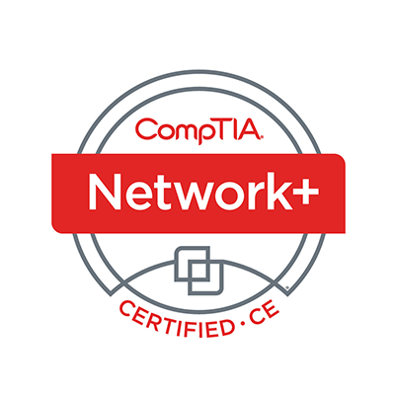
Welcome
Lee McWhorter
Instructor
Lead Author
Woz U Cyber Security Program
lee@mcwhortertechnologies.com

Slide 9
POLL
Where are you still having issues? Please choose 1, lowest level that applies.
Getting VirtualBox installed and running
Getting GNS3 installed and running
Importing the GNS3 project file into GNS3
Importing the .ova files into VirtualBox
No issues, I’ve got it all running now, Yay!

Slide 10
POLL
Which of the following might we need to scan and/or enumerate?
Applications
Devices
Computers
Networks
Systems
All of the above

Slide 11
POLL – ANSWER SLIDE
Which of the following might we need to scan and/or enumerate?
Applications
Devices
Computers
Networks
Systems
All of the above

Slide 12
POLL
Which of the following is commonly referred to as the ‘Swiss Army Knife’ of network utilities?
ncat
nmap
nc
arp-scan
None of the above
All of the above

Slide 13
POLL – ANSWER SLIDE
Which of the following is commonly referred to as the ‘Swiss Army Knife’ of network utilities?
ncat
nmap
nc
arp-scan
None of the above
All of the above

Slide 14
POLL
A Stealth scan quietly sends a full set of TCP handshake packets to avoid detection. True or False?
True
False

Slide 15
POLL – ANSWER SLIDE
A Stealth scan quietly sends a full set of TCP handshake packets to avoid detection. True or False?
True
False
Remember a Stealth scan sends just a SYN packet and looks at the response. If SYN/ACK is sent back, the port is open, if not it is closed. The scanner then sends an RST to any SYN/ACKs received to end the connection.

Slide 16
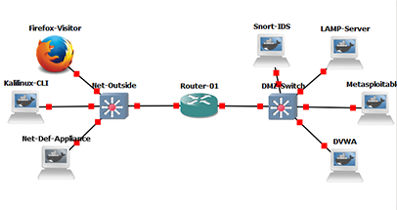
GNS3 Topology Quick Reference 1
Left/Outside 10.1.1.x - 10.1.1.1 Router-01 10.10.10.1 - Right/DMZ 10.1010.x

Slide 17
GNS3 Topology Quick Reference 2
Outside
  Firefox-Visitor appliance will not have IP. Set to 10.1.1.250 using Control Panel or the provided shell script in the home folder – open Terminal then run:
    ./set-10-1-1-250.sh
  KaliLinux-CLI appliance is at 10.1.1.100. This appliance has nmap, sqlmap, metasploit framework, hydra, etc.
  Net-Def-Appliance is at 10.1.1.200. This appliance has nmap, sqlmap, nikto, OpenVAS, etc. May appear to ‘hang’ on boot up, just wait for it… ☺
    OpenVAS available at https://10.1.1.200:4000 uses admin/admin to login.
    Nikto and sqlmap can be found in /usr/local/

Slide 18
GNS3 Topology Quick Reference 3
DMZ
  LAMP-Server is at 10.10.10.10 and has persistent /var/www/html folder.
  Metasploitable2 is at 10.10.10.11 and login using msfadmin/msfadmin
  DVWA is at 10.10.10.12 and the Console shows the web logs. For shell access remember to use Auxiliary Console. Remember to Create DB via web!
  Snort-IDS has NO IP address. It can passively monitor the first three DMZ switch ports (going to the servers above) via port mirroring which is set up.
    When first booted, Snort is NOT running. Use something like this following:
      snort -A console -c /etc/snort/snort.conf –i eth0
      This will display alerts to console and use the indicated conf file and interface.
      This appliance has a full ruleset and a persistent /etc/snort folder to save configurations.

Slide 19
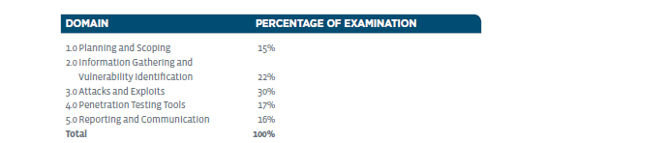
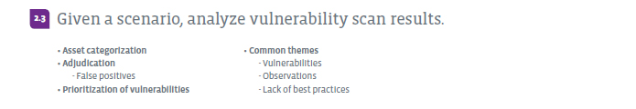
Information Gathering– Domain 2.3

Slide 20
Information Gathering– Domain 2.3
Asset categorization - identify and categorize high-value assets.
Adjudication – defined: a formal judgment on a disputed matter.
  False positives – our scanning will produce these, we must filter them out.
Prioritization of vulnerabilities – Which targets will we focus on first?
Common themes
  Vulnerabilities
  Observations
  Lack of best practices

Slide 21
Information Gathering– Domain 2.3
nmap -A -p 21 –T4 192.168.56.101
Starting Nmap 7.2 ( https://nmap.org ) at 2018-06-05 19:33 CST
Nmap scan report for 192.168.56.101
Host is up, received arp-response (0.00051s latency).
Not shown: 65505 closed ports
Reason: 65505 conn-refused
PORT STATE SERVICE REASON VERSION
21/tcp open ftp syn-ack vsftpd 2.3.4
|_ftp-anon: Anonymous FTP login allowed (FTP code 230)

Slide 22

Chat Question
What did Nikto ‘say’ when if found a possible vulnerability in a web scan as shown last session?
Answer in the chat window and let’s share.
This photo is for placement only

Slide 23
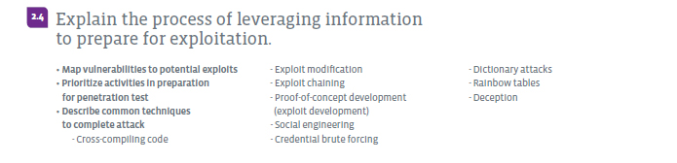
Information Gathering– Domain 2.4

Slide 24
Information Gathering– Domain 2.4
Map vulnerabilities to potential exploits
  Research vulnerabilities found in scanning to find possible exploits to use.
  Use the various Open Source vulnerability databases and tools
    Metasploit framework and even nmap effectively have local databases of known exploits. Can use ‘search’ from Metasploit command line, like: search vsftpd
Prioritize activities in preparation for penetration test
  Are we going to need to custom compile any exploits?
  What other final prep does our information gathering indicate we need to do?

Slide 25
Information Gathering– Domain 2.4
Describe common techniques to complete attack
  Cross-compiling code
    Kali is a Linux OS, yet you can compile Windows exploits on it using Mingw-w64.
    See: https://www.hackingtutorials.org/exploit-tutorials/mingw-w64-how-to-compile-windows-exploits-on-kali-linux/
  Exploit modification – might have to modify an exploit to get past new security updates or, even more commonly ,to mask it from AV (anti-virus)
  Exploit chaining – can we use one exploit to say get inside the firewall, then pivot and exploit further from there?
  Proof-of-concept development (exploit development)

Slide 26
Information Gathering– Domain 2.4
Describe common techniques to complete attack
  Social engineering – manipulating people to get information and access. Maybe test their handling of ‘IT staff’ showing up unannounced? Dumpster diving for information, etc.?
  Credential brute forcing – Can directly attack or attempt logins on systems or crack password files offline.
  Dictionary attacks – brute force attacks usually use a ‘dictionary’ of common (i.e., bad or breached) usernames and passwords.
  Rainbow tables – pre-computed hash values of known usernames and passwords used for offline password file cracking.
  Deception – see Social Engineering. Maybe call and pretend to be prospect?

Slide 27
POLL
Have any of your ever done any password cracking?
Yeah, all the time
Yes, but only in lab environment.
Played with it, but not much
Nope, new to me

Slide 28
DEMO
Hydra password cracking in the topology

Slide 29
Demo – Basic Command Reference
Hydra or THC Hydra is a brute force password cracker on the Kalilinux-CLI.
  It can take usernames and passwords in from text files. Either use two files (one for usernames and one for passwords) or one file with colon (:) separated values like:
    admin:admin
    root:root
Command line shown in demo:
  hydra -L top-123-usernames.txt -P top-123-badpasswords.txt ftp://10.10.10.11
  Make sure to change into /etc/network first using:
    cd /etc/network
  This is the persistent folder on this appliance and contains the files.

Slide 30
Demo – Basic Command Reference
There are many sources of bad username and password lists. A simple Google search will return tons of options. However of note:
  Daniel Miessler’s SecLists:
  https://github.com/danielmiessler/SecLists/tree/master/Passwords
Also for your personal reference (not a list you can use per se):
  https://haveibeenpwned.com/

Slide 31
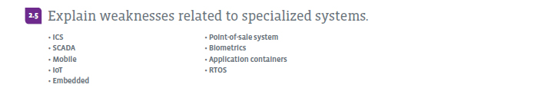
Information Gathering– Domain 2.5

Slide 32
Information Gathering– Domain 2.5
ICS (Industrial Control Systems)
SCADA (Supervisory control and data acquisition) – Stuxnet
  See: https://en.wikipedia.org/wiki/Stuxnet
Mobile – OMG, so many… Lack of updates, root/jailbreak, 3rd party apps…
IoT (Internet of Things) just Embedded systems in everything…
Embedded – Embedded systems are generally computing resources (chips, systems on a chip, etc.) ‘embedded’ into other systems. See ICS/SCADA.
  Your car likely has numerous such systems, such as for anti-lock brakes.

Slide 33
Information Gathering– Domain 2.5
Point-of-sale system – Look no further than the Target and Home Depot attacks of a couple of years ago. Credit card skimmers and other vulnerabilities such as passive reading of RF (radio frequency), etc.
Biometrics – not 100 percent accurate…
Application containers – Docker and other such application level virtualization. If an attackers ‘breaks out’ of a container, she can likely then break in to another or attack from the lower level system.
RTOS (Real-time operating system) such as found in embedded systems. Security may not be consideration. Limited resources, passive attacks.

Slide 34
Provided VM Quick Reference
All provided VMs are in .ova format and were made for VirtualBox.
All are set up with fixed IP addresses on the VirtualBox host-only adapter.
Kali Linux is at 192.168.13.13 and uses root / toor as username / password.
Dev-Client is at 192.168.13.150 and use either victim/victim or dev/dev.
Net-Server is at 192.168.13.250 and uses mail-admin / mail-admin.
Metasploitable2 is at 192.168.13.251 and uses msfadmin / msfadmin.
We will only work with 2 or 3 at a time. For example, we’ll need three running (Kali, Server & Client) for spear phishing, but generally will use 2.

Slide 35
Homework for next class!
Fire up the Snort application on the Snort-IDS appliance following the Quick Reference Guide slide’s information and sample command line.
Run Hydra within the topology as demonstrated and against other targets (i.e., other servers and/or protocols like ssh). Does Snort see these attempts? Were you successful in other ways?
Make sure you have all provided VirtualBox VMs downloaded, imported into VirtualBox, and running successfully.

Slide 36
Next Class!
Attacks and Exploits I - Domains 3.1 and 3.2.
Social engineering attack types and network-based vulnerabilities.
  Spear phishing demonstration using the Social Engineering Toolkit (SET).
  FTP exploit demo using Kali and Metasploitable2
We will be using all the provided VM’s. In particular the Kali Linux, Net-Server, and Dev-Client VMs will be used to demo spear phishing. Then the Kali Linux and Metasploitable2 VM will be used to demo the FTP exploit.

Slide 37

Discussion time: Please type your questions in chat
Questions over content.
Share you experience.
What would you like to see
different moving forward?
Let’s keep the going on LinkedIn in the CompTIA Instructor Forum: http://bit.ly/2wMU4nL

