Slide 1


PenTest+ TTT Session 6: Attacks and Exploits II
06/14/2018
@TeachCompTIA #PenTestPlusTTT

Slide 2



Housekeeping
Unmute your speakers.
Use Chrome if you have issues
  Enable Flash: Chrome://settings/content flash settings enabled
Recording will be distributed within two hours. Slides and homework can be downloaded from the resource widget. You are able to do this via the recording as well.
Submit questions via the Q&A. The questions will be answered as submitted throughout the sessions.

Slide 3







Take Control of Your Console
Widgets are resizable and movable
Use the controls to minimize or maximize a widget
Drag the bottom right hand corner to resize it
Click the icon to download resources & bookmark helpful links
Chat with the audience and instructor by clicking the Group Chat icon and enter you questions or comments
Have a question? Click the Q&A icon and enter your questions
You can print your Certification of Attendance using the certification widget , after attending at least 110 minutes of the session
Do you have an idea or resource? We are trying the Idea widget out. Share resources you are using by typing in the Idea widget
The media player will show video, and when the instructor shares the screen, will show shared content.

Slide 4



Welcome to the Train-the-Trainer Series
Instructor:
T. Lee McWhorter, Jr.
IT Expert Generalist and Educator
lee@mcwhortertechnologies.com
Host:
Stephen Schneiter
Instructor Network Program Manager
CompTIA
sschneiter@comptia.org
Host:
Tazneen Kasem
Director. Product Management
Network+, CTT+, Project+ & CIN
CompTIA
tkasem@comptia.org
4

Slide 5

Agenda
Session Objectives
Review
Wireless & RF-based vulnerabilities
Application vulnerabilities

Slide 6
PenTest+ PT0-001 TTT Session Outline
Date | Topic
05/29/2018 | Introduction: CompTIA program information, Tech review (Labs, GNS3 Project, & VMs), and Planning and Scoping I.
05/31/2018 | Planning and Scoping II: Penetration testing engagement scoping and compliance-based assessments.
06/05/2018 | Information Gathering: Scanning, enumerating and the many other means of information gathering.
06/07/2018 | Vulnerability Identification: Vulnerability scanning and analysis to prepare for exploitation.
06/12/2018 | Attacks and Exploits I: Social engineering attack types and physical security.
06/14/2018 | Attacks and Exploits II: Network-based, wireless & RF-based, and application vulnerabilities.
✓
✓
✓
✓
✓
✓

Slide 7
PenTest+ PT0-001 TTT Session Outline
Date | Topic
06/26/2018 | Attacks and Exploits III: Local host vulnerabilities and post-exploitation techniques.
06/28/2018 | Penetration Tools I: Using and analyzing output from Nmap, Netcat and other penetration testing tools and utilities.
07/17/2018 | Penetration Tools II: Programming and scripting overview (BASH, PowerShell, Python & Ruby).
07/19/2018 | Reporting and Communications I: Report writing and handling best practices, and the importance of communications.
07/24/2018 | Reporting and Communications II: Recommending mitigation strategies and other post-report activities.
07/26/2018 | Wrap up: Final review, demos, and best practices as well as CompTIA wrap up information and survey.

Slide 8



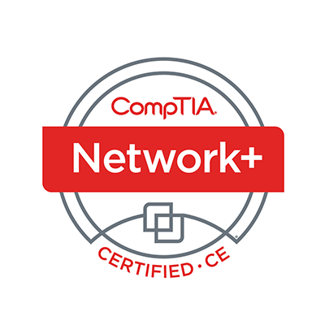
Welcome
Lee McWhorter
Instructor
Lead Author
Woz U Cyber Security Program
lee@mcwhortertechnologies.com

Slide 9
POLL
Which of the following is NOT a form of Social Engineering?
Spear Phishing
Whaling
Creating a USB drop stick
Credential Harvesting
Impersonation

Slide 10
POLL – ANSWER SLIDE
Which of the following is NOT a form of Social Engineering?
Spear Phishing
Whaling
Creating a USB drop stick
Credential Harvesting
Impersonation

Slide 11
POLL
Which of the following is NOT a motivation technique used by social engineers according to the PenTest+ Exam Objectives?
Authority
Scarcity
Consensus
Urgency
Fear

Slide 12
POLL – ANSWER SLIDE
Which of the following is NOT a motivation technique used by social engineers according to the PenTest+ Exam Objectives?
Authority
Scarcity
Consensus
Urgency
Fear
Consensus falls under either Social Proof or Likeness in the Objectives.

Slide 13
POLL
Which of the following is NOT an example of a Man-in-the-middle type attack?
ARP Spoofing
Replay
Relay
Downgrade
DNS poisoning
All are examples of Man-in-the-middle
None are examples of Man-in-the-middle

Slide 14
POLL – ANSWER SLIDE
Which of the following is NOT an example of a Man-in-the-middle type attack?
ARP Spoofing
Replay
Relay
Downgrade
DNS poisoning
All are examples of Man-in-the-middle
None are examples of Man-in-the-middle

Slide 15
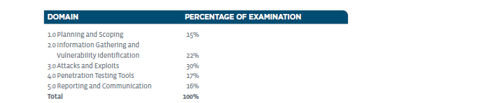
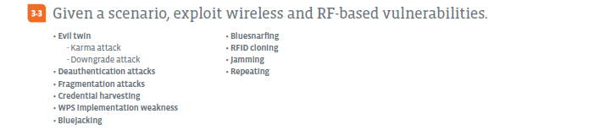
Attacks and Exploits – Domain 3.3

Slide 16
Attacks and Exploits – Domain 3.3
Evil twin - An evil twin is a fraudulent (Rogue Access Point) Wi-Fi access point that appears to be legitimate, set up to eavesdrop on wireless communications.
  Karma attack - KARMA stands for Karma Attacks Radio Machines Automatically.
    These devices listen for SSID requests and respond as if they were that Access Point.
  Downgrade attack – Attempts to force lower level, more insecure protocol or connection.
Deauthentication attacks - A Wi-Fi deauthentication attack is a type of denial-of-service attack that targets communication between a user and a Wi-Fi wireless access point.

Slide 17
Attacks and Exploits – Domain 3.3
Fragmentation attacks - IP fragmentation attacks are a common form of denial of service attack, in which the perpetrator overwhelms a network by exploiting datagram fragmentation mechanisms.
Credential harvesting - The term credential harvesting (also known as account harvesting) refers to the attacking technique or activities of obtaining legitimate user IDs and even passwords to gain access to target systems for illegal or malicious purposes.
  We saw this using the Social Engineering Toolkit using a cloned site.
  Check out ESPortalV2 at: https://github.com/exploitagency/ESPortalV2
  for a wifi specific application.

Slide 18
Attacks and Exploits – Domain 3.3
WPS implementation weakness - A number of popular home and small office routers suffer from an implementation problem that could lead an experienced hacker to learning the devices' eight-digit Wi-Fi Protected Setup (WPS) PIN.
Bluejacking - is the sending of unsolicited messages over Bluetooth to Bluetooth-enabled devices such as mobile phones, PDAs or laptops.
Bluesnarfing - is the theft of information from a wireless device through a Bluetooth connection.

Slide 19
Attacks and Exploits – Domain 3.3
RFID cloning - When an attacker takes the RF signal of a badge (or other device) and makes an exact copy.
Jamming - A kind of Denial of Service attack, which prevents other nodes from using the channel to communicate by occupying the channel that they are using to communicate.
Repeating - A wireless repeater takes an existing signal from a wireless router or wireless access point and rebroadcasts it to extend range or create a second network. This however can potentially opens another security attack vector.

Slide 20
Attacks and Exploits – Domain 3.3
Some Tools:
  Aircrack-ng is a complete suite of tools to assess WiFi network security. It focuses on different areas of WiFi security:
    Monitoring
    Attacking
    Testing
    Cracking
  Various wifi scanners and related tools can be found on many platforms including Android.
  Fake cell phone towers (also called ISMI (International mobile subscriber identity) catchers or Stingrays)

Slide 21
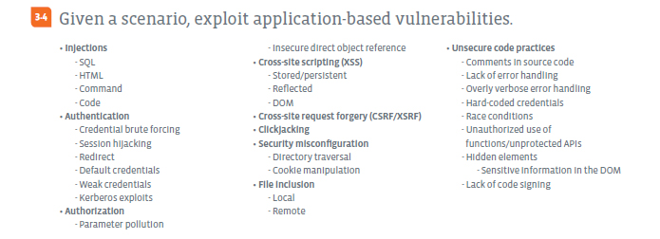
Attacks and Exploits – Domain 3.4

Slide 22
Attacks and Exploits – Domain 3.4
Injections - injection attack consists of insertion or "injection" of additional information via the input data from the client to the application.
  SQL - SQL (Standard Query Language) Injections involve injecting additional SQL statements into client input.
  HTML – HTML (HyperText Markup Language) Injections involve injecting additional HTML code, for example in Cross-site scripting attacks.
  Command – Command Injections involve injecting command line options attackers seek to run on the target system.
  Code – Code Injections can involve the injection of various types of code including JavaScript.

Slide 23
DEMO
SQL Injection demos, manual and with SQLmap

Slide 24
Demo – Basic Command Reference
To set up for this demonstration, you must first use the Firefox browser on the Kali Linux VM to visit:
  http://192.168.13.251/dvwa/
  Login with admin/password
  Click on the DVWA Security button (scroll down, it is lower on side menu).
  Change the drop-down menu on this page to low from high and click Submit.
Now you must capture the PHP Session cookie in one of two ways:
  Launch Wireshark on another Workspace to capture packets while Submitting the form on the SQL Injection page.
  Use BurpSuite as proxy to capture this information. Will demo Wireshark.

Slide 25
Demo – Basic Command Reference
SQLmap is a python program found in /usr/share/sqlmap
  Open a terminal in a new Workspace and issue the following command
    cd /usr/share/sqlmap
The basic usage is as follows:
  python sqlmap.py -u “http://192.168.13.251/dvwa/vulnerabilites/sqli/?id=1&Submit=Submit#” --cookie="PHPSESSID=11odjqs01fbq5mrpk01h2pf5c5; security=low“ -options
    --dbs finds information about the databases if the URL is vulnerable.
    -b displays banner information helping to confirm back-end database.
    -f fingerprints the database and underlying system.
  NOTE: Your cookie value will be different!

Slide 26
Demo – Basic Command Reference
To manually exploit the SQL Injection
  Visit: http://192.168.13.251/dvwa/vulnerabilites/sqli
  Enter the number 3 in the form and click Submit. Should return Hack Me.
  In the browser’s URL bar, carefully replace just the number 3 after ID= with:
    %25'+OR+'0'%3D'0
  Then hit Enter
We have successfully inject SQL to make their SQL statement of:
  SQL SELECT * FROM USERS WHERE ID=3
into something like:
  SQL SELECT * FROM USERS WHERE ID=% OR 0=0

Slide 27
Demo – Basic Command Reference
To use SQLmap to exploit this database vulnerability we build on our base:
  python sqlmap.py -u “http://192.168.13.251/dvwa/vulnerabilites/sqli/?id=1&Submit=Submit#” --cookie="PHPSESSID=11odjqs01fbq5mrpk01h2pf5c5; security=low“
And add different parameter/option sets such as:
  --current-user --is-dba --current-db --hostname
  --users --passwords --privileges –roles
  NOTE: Your cookie value will be different!

Slide 28
Attacks and Exploits – Domain 3.4
Authentication
  Credential brute forcing – think Hydra! (or offline cracking).
  Session hijacking - attacks consist of the exploitation of the web session control mechanism, which is normally managed using a session token.
  Redirect - is a kind of vulnerability that redirects you to another page than the intended website, usually integrated with a phishing attack.
  Default credentials – Sadly too many leave these in place…
  Weak credentials – think Hydra! ☺ (or offline cracking).

Slide 29
Attacks and Exploits – Domain 3.4
Authentication
  Kerberos exploits – Golden tickets are forged Kerberos Ticket-Granting Tickets (TGT) and a Silver tickets are forged Kerberos Ticket Granting Service (TGS) tickets, also called service tickets. Golden tickets allow for gaining access to any Kerberos service, while Silver tickets are limited to targeted service.
Authorization
  Parameter pollution - pollutes the HTTP parameters of a web application to perform a malicious attack.
  Insecure direct object reference - occur when an application provides direct access to objects based on user-supplied input. As a result, attackers can bypass authorization and access resources directly, such as database records.

Slide 30
Attacks and Exploits – Domain 3.4
Cross-site scripting (XSS) – is a type of injection, in which malicious scripts are injected into otherwise benign and trusted web sites. XSS attacks occur when an attacker uses a web application to send malicious code, usually in the form of a client-side script, to a different end user.
  Stored/persistent - data provided by the attacker is saved by the server.
  Reflected - also known as non-persistent attacks.
  DOM – Vulnerability is in the DOM (Document Object Model) not HTML.
Cross-site request forgery (CSRF/XSRF) - is a type of malicious exploit of a website where unauthorized commands are transmitted from a user that the web application trusts.

Slide 31
Attacks and Exploits – Domain 3.4
Clickjacking - is when an attacker uses multiple transparent or opaque layers to trick a user into clicking on a button or link on another page when they were intending to click on the top level page.
Security misconfiguration
  Directory traversal - attack which allows attackers to access restricted directories and execute commands outside of the web server's root directory.
  Cookie manipulation – DOM (Document Object Model)-based cookie manipulation arises when a script writes controllable data into the value of a cookie.
File inclusion – Both Local and Remote possibilities.

Slide 32
DEMO
File and command injection demos

Slide 33
Demo – Basic Command Reference
To set up for this demonstration, you must first use the Firefox browser on the Kali Linux VM to visit:
  http://192.168.13.251/dvwa/
  Login with admin/password
  Click on the DVWA Security button (scroll down, it is lower on side menu).
  Change the drop-down menu on this page to low from high and click Submit.
Then choose Upload on the DVWA side menu.
  Using this form, upload nc from /bin

Slide 34
Demo – Basic Command Reference
If you login to the Metasploitable2 VM using msfadmin/msfadmin, then issue the following command:
  ls -l /var/www/dvwa/hackable/uploads
You will see the file was successfully uploaded, but has the wrong permissions and is not executable.
  rw------- nc
Now visit the Command Execution page. This page provides a ping command that is vulnerable to command injection. Enter:
  192.168.13.13;chmod 755 /var/www/dvwa/hackable/uploads/nc

Slide 35

Chat Question
Have any ideas for how we might use that nc (netcat) we uploaded?
Answer in the chat window and let’s share.
This photo is for placement only

Slide 36
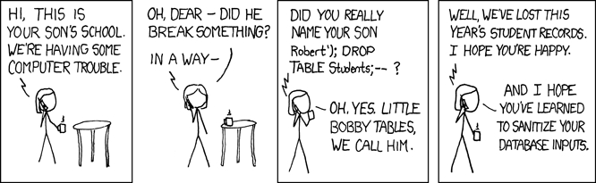
Attacks and Exploits – Domain 3.4
Unsecure code practices
  Comments in source code – While developers are commonly taught to comment their code for maintainability, sometimes this can provide too much information, potentially useful to an attacker.
  Lack of error handling

Slide 37
Attacks and Exploits – Domain 3.4
Unsecure code practices
  Overly verbose error handling – This can be within the application itself or can be due to misconfiguration of the environment, for example PHP configured in full debug mode.
  Hard-coded credentials – While actually fairly common, this can present a problem if these are accessed by an attacker. For example, if the source code of a website can be accessed via some exploit and this source code contains the login information for the database user the applications is using (think PHP based websites like WordPress sites among others), then an attacker might be able to use this information to directly access the database thus bypassing any security within the application itself.

Slide 38
Attacks and Exploits – Domain 3.4
Unsecure code practices
  Race conditions - is the behavior of an electronics, software, or other system where the output is dependent on the sequence or timing of other uncontrollable events. This can cause a ‘bug’ or potentially a DoS attack.
  Unauthorized use of functions/unprotected APIs (Application Programming Interface)
  Hidden elements – example could be as simple as <INPUT TYPE=HIDDEN> field.
    Sensitive information in the DOM
  Lack of code signing - Code signing is the method of using a certificate-based digital signature to sign executables and scripts in order to verify the author's identity and ensure that the code has not been changed or corrupted since it was signed by the author.

Slide 39
Homework for next class!
NOTE: Next week off, next class not until 6/26!
Set up the DVWA on Metasploitable2.
Can you recreate the SQLmap scans and attacks, even those not shown?
Recreate the demonstrated File and Command Injections.

Slide 40
Next Class!
NOTE: Next week off, next class not until 6/26!
Attacks and Exploits II - Domains 3.5, 3.6 and 3.7.
  Local Host vulnerabilities
  Physical Security Attacks
  Post-exploitation techniques
We will be using 2 of the provided VM’s. In particular the Kali Linux and Metasploitable2 VMs will be used.

Slide 41

Discussion time: Please type your questions in chat
Questions over content.
Share you experience.
What would you like to see
different moving forward?
Let’s keep the going on LinkedIn in the CompTIA Instructor Forum: http://bit.ly/2wMU4nL

