Slide 1

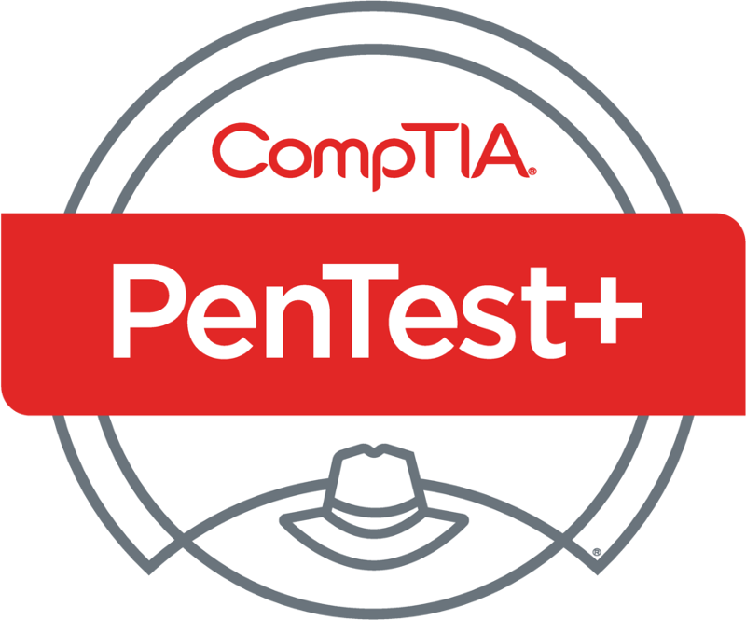
PenTest+ TTT Session 9: Penetration Tools II
07/17/2018
@TeachCompTIA #PenTestPlusTTT

Slide 2



Housekeeping
Unmute your speakers.
Use Chrome if you have issues
  Enable Flash: Chrome://settings/content flash settings enabled
Recording will be distributed within two hours. Slides and homework can be downloaded from the resource widget. You are able to do this via the recording as well.
Submit questions via the Q&A. The questions will be answered as submitted throughout the sessions.

Slide 3







Take Control of Your Console
Widgets are resizable and movable
Use the controls to minimize or maximize a widget
Drag the bottom right hand corner to resize it
Click the icon to download resources & bookmark helpful links
Chat with the audience and instructor by clicking the Group Chat icon and enter you questions or comments
Have a question? Click the Q&A icon and enter your questions
You can print your Certification of Attendance using the certification widget , after attending at least 110 minutes of the session
Do you have an idea or resource? We are trying the Idea widget out. Share resources you are using by typing in the Idea widget
The media player will show video, and when the instructor shares the screen, will show shared content.

Slide 4



Welcome to the Train-the-Trainer Series
Instructor:
T. Lee McWhorter, Jr.
IT Expert Generalist and Educator
lee@mcwhortertechnologies.com
Host:
Stephen Schneiter
Instructor Network Program Manager
CompTIA
sschneiter@comptia.org
Host:
Tazneen Kasem
Director. Product Management
Network+, CTT+, Project+ & CIN
CompTIA
tkasem@comptia.org
4

Slide 5

Agenda
Session Objectives
Review
Programming and scripting overview:
BASH
PowerShell
Python
Ruby

Slide 6
PenTest+ PT0-001 TTT Session Outline
Date | Topic
05/29/2018 | Introduction: CompTIA program information, Tech review (Labs, GNS3 Project, & VMs), and Planning and Scoping I.
05/31/2018 | Planning and Scoping II: Penetration testing engagement scoping and compliance-based assessments.
06/05/2018 | Information Gathering: Scanning, enumerating and the many other means of information gathering.
06/07/2018 | Vulnerability Identification: Vulnerability scanning and analysis to prepare for exploitation.
06/12/2018 | Attacks and Exploits I: Social engineering attack types and physical security.
06/14/2018 | Attacks and Exploits II: Network-based, wireless & RF-based, and application vulnerabilities.
✓
✓
✓
✓
✓
✓

Slide 7
PenTest+ PT0-001 TTT Session Outline
Date | Topic
06/26/2018 | Attacks and Exploits III: Local host vulnerabilities and post-exploitation techniques.
06/28/2018 | Penetration Tools I: Using and analyzing output from Nmap, Netcat and other penetration testing tools and utilities.
07/17/2018 | Penetration Tools II: Programming and scripting overview (BASH, PowerShell, Python & Ruby).
07/19/2018 | Reporting and Communications I: Report writing and handling best practices, and the importance of communications.
07/24/2018 | Reporting and Communications II: Recommending mitigation strategies and other post-report activities.
07/26/2018 | Wrap up: Final review, demos, and best practices as well as CompTIA wrap up information and survey.
✓
✓
✓

Slide 8


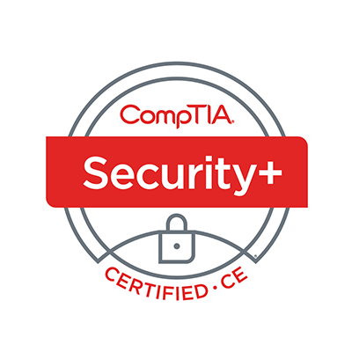
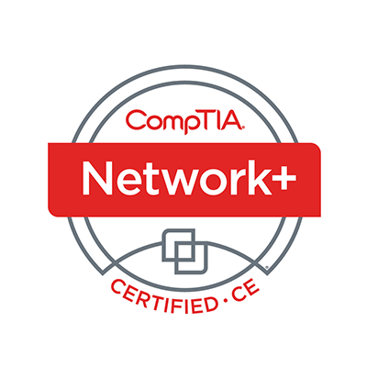
Welcome
Lee McWhorter
Instructor
Lead Author
Woz U Cyber Security Program
lee@mcwhortertechnologies.com

Slide 9
POLL
What does the following nmap scan do?
nmap -sS –p 53 -sV -T4 x.x.x.x/24 -oG file
nmap sends 53 packets with a slow full scan, versioning, file as input
nmap scans port 53 with a fast full scan, OS detection, file as input
nmap scan port 53 with a fast stealth scan, versioning, file as output
nmap sends 53 packets with a stealth scan, versioning, file as output
nmap scans port 53 with a full scan, OS detection, file as input

Slide 10
POLL – Answer Slide
What does the following nmap scan do?
nmap -sS –p 53 -sV -T4 x.x.x.x/24 -oG file
nmap sends 53 packets with a slow full scan, versioning, file as input
nmap scans port 53 with a fast full scan, OS detection, file as input
nmap scan port 53 with a fast stealth scan, versioning, file as output
nmap sends 53 packets with a stealth scan, versioning, file as output
nmap scans port 53 with a full scan, OS detection, file as input

Slide 11
POLL
Which of the following is NOT a use case for penetration testing tools?
Reconnaissance
Enumeration
Debugging
Evasion
Forensics

Slide 12
POLL – Answer Slide
Which of the following is NOT a use case for penetration testing tools?
Reconnaissance
Enumeration
Debugging
Evasion
Forensics

Slide 13
POLL
Which of the following penetration testing tools is NOT in the objectives?
Nikto
Cain and Abel
Shodan
Kali Linux
ncat and netcat
None are listed in the objectives
All are listed in the objectives

Slide 14
POLL – Answer Slide
Which of the following penetration testing tools is NOT in the objectives?
Nikto
Cain and Abel
Shodan
Kali Linux
ncat and netcat
None are listed in the objectives
All are listed in the objectives

Slide 15
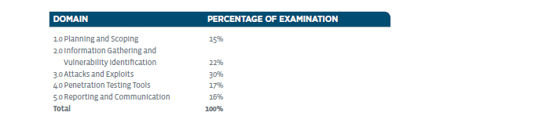
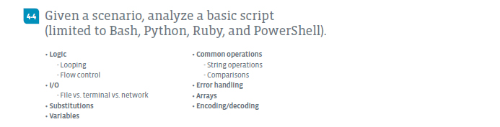
Penetration Tools – Domain 4.4

Slide 16
Penetration Tools – Domain 4.4
There are basically two ways to handle this sub domain:
  Assume or require previous basic programming experience and then teach to the specific objectives covered by Exam.
  Teach basic programming concepts, introduce all four of the possible languages, and cover the objectives from the Exam.
I have chosen the second option for a few of reasons:
  Around 25% of our class does not have previous programming experience.
  I simply believe this is the better approach.
  I have come up with what I hope is a unique way to present this material that I think you will find useful, educational and hopefully even fun.

Slide 17
Penetration Tools – Domain 4.4
What is programming?
  the act of instructing computers , via a sequence of instructions called a program or script, to perform tasks and solve problems.
How are programs written?
  Machine code was used for early programs, written in the instruction set of the particular machine, often directly in binary. Assembly languages were then developed that let the programmer specify instruction in a text format with abbreviations for operations and meaningful names for interacting with stored values. However, this was limited by the fact that any two machines with different instruction sets also had different versions of machine code or Assembly language.

Slide 18
VIDEO
Minecraft CPU and programming video
https://www.youtube.com/watch?v=yuMlhKI-pzE

Slide 19
Penetration Tools – Domain 4.4
How are programs written?
  Today most programs are writing in a Higher-level language that allow the programmer to write programs that are more abstract, and less bound to the underlying hardware. Early examples of higher-level languages include Fortran (derived from Formula Translation), COBOL (acronym for Common Business-Oriented Language), Lisp (derives from LISt Processor), and BASIC (Beginner's All-Purpose Symbolic Instruction Code).
  Most programs are simply text files (or a collection of related text files) and we have developed very powerful text or code editors to help us write programs. Today’s editors and integrated development environments (IDE) provide for error and syntax checking, and other features such as color coding to help make programming easier and to help prevent mistakes and bugs.

Slide 20
Penetration Tools – Domain 4.4
Scripting and Programming 101
  Don’t Panic! ☺
  Scripts are just short programs that automate the execution of tasks that could alternatively be executed one-by-one at the command line.
  All programming languages, including scripting languages, have a collection of commands or keywords and a set of rules on how to use them. This set of rules for writing a program or script in any given language is called the Syntax. Once you learn the keywords and Syntax, you can use an editor to write your code.
    Interpreted languages (each line of code is run or interpreted line by line)
    Compiled languages (code is compiled to convert it into executable binary code)

Slide 21
Penetration Tools – Domain 4.4
Scripting and Programming 101
  Programming languages also support variables within their Syntax. Variables in programming are simply named placeholders for some other value. The variable name is used in code to reference the stored value. For example, a website which requires a login might store the user name in a variable called $UserName.
  Be aware that most languages have rules for naming a variable, much like file naming rules for an operating system, where certain special characters are not allowed. It is good practice to use short, descriptive names and no spaces.
  An important concept related to variables is Scope, the visibility of variables a script or program can see or use. Most languages have both global and local scopes, so if a variable is not working as expected, it could be a scope issue.

Slide 22
Penetration Tools – Domain 4.4
Scripting and Programming 101
  For a script or program to be more than just a list of individual commands, the languages support flow control functions such as IF-statements and Loops.
  IF-statements allow a script or program to produce different results based on particular criteria. Most languages support more complex constructs using ElseIF and Else as well. Think: IF this, do that…
  While there are different types of Loops, these structures allow a script or program to repeat steps as needed based upon certain criteria. There are a number of common loop types, including While, Do, and For.
  To support conditional criteria, languages support Operators such as the standard math (+, -, *, /), logical (<, >, =, ==), and others. The plus sign has two meanings, addition on numbers or concatenation on strings.

Slide 23
Penetration Tools – Domain 4.4
Scripting and Programming 101
  Another important part of programming is the concept of Functions, or scripts within scripts.
  Functions allow a programmer to group together a number of commands and give that group a name. These are particularly useful if there are certain tasks which need to be performed several times. Instead of writing out the same code over and over again throughout the program, functions allow the code to be written once, then called via the function name every time it is needed.
  Functions also make it easier to re-use code and share this code and functionality across multiple scripts or programs.

Slide 24
Penetration Tools – Domain 4.4
Scripting and Programming 101
  Of the types of programming, Procedural & Object-Oriented are most common.
  Procedural programming is a programming paradigm, based upon the concept of the procedure call. Procedures (often also called routines, subroutines, or functions) are simply a collection of computational steps to be carried out. Any given procedure or function may be called at any point in a program's execution. Generally, procedural programs or scripts are organized in a fairly linear way, though flow control statements and functions can change the order of execution.
  Object-oriented programming (OOP) is a programming paradigm based on the concept of "objects", which may contain data, in the form of fields, properties or attributes; and code, in the form of procedures, often known as methods.

Slide 25
Penetration Tools – Domain 4.4
Components of Procedural Programs & Languages
Procedural
  Syntax
  Key or Reserved words
  Variables
  Functions
Components of Objected Oriented Programs & Languages
Object Oriented
  Syntax
  Key or Reserved words
  Fields, properties, or attributes
  Methods

Slide 26
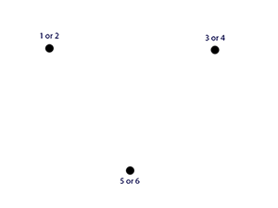
Penetration Tools – Domain 4.4
Fun example: Chaos Theory experiment in BASIC
  Put 3 dots in shape of a triangle on paper
  Label as shown
  Roll a six-side dice to determine start
  Then continue rolling the die:
    Rule is: move halfway to next indicated
    dot based on die roll and then
    place a new dot on the paper.
  Rinse and repeat

Slide 27

Chat Question
What do you think will happen if we write and run a program to do the Chaos Theory experiment? Will it fill in the triangle or ?
Answer in the chat window and let’s share.
This photo is for placement only

Slide 28
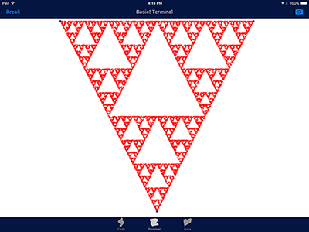
Penetration Tools – Domain 4.4

Slide 29
Penetration Tools – Domain 4.4
R = 3
X = 200
Y = 10
BGCOLOR 255,255,255
COLOR 0,0,255
CIRCLE 200,10,R
CIRCLE 840,10,R
CIRCLE 520,640,R
COLOR 255,0,0
R = 1
LOOP:
RN = RND
IF RN < 0.3333 THEN
DX = X - 200
DY = Y – 10
XMODE = 1
YMODE = 1
ELSE
IF RN < 0.6666 THEN
DX = 840 - X
DY = Y - 10
YMODE = 1
ELSE
IF X > 520 THEN
DX = X -520
DY = 640 - Y
XMODE = 1
ELSE
DX = 520 - X
DY = 640 - Y
END IF
END IF
END IF
IF XMODE = 1 THEN
X = X - (DX/2)
ELSE
X = X + (DX/2)
END IF
IF YMODE = 1 THEN
Y = Y - (DY/2)
ELSE
Y = Y + (DY/2)
END IF
POINT X,Y
XMODE = 0
YMODE = O
GOTO LOOP

Slide 30
Penetration Tools – Domain 4.4
BASH (Bourne-again shell) is a shell and command language written by Brian Fox for the GNU Project as a free software replacement for the Bourne shell. BASH is found on Unix (this includes Macs) and Linux computers and is usually the default shell on such systems. It also can be added to Windows in a number of ways.
BASH (and other) shell scripts are simply text files, often with the .sh file extension though this is not technically required.
One Note: For BASH (or other) shells scripts to run, they must be given the execute permission, usually with a command like: chmod 755 script.sh

Slide 31
Penetration Tools – Domain 4.4
PowerShell (originally known as Windows PowerShell) is a task automation and configuration management framework from Microsoft, consisting of a command-line shell and associated scripting language. PowerShell was made open-source and cross-platform in 2016 with the release of PowerShell Core. In PowerShell, tasks are generally performed by cmdlets (pronounced command-lets) and a series of cmdlets may be combined into scripts.
One Note: On Windows by default, PowerShell scripts are restricted. To run scripts, either change this restriction globally (not recommended) or make a custom PowerShell Shortcut using this command line:
powershell.exe -Execution Policy Unrestricted

Slide 32
Penetration Tools – Domain 4.4
Python is an interpreted high-level programming language for general-purpose programming which was created by Guido van Rossum in 1991. Python has a design philosophy that emphasizes code readability, using significant whitespace. It provides constructs that enable clear programming for both small and large scale projects.
Python features a dynamic type system and automatic memory management. It supports multiple programming paradigms including, but not limited to, object-oriented and procedural, and has a large and comprehensive standard library.

Slide 33
Penetration Tools – Domain 4.4
Ruby is a dynamic, interpreted, reflective, object-oriented, general-purpose programming language. It was designed and developed in the 1990s by Yukihiro "Matz" Matsumoto of Japan.
According to the Yukihiro, Ruby was influenced by Perl, Smalltalk, Eiffel, Ada, and Lisp. It supports multiple programming paradigms, including functional, object-oriented, and imperative.
Ruby has gained in prominence over the years, especially given the popularity of Ruby on Rails (or Rails), which is a server-side web application framework written in Ruby.
See: https://poignant.guide/

Slide 34
Penetration Tools – Domain 4.4
As we cover the basics in each language, compare and contrast them, and examine the Exam objectives, I will provide examples in all four languages of each concept. Most times these are identical examples, but not always.
Code snippets will be presented using the template to follow, which is divided into four areas, one for each language covered by the objectives.
I would advise most to pick one area/language and focus mainly on those.
Let’s start where every programming class starts – Hello World! ☺

Slide 35
Hello World
BASH
#!/bin/bash
#Hello World Bash Script
echo "Hello World!"
PowerShell
#Hello World PowerShell Script
echo "Hello World!"
Python
#Hello World Python Script
print (“Hello World!”)
Ruby
#!/usr/bin/ruby
#Hello World Ruby Script
puts "Hello World!"

Slide 36
Variables
BASH
#BASH variable declaration
SalesTaxRate = .0825
Note: Would use $SalesTaxRate to reference
PowerShell
#PowerShell variable declaration
$SalesTaxRate = .0825
Python
#Python variable declaration
SalesTaxRate = .0825
Ruby
#Ruby local variable declaration
_SalesTaxRate = .0825
Note: Ruby has many types of variables including Global ($), Local ( _ or lower case), Instance (@) and Class (@@)

Slide 37
Constants
BASH
#BASH constant declaration
readonly SalesTaxRate = .0825
PowerShell
#PowerShell constant declaration
Set-Variable SalesTaxRate -option Constant -value .0825
Python
There is no constant in Python core, though some people have created their own functions for this.
Ruby
#Ruby constant declaration
SalesTaxRate = .0825
Note: In Ruby a constant begins with a Capital letter.

Slide 38
Arrays I (Basic or Indexed Arrays)
BASH
#BASH array declaration
tempArray = (value1, value2, value3)
PowerShell
#PowerShell array declaration
$tempArray = @(value1, value2, value3);
Python - List
#Python list (array) declaration
tempArray = [value1, value2, value3]
Ruby
#Ruby array declaration
tempArray = [value1, value2, value3]

Slide 39
Arrays II (Accessing an Array item, note zero offset)
BASH
tempArray = (value1, value2, value3)
echo {$tempArray[0]}
Would output value1
PowerShell
$tempArray = @(val1, val2, val3);
echo $tempArray[1]
Would output val2
Python - List
tempArray = [value1, value2, value3]
print (tempArray[2])
Would output value3
Ruby
tempArray = [value1, value2, value3]
puts tempArray[0]
Would output value1

Slide 40
Arrays III (Named or Associative Arrays)
BASH
declare -A MyArray
MyArray[foo]=bar
echo ${MyArray[foo]}
Would output bar
PowerShell
$MyArray = @{}
$MyArray.foo = 'bar‘
echo $MyArray.foo
Would output bar
Python - Dictionary
MyArray = [{“foo”: “bar”}]
print (MyArray[“foo”])
Would output bar
Ruby
_MyArray = {“foo” => bar”}
puts _MyArray[“foo”]
Would output bar

Slide 41
IF Statements
BASH
if [$TotalSales -gt $BonusThreshold] then
# Code to calculate bonus here
fi
PowerShell
If ($TotalSales -gt $BonusThreshold) { # Code to calculate bonus here
}
Python
if TotalSales > BonusThreshold:
# Code to calculate bonus here
Ruby
if _TotalSales > _BonusThreshold
# Code to calculate bonus here
end

Slide 42
IF / ElseIf (or Elsif or Elif)/ Else Statements
BASH
if [<condition>] then
# Code here
elif [<condition>] then
# Code here
else
# Code here
fi
PowerShell
if (<condition>) {
# Code here
} elseif (<condition>) {
#Code here
} else {
#Code here
}
Python
if <condition>:
# Code here
elif <condition>:
# Code here
else:
# Code here
Ruby
if <condition>
# Code here
elsif <condition>
# Code here
else
# Code here
end

Slide 43
Loops
BASH – While Loop
while [$this -eq $that]
do
# commands
done
PowerShell – Do While Loop
Do {
# commands
} While ($this -eq $that)
Python – For Loop
tempArray = [value1, value2, value3]
for x in tempArray:
print (x)
Ruby – For Loop
tempArray = [value1, value2, value3]
for x in tempArray
puts x
end

Slide 44
Comparison Operators
BASH
For integers Bash uses: -eq (equal), -ne (not equal), -gt (greater than), -ge (greater or equal), -lt (less than), and -le (less or equal)
For strings Bash uses: = or == (equals), != (not equal), > (greater), and < (less)
PowerShell
PowerShell uses: eq (equals), ne (not equal), gt (greater than), ge (greater or equal), lt (less than), and le (less or equal)
Python
Python uses: == (equal), != or <> (not equal), > (greater than), >= (greater or equal), < (less than), and <= (less than or equal)
Ruby
Ruby uses: == (equal), === (equal in case statements), != (not equal), > (greater than), >= (greater or equal), < (less than), and <= (less than or equal)

Slide 45
String Operations
BASH
testString = “Test String”
echo ${#testString} # Returns 11
echo ${testString:0:4} # Returns Test
echo ${testString/Test/Testing} # Returns Testing String
PowerShell
$testString = “Test String”
echo $testString + “2” # Returns Test String2
$testString.Substring(0,4) # Returns Test
Python
testString = “Test String”
print testString.uppercase #Returns TEST STRING
print testString.replace(“Test”, “Testing”)
#Returns Testing String
Ruby
testString = “Test String”
print testString.length # Returns 11
print testString.upcase # Returns TEST STRING

Slide 46
I/O (Input/Output)
BASH
echo “Please enter your name”
read userName
echo “Hello $username!”
PowerShell
$userName = Read-Host -Prompt 'Please enter your name‘
Echo “Hello “ + $username
Python
userName = input(‘Please enter your name ')
print (“Hello “, userName)
Ruby
puts “Please enter your name”
userName = gets
puts “Hello “ + userName

Slide 47
I/O Continued
BASH
tempFile=$(<test.txt)
echo "$tempFile“
Bash can make use of system resources and utilities to access remote files.
PowerShell
$tempFile = Get-Content - Path C:\test.txt
Can use Where-Object cdmlet to search
PowerShell has numerous networking & TCP cmdlets like Get-NetIPAddress
Python
tempFile = open(‘test.txt', 'w')
The w in this example stands for write, there is also read (r) and read/write (r+)
tempFile = open(‘//Host/share/test.txt', 'w')
Ruby
File.open(‘test.txt’)
File.open(test.txt, 'w') { |file| file.write(“test text") }
Use open-uri Library to access via URLs.

Slide 48
Error handling
BASH
cd $some_directory
if [ "$?" = "0" ]; then
rm *
Else
echo "Cannot change directory!" 1>&2 exit
fi
PowerShell
Function Do-Something {
[CmdletBinding()]
param()
try {
if (-not (Test-Path –Path 'C:\test.txt')) {
Write-Host 'The file does not exist'
}
Write-Host 'The file does exist'
} catch {
}
}
Python
try:
print 1/0
except ZeroDivisionError:
print "You can't divide by zero!"
Ruby
def raise_and_rescue
begin
puts 'I am before the raise.‘
raise 'An error has occured.‘
puts 'I am after the raise.‘
rescue
puts 'I am rescued.‘
end
puts 'I am after the begin block.‘
end
raise_and_rescue

Slide 49
Encoding / Decoding
When we talk about encoding and decoding within the programming context we are generally referring to various encoding standards like ASCII (American Standard Code for Information Interchange). Of course custom encoding/decoding can also be done. Common standards include:
  ASCII (American Standard Code for Information Interchange)
  ISO/IEC 10646, Information technology — Universal Coded Character Set (UCS)
  Unicode
    UTF-8 (first 128 Unicode points are the ASCII characters)
    UTF-16 (extends UCS-2)
    UTF-32 (as known as UCS-4)

Slide 50
DEMO
Development set up on Dev-Client VM

Slide 51
Demo – Basic Command Reference
VSCode is found below Firefox on the favorite bar.
But for all of the languages you can also play at the terminal:
  BASH: Open a terminal, BASH is the default shell.
  PowerShell: Type pwsh and hit Enter at the terminal to start Powershell, use exit to close.
  Python: Type python3 and hit Enter at the terminal to start the interactive environment. Use quit() to close.
  Ruby: Type irb and hit Enter at the terminal to start the interactive environment, use exit to close.

Slide 52
Demo – Basic Command Reference
When creating scripts remember:
  BASH: BASH scripts usually are given a .sh file extension and must be given the execute permission using some like:
    chmod 755 script-name.sh
  PowerShell: By convention, PowerShell scripts are given a .ps1 file extension and can be run using something like: pwsh script-name.ps1
  Python: Python scripts or programs are generally given a .py file extension and can be run using something like: python3 script-name.py
  Ruby: Ruby scripts or programs are generally given a .rb file extension and must be given the execute permission using some like:
    chmod 755 script-name.rb

Slide 53
Homework for next class!
Use the provided Dev-Client virtual machine to play around with scripting and programming. Log into this VM using dev/dev and you will find that it has all four languages covered in the objectives and VSCode as an editor (though you can use the vi or nano editors in the terminal as well).
Try some of the example code blocks, or better yet combine some to see if you can produce some working scripts in the language(s) of your choice.
Or download some sample scripts (you can change VM to NAT for this).
Bonus homework: Attempt to rewrite Lee’s Chaos Theory experiment in one of the languages covered in the objectives. Note: You’ll have to do some additional research as graphical type functions have not been shown.

Slide 54
Next Class!
Reporting and Communications I - Domains 5.1 and 5.2
  Report writing and handling best practices
  Post-report delivery activities
We will be mainly using the Kali Linux VM for this session.
Over the last few sessions, we will also be presenting some Red/Blue team and Capture the Flag (CTF) concepts and activities.

Slide 55

Discussion time: Please type your questions in chat
Questions over content.
Share you experience.
What would you like to see
different moving forward?
Let’s keep the going on LinkedIn in the CompTIA Instructor Forum: http://bit.ly/2wMU4nL

