Slide 1


PenTest+ TTT Session 10: Reporting and Communications I
07/19/2018
@TeachCompTIA #PenTestPlusTTT

Slide 2



Housekeeping
Unmute your speakers.
Use Chrome if you have issues
  Enable Flash: Chrome://settings/content flash settings enabled
Recording will be distributed within two hours. Slides and homework can be downloaded from the resource widget. You are able to do this via the recording as well.
Submit questions via the Q&A. The questions will be answered as submitted throughout the sessions.

Slide 3







Take Control of Your Console
Widgets are resizable and movable
Use the controls to minimize or maximize a widget
Drag the bottom right hand corner to resize it
Click the icon to download resources & bookmark helpful links
Chat with the audience and instructor by clicking the Group Chat icon and enter you questions or comments
Have a question? Click the Q&A icon and enter your questions
You can print your Certification of Attendance using the certification widget , after attending at least 110 minutes of the session
Do you have an idea or resource? We are trying the Idea widget out. Share resources you are using by typing in the Idea widget
The media player will show video, and when the instructor shares the screen, will show shared content.

Slide 4


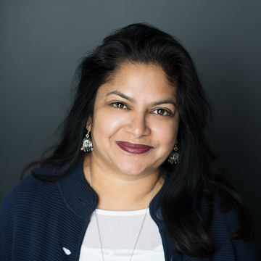
Welcome to the Train-the-Trainer Series
Instructor:
T. Lee McWhorter, Jr.
IT Expert Generalist and Educator
lee@mcwhortertechnologies.com
Host:
Stephen Schneiter
Instructor Network Program Manager
CompTIA
sschneiter@comptia.org
Host:
Tazneen Kasem
Director. Product Management
Network+, CTT+, Project+ & CIN
CompTIA
tkasem@comptia.org
4

Slide 5

Agenda
Session Objectives
Review
Report writing
Best practices
Importance of communications

Slide 6
PenTest+ PT0-001 TTT Session Outline
Date | Topic
05/29/2018 | Introduction: CompTIA program information, Tech review (Labs, GNS3 Project, & VMs), and Planning and Scoping I.
05/31/2018 | Planning and Scoping II: Penetration testing engagement scoping and compliance-based assessments.
06/05/2018 | Information Gathering: Scanning, enumerating and the many other means of information gathering.
06/07/2018 | Vulnerability Identification: Vulnerability scanning and analysis to prepare for exploitation.
06/12/2018 | Attacks and Exploits I: Social engineering attack types and physical security.
06/14/2018 | Attacks and Exploits II: Network-based, wireless & RF-based, and application vulnerabilities.
✓
✓
✓
✓
✓
✓

Slide 7
PenTest+ PT0-001 TTT Session Outline
Date | Topic
06/26/2018 | Attacks and Exploits III: Local host vulnerabilities and post-exploitation techniques.
06/28/2018 | Penetration Tools I: Using and analyzing output from Nmap, Netcat and other penetration testing tools and utilities.
07/17/2018 | Penetration Tools II: Programming and scripting overview (BASH, PowerShell, Python & Ruby).
07/19/2018 | Reporting and Communications I: Report writing and handling best practices, and the importance of communications.
07/24/2018 | Reporting and Communications II: Recommending mitigation strategies and other post-report activities.
07/26/2018 | Wrap up: Final review, demos, and best practices as well as CompTIA wrap up information and survey.
✓
✓
✓
✓

Slide 8



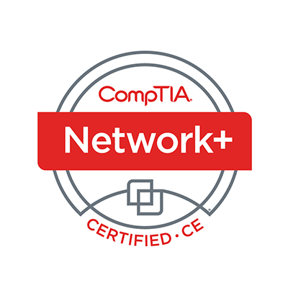
Welcome
Lee McWhorter
Instructor
Lead Author
Woz U Cyber Security Program
lee@mcwhortertechnologies.com

Slide 9
POLL
Functions in procedural programming and Methods in object-oriented programming are really the same thing? True or False
True
False

Slide 10
POLL – Answer Slide
Functions in procedural programming and Methods in object-oriented programming are really the same thing? True or False
True
False

Slide 11
POLL
Which of the following are types of Loops supported by the languages in the Exam objectives?
For Loop
While Loop
Do While Loop
All of the above are supported loops
None of the above are supported loops

Slide 12
POLL – Answer Slide
Which of the following are types of Loops supported by the languages in the Exam objectives?
For Loop
While Loop
Do While Loop
All of the above are supported loops
None of the above are supported loops

Slide 13
POLL
Which of the languages in the Exam objectives uses an IF statement like that shown below:
if TotalSales > BonusThreshold:
# Code to calculate bonus here
Ruby
Python
PowerShell
BASH

Slide 14
POLL – Answer Slide
Which of the languages in the Exam objectives uses an IF statement like that shown below:
if TotalSales > BonusThreshold:
# Code to calculate bonus here
Ruby
Python
PowerShell
BASH

Slide 15
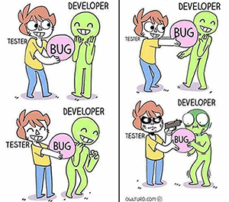
A little Programming Humor before we move one ☺

Slide 16
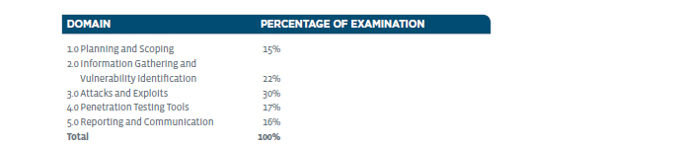
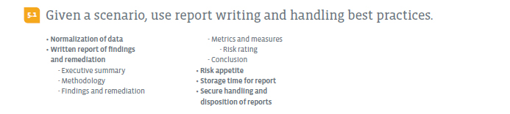
Reporting and Communication – Domain 5.1

Slide 17
Reporting and Communication – Domain 5.1
Normalization of data
  Normalization of data can have a range of meanings, including Statistical normalizations and Database normalizations. For our purposes we are talking more about Statistical normalization.
    Normalization of ratings means adjusting values measured on different scales to a common scale, often when the goal of generating averages.
    In addition, for more complex cases, this can mean more advanced adjustments designed to bring the entire probability distributions of adjusted values into alignment.
    Additional examples include normalizing education scores so that we align the distribution of scores to a normal distribution (think curving grades) and normalizing values in time series data to account for things like inflation.

Slide 18

Chat Question
How do you think the normalization of data applies to Pen Tests and what types of data might need to be normalized?
Answer in the chat window and let’s share.
This photo is for placement only

Slide 19
Reporting and Communication – Domain 5.1
Normalization of data
  One example I found from a Pen Testing company’s web site was like this:
    (Note: I made slight editorial changes as appropriate)
    “our penetration testers efficiently correlate and normalize all scanning data to recommend a best set of remediation actions for any potential vulnerabilities”
    “our system automates vulnerability results, data aggregation, and reporting so our ethical hackers can focus on…”
    Note: For a bit more on the stats see: http://www.statisticshowto.com/normalized/

Slide 20
Reporting and Communication – Domain 5.1
Normalization of data
  Maltego
    Maltego is an interactive data mining tool that renders directed graphs for link analysis. The tool is used in online investigations for finding relationships between pieces of information from various sources located on the Internet.
    Maltego fits here at least indirectly for the data work it does behind the scene and reporting functions. It also could have been covered in the Information Gathering Domain given how it brings together so much data from various public sources.
    Maltego CE is the community version of Maltego that is available for free after an online registration. Maltego CE includes most of the same functionality as the commercial version however it has some limitations. It is included with Kali Linux and can be found on the favorite bar and under Reporting Tools on the main menu.

Slide 21
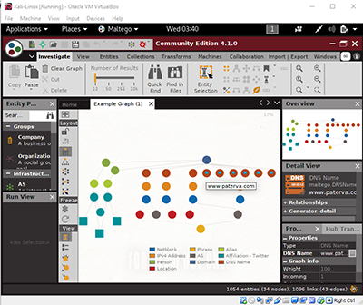
Reporting and Communication – Domain 5.1
Normalization of data
  Maltego can be used to determine
  the relationships between:
    People
      Names
      Email addresses
      Aliases
    Groups of people (social networks)
    Companies
    Organizations
    Web sites
    Internet infrastructure such as:
      Domains
      DNS names
      Netblocks
      IP addresses
    Affiliations
    Documents and files

Slide 22
Reporting and Communication – Domain 5.1
Normalization of data
  Maltego
  Connections between all the pieces of information are found using open source intelligence (OSINT) techniques by querying sources such as DNS records, Whois records, search engines, social networks, various online APIs and extracting meta data.
    A Couple Maltego tutorials:
      https://www.computerweekly.com/tip/Maltego-tutorial-Part-1-Information-gathering
      https://resources.infosecinstitute.com/maltego-making-sense-data/#gref

Slide 23
Reporting and Communication – Domain 5.1
Written report of findings and remediation
  Executive summary – A short introduction, overview and summary that starts our report. Generally intended for review by upper management who likely won’t read the details or the whole report. ☺
  Methodology – details the methods and techniques used in the test.
  Findings and remediation – What was found and how to fix it.
  Metrics and measures – Used to rank and detail findings (see below).
    Risk rating – Rating of risk (low, medium, high, critical) of found vulnerabilities.
  Conclusion – Wrap and final summary of report findings.

Slide 24
DEMO
Sample Pen Test report show and tell

Slide 25
Demo – Basic Reference
The sample Hacme Bank Pentest Report shown comes from OWASP (Open Web Application Security Project).
The sample report can be found on Sourceforge via the following Google link:
  https://www.google.com/url?sa=t&rct=j&q=&esrc=s&source=web&cd=2&ved=0ahUKEwig4svshKjcAhUIP6wKHdRfCZ4QFgg1MAE&url=https%3A%2F%2Fsourceforge.net%2Fp%2Fowasp%2Fmailman%2Fattachment%2F4453FF1F.2070305%2540ddplus.net%2F1%2F&usg=AOvVaw1n4gj5LG5EzJusrZ_gF1eT
  It is a PDF and illustrates the main concepts outlined in the objectives except, strangely enough, it has no conclusion and is ordered a bit differently.

Slide 26
Reporting and Communication – Domain 5.1
Some other Reporting Tools found in Kali Linux
  “Dradis CE is an extensible, cross-platform, open source reporting framework for generating one-click reports that’ll save you hours on every project.”
    https://dradisframework.com/ce/
  “MagicTree is a penetration tester productivity tool. It is designed to allow easy and straightforward data consolidation, querying, external command execution and (yeah!) report generation.”
    https://www.gremwell.com/what_is_magictree

Slide 27
Reporting and Communication – Domain 5.1
Risk appetite – We discussed the clients’ Risk appetite in the Planning and Scoping stage. It has two impacts in this stage. 1) If client had low Risk appetite, our report would mention this given the possibility we missed things in our test taking this into account. 2) This will help guide us in ranking and reporting of found vulnerabilities.
Storage time for report (see below)
Secure handling and disposition of reports
  Both of the above are related to document security given the sensitive information a pen test report can contain. Usually contract will call for limit on how long report is stored and how it should be encrypted and transferred.

Slide 28
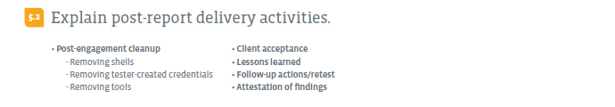
Reporting and Communication – Domain 5.2

Slide 29
Reporting and Communication – Domain 5.2
Post-engagement cleanup
  Removing shells
    We are generally required to remove any shells used during a penetration test. Often this is written in the statement of work that no backdoors will be left in a client’s systems.
  Removing tester-created credentials
    It is also important to remove any tester created credentials because not only does this leave a possible future vulnerability, but can also cause mistrust with the client.
  Removing tools
    Removing any tools that were used is critical so that they are not used by users once the testing concludes. Many outside pen testers also do not want to leave their tools for fear clients will use them without their involvement in future.

Slide 30
Reporting and Communication – Domain 5.2
Client acceptance
  Just like with the Planning and Scoping phase where it was important to get appropriate permissions and sign offs for the testing, it is also very important to make sure the client accepts the report and findings. Often, who should sign off on the final report is in the contract and this is then often tied to final payment.
Lessons learned
  Applies both to the lessons learned and findings that we report to the client, as well as to the lessons learned by the pen testing team to better prepare for future engagements.

Slide 31
Reporting and Communication – Domain 5.2
Follow-up actions/retest
  In addition to any post testing clean up already discussed, there may be other steps required in the contract, including retests at a later date. This is often used to see whether the recommended remediation steps have been properly implemented based on the initial test’s findings.
Attestation of findings
  Attestation means “an act or instance of attesting something such as proving of the existence of something through evidence or an official verification of something as true or authentic such as a notary's attestation of the will.”
  We have to verify our findings to the client or possibly regulators/auditors.

Slide 32
Red/Blue Team Concepts and Activities
Red Team-Blue Team exercises take their name from their military antecedents. The idea is simple: one group of security pros — a Red Team — attacks something, and an opposing group — the Blue Team — defends it.
A Red Team is a group of highly skilled experts hired to provide adversarial services, i.e., to act like attackers. The goal of Red Team operations is to continuously challenge the plans, defensive measures, and security concepts of the organization.
A Blue Team exists to defend against attackers while continually improving an organization's security posture. Blue Team professionals are expected to determine false positives & react quickly to any possible malicious events.

Slide 33
Red/Blue Team Concepts and Activities
Red Team-Blue Team activities can take many forms, but one of the most common types is Capture the Flag (CTF).
Many of us will have fond memories of playing Capture the Flag as a kid. Running through the woods or park, trying to slip by your friends on the 'enemy' team to sneak into their base and take their Flag - good times.
In computing, capture the flag activities usually take the form of virtual networks or servers which have been designed to not only test our skills but to have a bit of fun. We find ‘flags’ by using the skills and techniques of a pen tester. These flags usually provide clues to additional flags, often leading to the ultimate goal of acquiring the root flag and access.

Slide 34
Chat Question
Have any of your done any CTF events and/or attempted any CTF VM’s yourself?
Answer in the chat window and let’s share.
This photo is for placement only

Slide 35
Red/Blue Team Concepts and Activities
There are many resources and guides for conducting CTF activities, as well as many groups and leagues.
A source of many great CTF virtual machine systems is Vulnhub.com and this is the source of the CTF VM I am providing for your learning and fun.
Some other related resources:
  Tools and Resources to Prepare for a Hacker CTF Competition or Challenge
    https://resources.infosecinstitute.com/tools-of-trade-and-resources-to-prepare-in-a-hacker-ctf-competition-or-challenge/#gref
  Security Scenario Generator (SecGen)
    https://github.com/cliffe/SecGen

Slide 36
Red/Blue Team Concepts and Activities
The Rickdiculously Easy Capture the Flag VM has been provided for use with the other provided VMs, particularly Kali Linux.
This VM can be downloaded from either the CIN Box account or from my website. This copy has been built to work with the provided Kali VM and except for the VirtualBox host-only adapter networking change, this VM is as originally designed. This VM was built by Luke and can be found on vulnhub.com.
Simply download the VM and import into VirtualBox. Once it boots up, it’s IP can be found on it’s login screen.
Fire up the Kali Linux VM and check it out. ☺

Slide 37
Homework for next class!
Use the provided Kali Linux virtual machine to play around with some of the reporting tools.
Check out the RickdiculouslyEasy VM that was made available tonight. Can you find some flags using the tools and skills you have learned during this course?
The VM can be downloaded from either the CIN Box account or my website:
http://www.mctechs.com/CompTIA/PenTest+TTT/!Project-and-VM-files/

Slide 38
Next Class!
Reporting and Communications II - Domains 5.3 and 5.4
  Recommend mitigation strategies for discovered vulnerabilities
  importance of communication during the penetration testing process
We will be mainly be using the RickdiculouslyEasy VM for this session.
We will also have some poll questions on additional and/or review topics you would like to see covered during our last wrap up session.

Slide 39
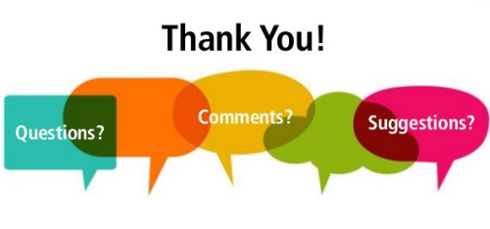
Discussion time: Please type your questions in chat
Questions over content.
Share you experience.
What would you like to see
different moving forward?
Let’s keep the going on LinkedIn in the CompTIA Instructor Forum: http://bit.ly/2wMU4nL

