Slide 1


PenTest+ TTT Session 11: Reporting and Communications II
07/24/2018
@TeachCompTIA #PenTestPlusTTT

Slide 2



Housekeeping
Unmute your speakers.
Use Chrome if you have issues
  Enable Flash: Chrome://settings/content flash settings enabled
Recording will be distributed within two hours. Slides and homework can be downloaded from the resource widget. You are able to do this via the recording as well.
Submit questions via the Q&A. The questions will be answered as submitted throughout the sessions.

Slide 3







Take Control of Your Console
Widgets are resizable and movable
Use the controls to minimize or maximize a widget
Drag the bottom right hand corner to resize it
Click the icon to download resources & bookmark helpful links
Chat with the audience and instructor by clicking the Group Chat icon and enter you questions or comments
Have a question? Click the Q&A icon and enter your questions
You can print your Certification of Attendance using the certification widget , after attending at least 110 minutes of the session
Do you have an idea or resource? We are trying the Idea widget out. Share resources you are using by typing in the Idea widget
The media player will show video, and when the instructor shares the screen, will show shared content.

Slide 4



Welcome to the Train-the-Trainer Series
Instructor:
T. Lee McWhorter, Jr.
IT Expert Generalist and Educator
lee@mcwhortertechnologies.com
Host:
Stephen Schneiter
Instructor Network Program Manager
CompTIA
sschneiter@comptia.org
Host:
Tazneen Kasem
Director. Product Management
Network+, CTT+, Project+ & CIN
CompTIA
tkasem@comptia.org
4

Slide 5

Agenda
Session Objectives
Review
Recommending mitigation strategies
Other post-report activities

Slide 6
PenTest+ PT0-001 TTT Session Outline
Date | Topic
05/29/2018 | Introduction: CompTIA program information, Tech review (Labs, GNS3 Project, & VMs), and Planning and Scoping I.
05/31/2018 | Planning and Scoping II: Penetration testing engagement scoping and compliance-based assessments.
06/05/2018 | Information Gathering: Scanning, enumerating and the many other means of information gathering.
06/07/2018 | Vulnerability Identification: Vulnerability scanning and analysis to prepare for exploitation.
06/12/2018 | Attacks and Exploits I: Social engineering attack types and physical security.
06/14/2018 | Attacks and Exploits II: Network-based, wireless & RF-based, and application vulnerabilities.
✓
✓
✓
✓
✓
✓

Slide 7
PenTest+ PT0-001 TTT Session Outline
Date | Topic
06/26/2018 | Attacks and Exploits III: Local host vulnerabilities and post-exploitation techniques.
06/28/2018 | Penetration Tools I: Using and analyzing output from Nmap, Netcat and other penetration testing tools and utilities.
07/17/2018 | Penetration Tools II: Programming and scripting overview (BASH, PowerShell, Python & Ruby).
07/19/2018 | Reporting and Communications I: Report writing and handling best practices, and the importance of communications.
07/24/2018 | Reporting and Communications II: Recommending mitigation strategies and other post-report activities.
07/26/2018 | Wrap up: Final review, demos, and best practices as well as CompTIA wrap up information and survey.
✓
✓
✓
✓
✓

Slide 8



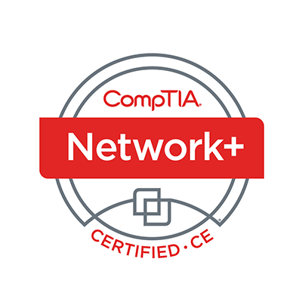

Welcome
Lee McWhorter
Instructor
Lead Author
Woz U Cyber Security Program
lee@mcwhortertechnologies.com

Slide 9
POLL
Which of the following should be part of a Pen Testing report?
Executive Summary
Conclusion
Metrics and measures
Methodology
All of the Above

Slide 10
POLL – Answer Slide
Which of the following should be part of a Pen Testing report?
Executive Summary
Conclusion
Metrics and measures
Methodology
All of the Above

Slide 11
POLL
Maltego is?
is an extensible, cross-platform, open source reporting framework for generating reports.
is a tool for data consolidation, querying, external command execution and report generation.
is an interactive data mining tool that renders directed graphs for link analysis.
None of the above

Slide 12
POLL – Answer Slide
Maltego is?
is an extensible, cross-platform, open source reporting framework for generating reports.
is a tool for data consolidation, querying, external command execution and report generation.
is an interactive data mining tool that renders directed graphs for link analysis.
None of the above

Slide 13
POLL
It is important to remove any shells, credentials, and tools used in a Pen Test because of which of the following reason?
To not cause mistrust with the client
To not leave a vulnerability behind
To avoid these things being taken advantage of by other users
None of the above
All of the above

Slide 14
POLL – Answer Slide
It is important to remove any shells, credentials, and tools used in a Pen Test because of which of the following reason?
To not cause mistrust with the client
To not leave a vulnerability behind
To avoid these things being taken advantage of by other users
None of the above
All of the above

Slide 15
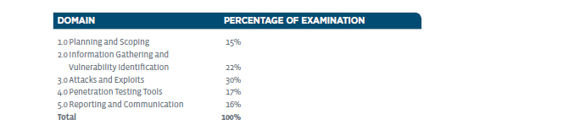
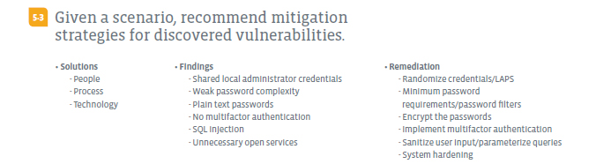
Reporting and Communication – Domain 5.3

Slide 16
Reporting and Communication – Domain 5.3
Solutions
  People
    Could mean hire more people, but less likely in most situations
    Mainly means TRAINING and policy enforcement
  Process
    From formal password and AUP (acceptable use policy) type policies to documented system setup and configuration guidelines
  Technology
    Mandatory access controls, Intrusion Protection System, among many other possible technical solutions for found problems.

Slide 17
Reporting and Communication – Domain 5.3
Findings
  Shared local administrator credentials
  Weak password complexity
  Plain text passwords
    Shared, weak or plain text passwords are very common despite our best efforts to prevent these practices.
  No multifactor authentication
    Even good passwords are potentially vulnerable.
  SQL injection
  Unnecessary open services
    Poor web application design or improperly configured systems are common.

Slide 18
Reporting and Communication – Domain 5.3
Remediation
  Randomize credentials/LAPS (Local Administrator Password Solution)
    https://technet.microsoft.com/en-us/mt227395.aspx
  Minimum password requirements/password filters
    Password filters provide a way for you to implement password policy and change notification.
    https://docs.microsoft.com/en-us/windows/desktop/secmgmt/password-filters
    https://www.slideshare.net/nFrontSecurity/how-do-password-filters-work
    https://haveibeenpwned.com/API/v2
  Encrypt the passwords
    Well doh! ☺ Mainly through using secure protocols (i.e., SCP over FTP, etc.)

Slide 19
Reporting and Communication – Domain 5.3
Remediation
  Implement multifactor authentication
    Multifactor authentication (MFA) is a security system that requires more than one method of authentication from independent types of credentials (see below) to verify the user's identity.
    Know (something the user and only the user knows), Have (something the user and only the user has), and Are (something the user and only the user is).
  Sanitize user input/parameterize queries
    These means stripping out special characters and error checking any user input to make sure additional commands, code, etc. will not be processed.
  System hardening

Slide 20
Reporting and Communication – Domain 5.3
Findings
  Shared administrator credentials
  Weak password complexity
  Plain text passwords
  No multifactor authentication
  SQL injection
  Unnecessary open services
Remediation
  Randomize credentials/LAPS
  Minimum password and/or filters
  Encrypt the passwords
  Use multifactor authentication
  Sanitize user input/queries
  System hardening

Slide 21
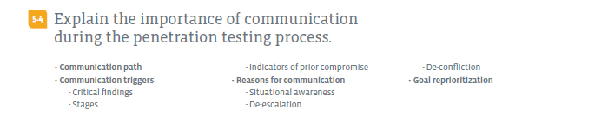
Reporting and Communication – Domain 5.4

Slide 22

Reporting and Communication – Domain 5.4
Communication path
  Typically during a Pen Test, a communication path has been defined as to who will be contacted when certain events happen during the test.

Slide 23

Chat Question
Put your thinking cap on… What types of things or events could happen during a Pen Test that might rank as Level IV on the previous graphic?
Answer in the chat window and let’s share.
This photo is for placement only

Slide 24
Reporting and Communication – Domain 5.4
Communication triggers
  Critical findings
    If we find the ‘keys to the castle’ at any stage we would generally want to follow the communication path and let the client know as soon as possible. This could lead to another exam objection: goal reprioritization.
  Stages
    Unless the test is done completely blind to the ‘blue team’ or internal IT/Security team, then it is usually common practice to report when stages are complete.
  Indicators of prior compromise
    Similar to the first, Critical Findings, if we break into a system and find tools and other indicators that “Kilroy was here”, then we generally stop and inform the client so they can immediately address the previous (or current?) breach…

Slide 25
Reporting and Communication – Domain 5.4
Reasons for communication
  Situational awareness
    Keep key members of the internal team informed, likely at agreed upon stages of the testing.
  De-escalation
  De-confliction
    Even in a blind test, we don’t necessarily want the ‘blue team’ or internal IT/Security team in all out war with the ‘red team’ or pen testers. The responses of the blue team could impact red team findings or actually take services offline, etc.
Goal reprioritization
  There are many reasons the goals of a pen test could change.

Slide 26
Chat Question
What do you think could be some reasons why the goals of a Pen Test would change during the course of a testing engagement?
Answer in the chat window and let’s share.
This photo is for placement only

Slide 27
DEMO
More Fun with the RickdiculouslyEasy CTF VM

Slide 28
Demo – Basic Reference
The RickdiculouslyEasy VM was provided last class for you to try out. We briefly looked at it and did some basic nmap scans.
Tonight we did some more in depth nmap scans:
  nmap -p 1-65535 ip_of_vm (see next slide)
  nmap - A -p 1-65535 ip_of_vm (Not shown: this can take long time… better to scan individual ports shown open with previous scan)
and checked out some of the base services offered by the VM, including:
  The HTTP server - nmap -A -p 80 ip_of_vm and with Firefox browser
  The FTP server - nmap -A -p 21 ip_of_vm and FTP login
  The SSH server - nmap -A -p 22 ip_of_vm and SSH login

Slide 29
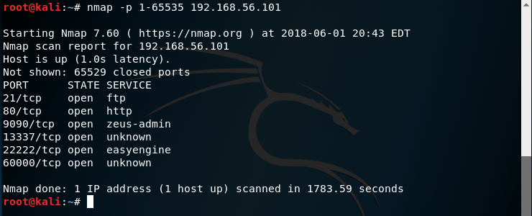
Demo – Basic Reference
The RickdiculouslyEasy
  nmap -p 1-65535 ip_of_vm

Slide 30
Demo – Basic Reference
The RickdiculouslyEasy VM
  https://www.vulnhub.com/entry/rickdiculouslyeasy-1,207/
This is a Fedora server VM, created with Virtualbox.
It is a very simple Rick and Morty themed boot to root.
There are 130 points worth of flags available (each flag has its points recorded within it) and you should also get root.
It's designed to be a beginner CTF, if you're new to pen testing, check it out!

Slide 31
CompTIA PenTest+ Acronyms
ACL Access Control List
ADFS Active Directory Federation Services
AP Access Point
API Application Programming Interface
APNS Apple Push Notification Service
APT Advanced Persistent Threat
ASLR Address Space Layout Randomization
BPA Business Partnership Agreement
CA Certificate Authority
CAPEC Common Attack Patterns Enumeration Classification
CERT Computer Emergency Response Team
CGI Common Gateway Interface
CIFS Common Internet File System
CIRT Computer Incident Response Team
CORS Cross-Origin Request Scripting
COTS Commercial Off-The-Shelf

Slide 32
CompTIA PenTest+ Acronyms
CRL Certificate Revocation List
CSRF Cross-Site Request Forgery
CVE Common Vulnerabilities Exposures
CVSS Common Vulnerability Scoring System
CWE Common Weakness Enumeration
DAST Dynamic Application Security Testing
DCOM Distributed Component Object Model
DFD Data Flow Diagram
DLL Dynamic Link Library
DNS Domain Name Service
DOM Document Object Model
DoS Denial of Service
DTP Dynamic Trunking Protocol
ECDSA Elliptic Curve Digital Signature Algorithm
EULA End User License Agreement
FTP File Transfer Protocol
GPO Group Policy Object

Slide 33
CompTIA PenTest+ Acronyms
GPP Generic Packetized Protocol
GRE Generic Routing Encapsulation
HSTS HTTP Strict Transport Security
HTML HyperText Markup Language
I/O Input/Output
ICMP Internet Control Message Protocol
ICS Industrial Control Systems
IDOR Indirect Object Reference
IoT Internet of Things
IPS Intrusion Prevention System
IV Initialization Vector
JPCERT Japan Computer Emergency Response Team
JTAG Joint Test Action Group
LAPS Local Administrator Password Solution
LFI Local File Inclusion
LLMNR Link-Local Multicast Name Resolution

Slide 34
CompTIA PenTest+ Acronyms
LSASS Local Security Authority Subsystem Service
MDM Mobile Device Management
MFA Multifactor Authentication
MITM Man-in-the-Middle
MSA Master Service Agreement
NAC Network Access Control
NBNS Net Bios Name Service
NDA Non-Disclosure Agreement
NFC Near-Field Communication
NIST National Institute of Standards and Technology
NOP No Operation
NSE Network Service Engine
OS Operating System
OSINT Open Source Intelligence
OWASP Open Web Application Security Project
PII Personally Identifiable Information

Slide 35
CompTIA PenTest+ Acronyms
POS Point of Sale
PS PowerShell
RCE Remote Code Execution
RDP Remote Desktop Protocol
RFI Remote File Inclusion
RFID Radio Frequent ID
RFP Request for Proposal
ROE Rules of Engagement
RPC Remote Procedure Call
RSH Remote Shell
RTOS Real Time Operating System
SAM Security Account Manager
SAN Subject Alternative Name
SAST Static Application Security Testing
SCADA Supervisory Control and Data Acquisition
SCEP Simple Certificate Enrollment Protocol

Slide 36
CompTIA PenTest+ Acronyms
SCP Secure Copy
SDK Software Development Kit
SGID Set Group ID
SID Secure Identifier
SIEM Security Incident Event Manager
SLA Service Level Agreement
SMB Server Message Block
SMTP Simple Mail Transfer Protocol
SNMP Simple Network Management Protocol
SOAP Simple Object Access Protocol
SOC Security Operation Center
SOW Statement of Work
SPN Service Principle Name
SQL Structured Query Language
SSH Secure Shell
SSL Secure Sockets Layer

Slide 37
CompTIA PenTest+ Acronyms
STP Spanning Tree Protocol
SUID Set User ID
TCP Transmission Control Protocol
TLS Transport Layer Security
TOTP Time-Based One-Time Password
TPM Trusted Platform Module
TTP Tactics, Techniques and Procedures
UDP User Diagram Protocol
VLAN Virtual Local Area Network
VM Virtual Machine
VNC Virtual Network Connection
VPN Virtual Private Network
WADL Web Application Description Language
WAF Web Application Firewall
WAR Web Application Archive
WEP Wired Equivalency Protocol

Slide 38
CompTIA PenTest+ Acronyms
WinRM Windows Remote Management
WMI Windows Management Instrumentation
WPAD Web Proxy Auto-Discovery
WPS WiFi Protected Setup
WSDL Web Services Description Language
XSD XML Schema Document
XSS Cross-Site Scripting
XST Cross-Site Tracing
XXE External Entity
This is all an exact reproduction of the CompTIA PenTest+ Acronyms list from the new PenTest+ Exam Objectives, but I figured this would be a good place to put them as reference.
Plus I personally have found studying these are a major part of preparation for a CompTIA exam.

Slide 39
POLL
Which of the following PenTest+ Domains would you most like to see more information on in our Wrap Up session?
Domain #1 - Planning and Scoping
Domain #2 - Information Gathering and Vulnerability Identification
Domain #3 - Attacks and Exploits
Domain #4 - Penetration Testing Tools
Domain #5 - Reporting and Communication

Slide 40
POLL
Which of the following technologies presented during this course would you like most to learn more about during our final Wrap Up session?
VirtualBox or virtualization
GNS3
The provided GNS3 topology
The provide VirtualBox virtual machines

Slide 41
Chat Question
What else would you like to see covered in our final Wrap Up session?
Answer in the chat window and let’s share.
This photo is for placement only

Slide 42
Additional Resources
The penetration testing execution ‘standard’
  http://www.pentest-standard.org/index.php/Main_Page
Penetration Testing - Is it right for you?
  https://www.sans.org/reading-room/whitepapers/testing/penetration-testing-you-265
So You Want To Be A Penetration Tester
  https://www.darkreading.com/careers-and-people/so-you-want-to-be-a-penetration-tester/d/d-id/1326163

Slide 43
Homework for next class!
If you haven’t already, try and find all the flags in the RickdiculouslyEasy VM that was made available last class and shown in detail tonight. Can you find them all?
The VM can be downloaded from either the CIN Box account or my website:
http://www.mctechs.com/CompTIA/PenTest+TTT/!Project-and-VM-files/

Slide 44
Next Class!
Wrap up (I don’t know about y’all, but I’m feeling a bit sad it’s the last)
  Final review, demos, and best practices
  CompTIA wrap up information and survey
We will be mainly be using a mix of previous stuff and it will depend in part on the results of the poll questions from tonight. ☺

Slide 45

Discussion time: Please type your questions in chat
Questions over content.
Share you experience.
What would you like to see
different moving forward?
Let’s keep the going on LinkedIn in the CompTIA Instructor Forum: http://bit.ly/2wMU4nL

